Slide 1
Meaningful photography in the age of “Insta” everything
Carolyn Ballou

Slide 2

The Cloud fills the gap

Slide 3
Instagram
#followforfollow #followmeback #like4like #me #selfie #mood #nofilter #love #instagood #photooftheday #fashion #beautiful #happy #cute #tbt #picoftheday #follow #me #summer #daily #smile #daily #food #like #instalike #fmaily #travel #fitness #life #beauty #amazing #instamood #sun #photo #music #beach #pretty #foodporn #swag #party
Notes:
It began as a photo sharing app. You could instantly upload photos from your phone and share them with your friends, put interesting filters on them and hashtag for a wider audience. It quickly turned into a status symbol in the eyes of a teenager. The more likes you get the more popular you are, the more friends you have, the more (or less) self worth you feel.
Most of our youth would not associate instagram with fine art or creative expression. When asked to use instagram for school… they look at you like you have three heads. Which brings me to...

Slide 4
The Problem

Slide 5
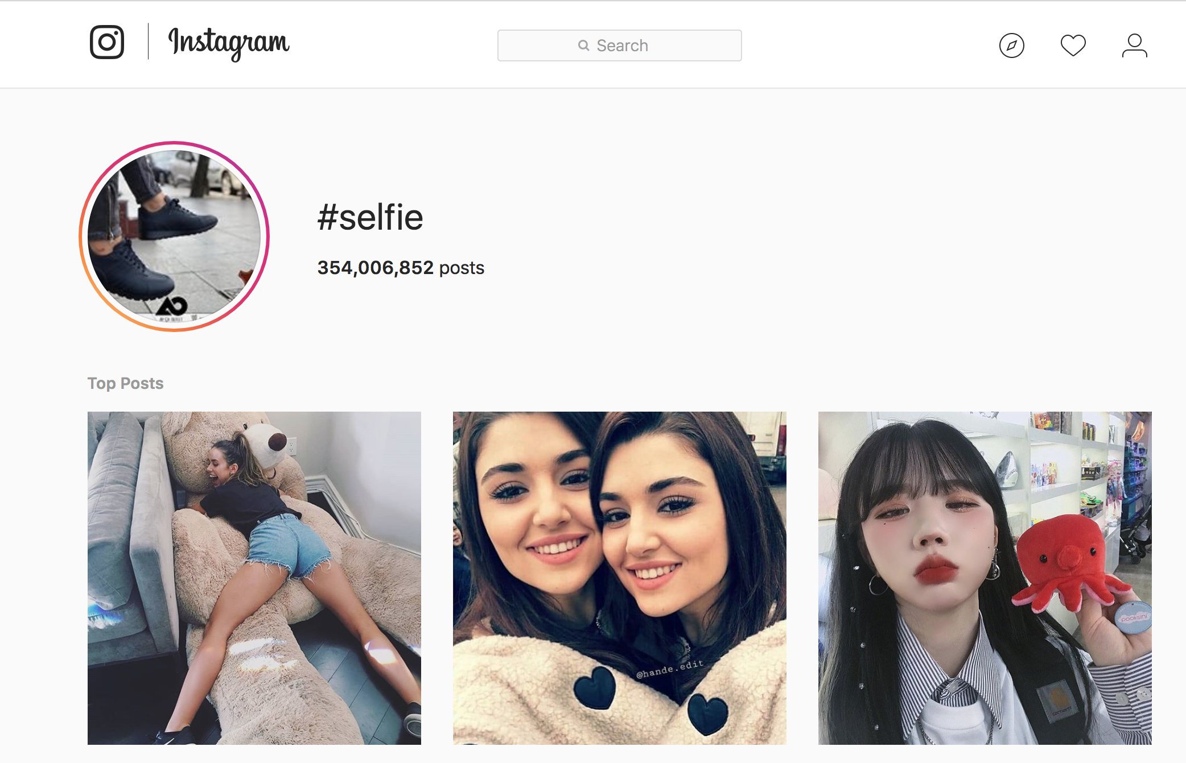
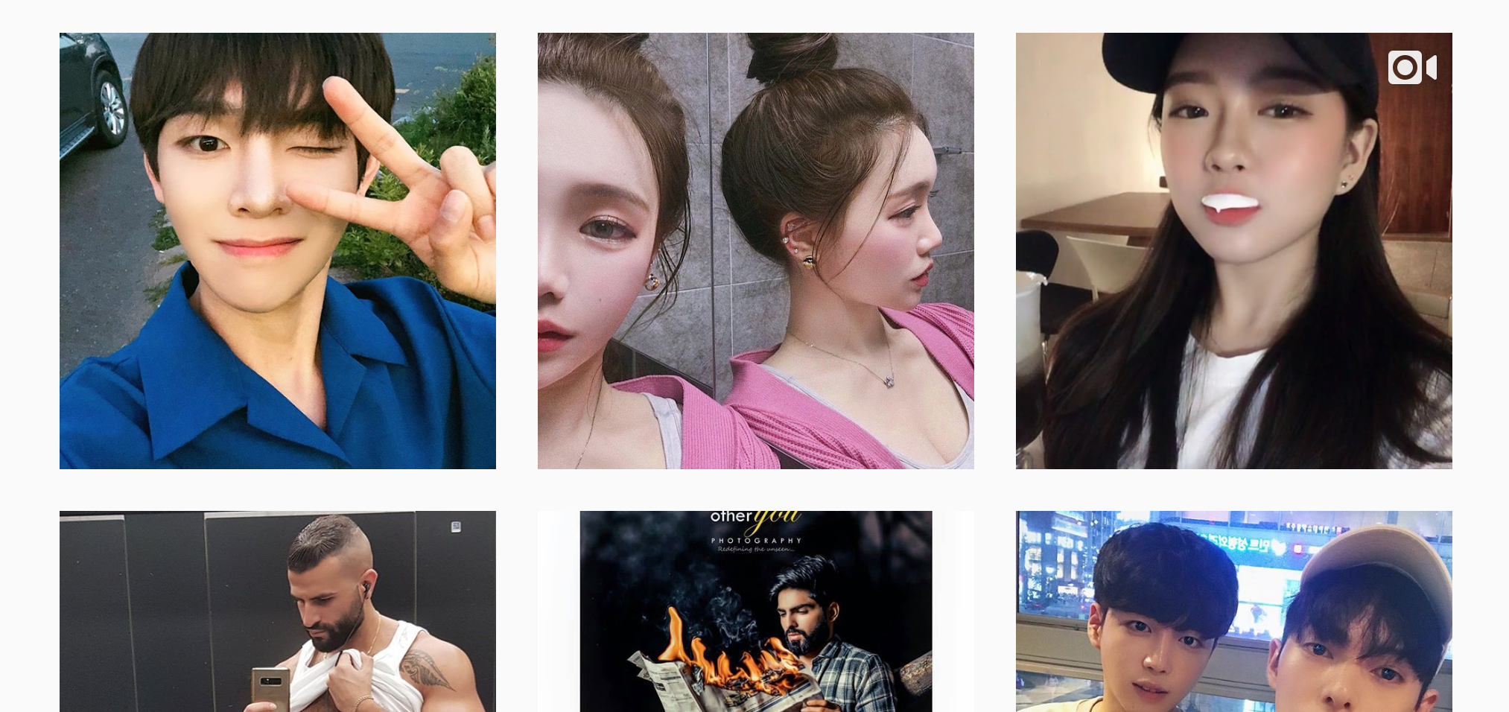
The plague of the selfie
#selfiestick
#snapchatselfie
#perfection
Notes:
There is nothing wrong with loving yourself and sharing it with the world, but instagram can be so much more powerful. It is free and accessible to anyone with a cell phone. Instagram is used to define who you are in this society and to share your interests and accomplishments with others. As any social media turns out you are reflecting you back on to yourself, and the users find value in accruing as many like as possible. Having likes is a self esteem booster, so putting out photos that others will like is the key motivating factor.
Another facet of instagram is the fine art aspect. There are thousands of serious professional artists who use instagram for the sole purpose of getting their work out to a wider audience.

Slide 6
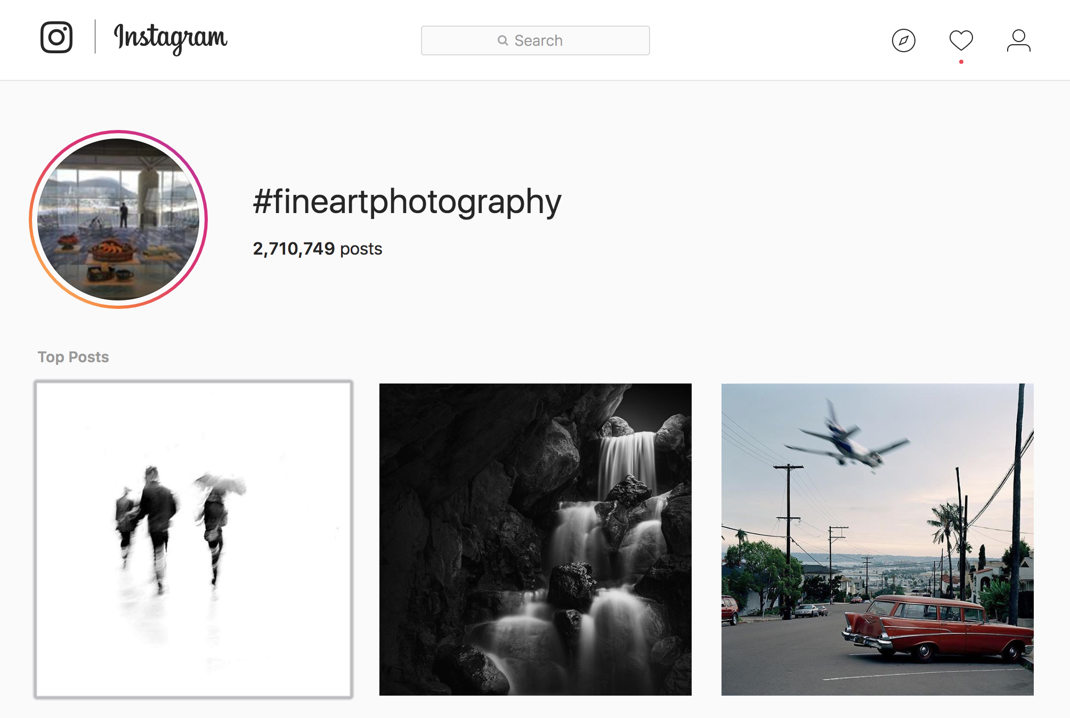
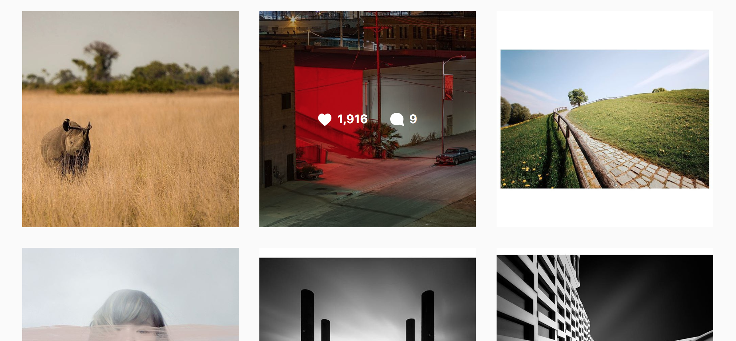
Diversity is key
#abstractphotography #blackandwhite
#blackandwhitephoto #artlovers
#photographer
#fineartphotography
Notes:
Students must learn to use this platform for other forms of communication.
Many of my students shudder at the idea of their instagram account being taken seriously by any one except their friends and they fear “ruining” their account with fine art photography.

Slide 7
The Solution
-What works in my classroom-
Notes:
What works in my classroom.

Slide 8
Create a seperate account for
Fine Art Photography
Notes:
Students can have multiple accounts linked to their phone allowing them to preserve their main account for their preferred social outlet. For purposes of grading and keeping track of student work production I ask that their name be a part of their profile identification. They can keep it private for further exclusivity. Parental consent is important, in the rare occasion you have a student who is not allowed to have social media accounts you’ll have to get creative. I allowed my student to email me photos and then I projected them so others could provide feedback.

Slide 9
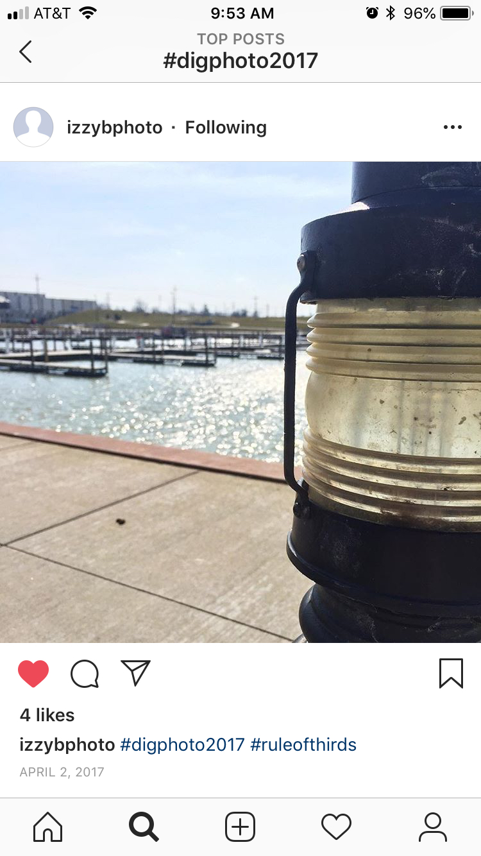
Own your hashtag
#digphoto2017
Notes:
Using a unique hashtag allows you to quickly find the photos your students are posting. And lucky for us the posts come neatly wrapped with the date and time of the post, so we can accurately assess the proposed due date and the timeliness of the students work.
Furthermore the hashtags can add additional information #ruleofthirds
These posts will not get many likes, but the point of this is to use social media differently, and for some of them it really sticks.

Slide 10
The Visual Language
-Basic Building Blocks of Composition-
Notes:
What works in my classroom.

Slide 11
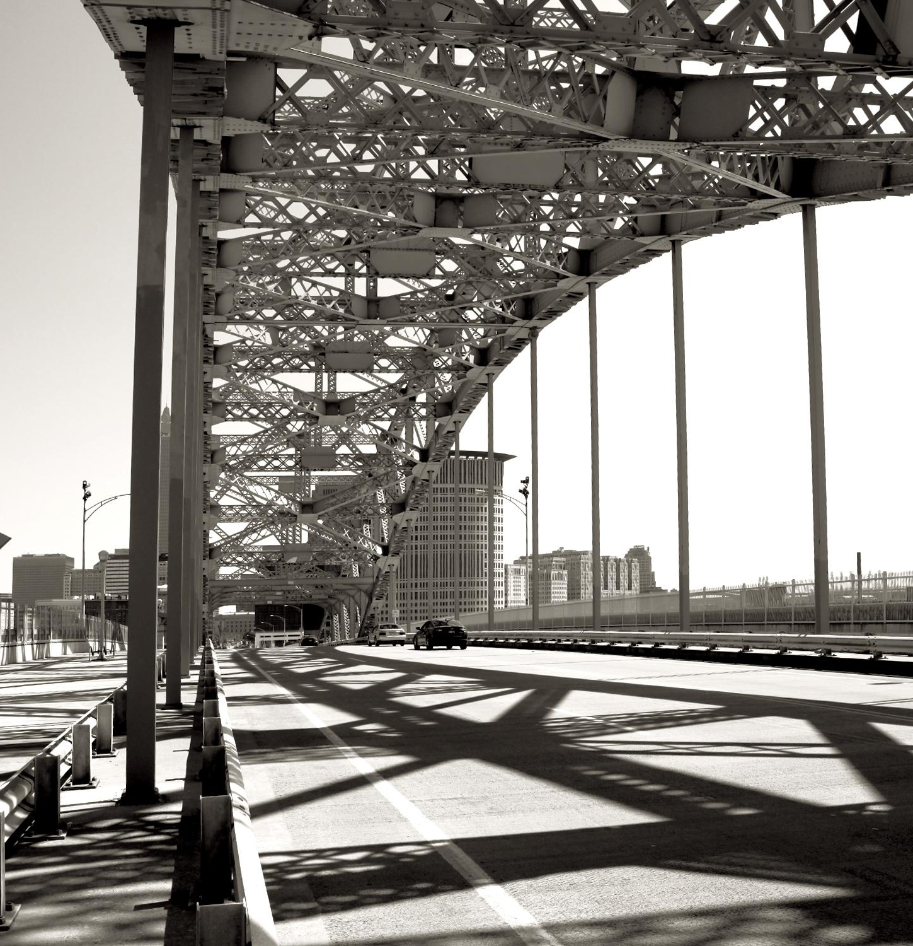
Elements and Principles of Art
Notes:
So moving onto the good stuff. PROJECTS!
As art educators we are taught the end all to art education are the elements and principles of design. In my classroom this is merely a starting point. I use the elements and principles to establish the vocabulary needed to describe their aesthetic choices, and to further give feedback to their peers.

Slide 12
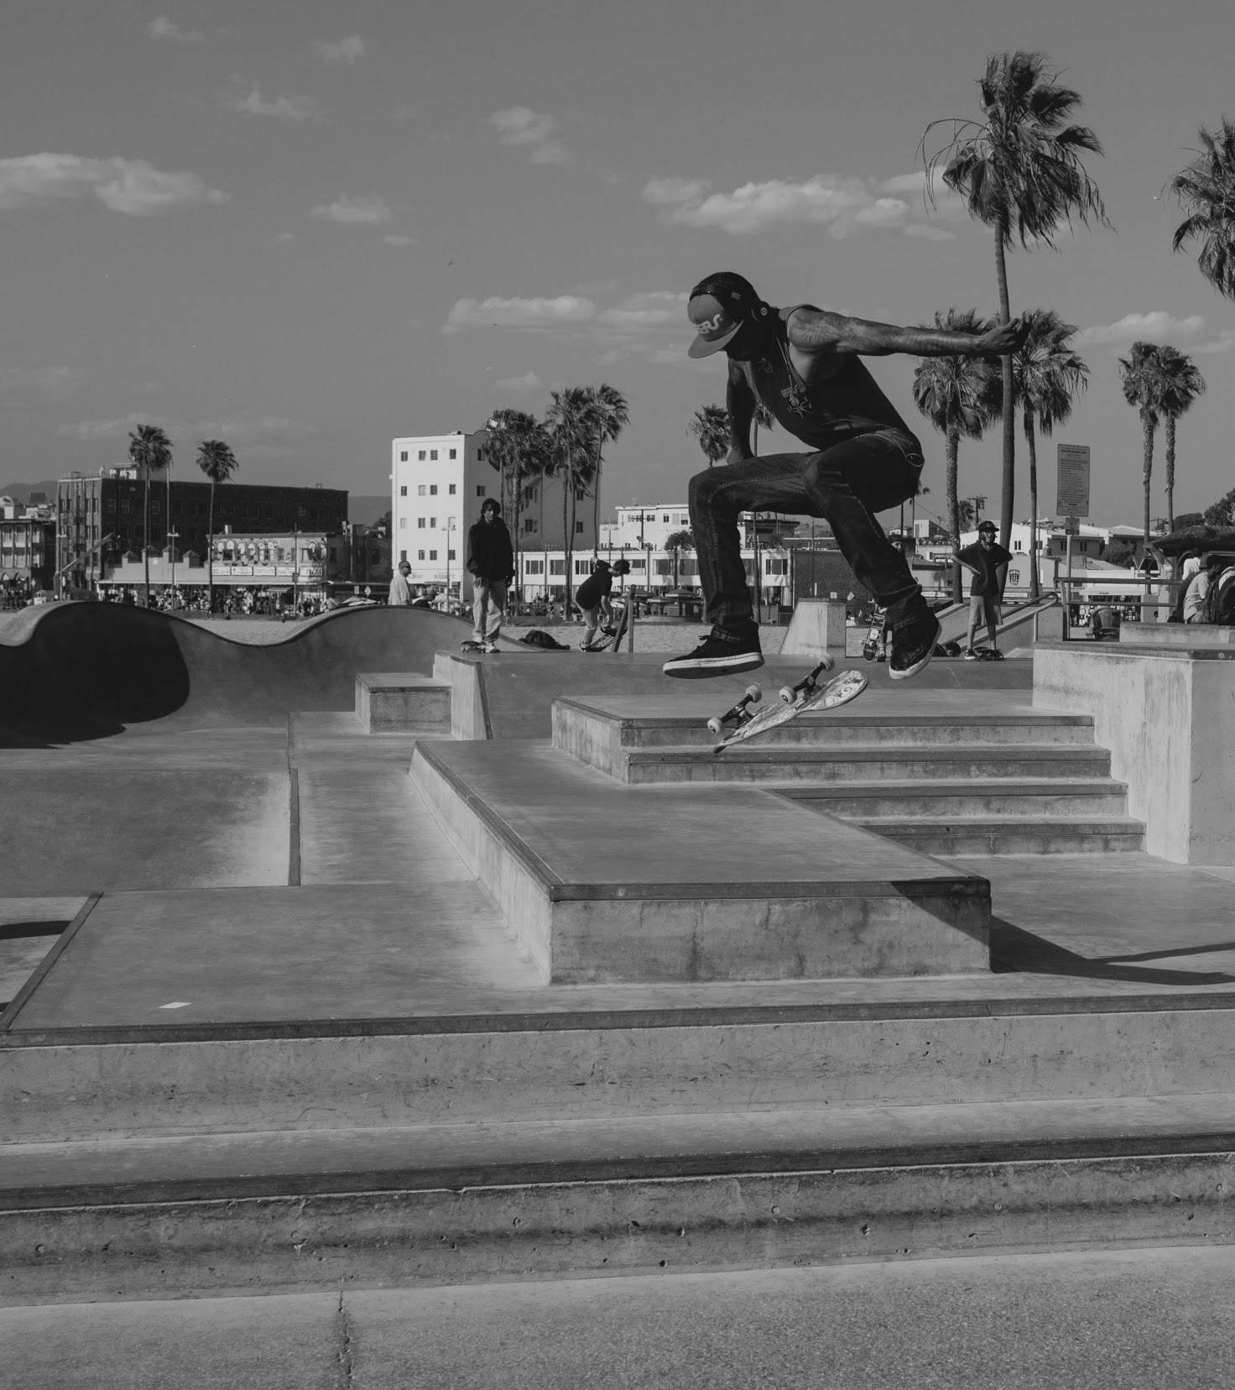
Elements and Principles of Art
Change photo to student work
Elements: Line, Texture, Shape, Space, Form
Notes:
I start the first week with the Elements, it doesn’t matter if they have been taught the elements in other art classes, their direct interpretation on photography offers a new way of seeing.

Slide 13
Elements and Principles of Art
Change photo to student work
Elements: Line, Texture, Shape, Space, Form
*Excluded*- Value and Color
BLACK AND WHITE PHOTOGRAPHY ONLY
Notes:
I have excluded Value and Color from the elements they begin with, because I fell it is imperative to teach photography through the restriction of Black and White only. Color is a commodity that we all take for granted, and only when that is completely stripped away can the untrained eye begin to distinguish the importance of value and composition. Take away the distraction of color and the young artist can tighten their skills far faster.

Slide 14
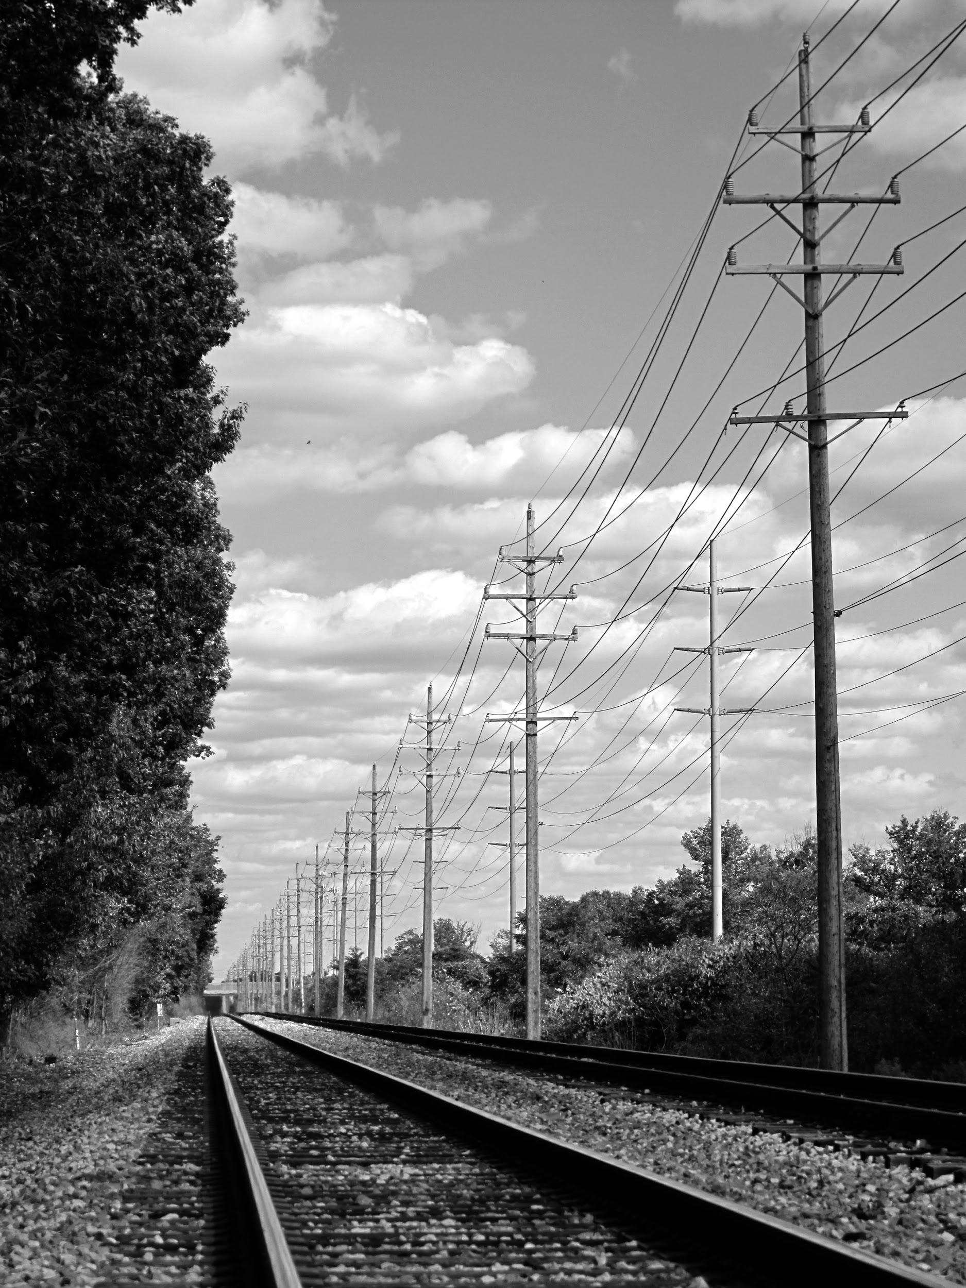
Line
#line #digphoto18 #fineartphotography #blackandwhite #instaart #composition
Notes:
I start with line and move on to the other elements usually ending in a project consisting of the 5 elements relevant to black and white photography.
See how the hashtags start to build up.

Slide 15
Line
#line #digphoto18 #fineartphotography #blackandwhite #instaart #composition
#space #repetition #rhythm #balance #perspective #contrast #proportion
Notes:
This is a good example of how one photo can demonstrate many of the elements and principles. In this situation I would go to this post and add several more hashtags in the comments.

Slide 16
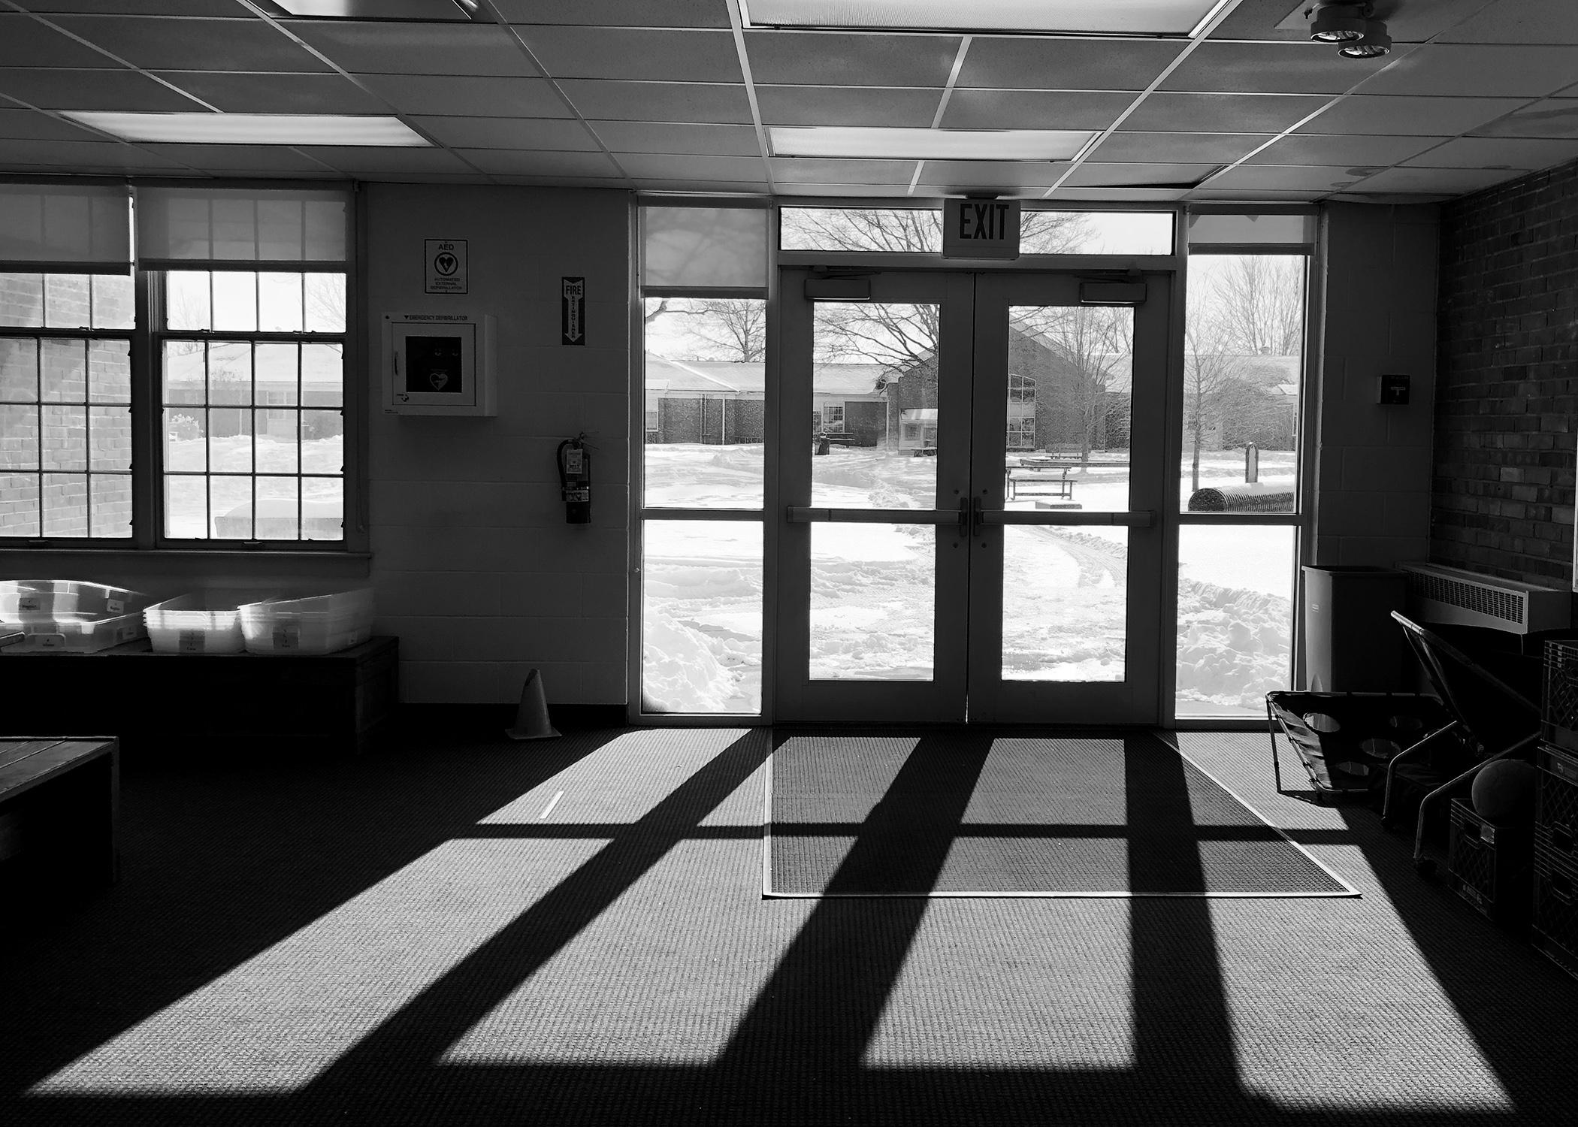
Shape
#shape #digphoto18 #fineartphotography #blackandwhite #instaart #composition #shadow #contrast #winter #exit #portal

Slide 17
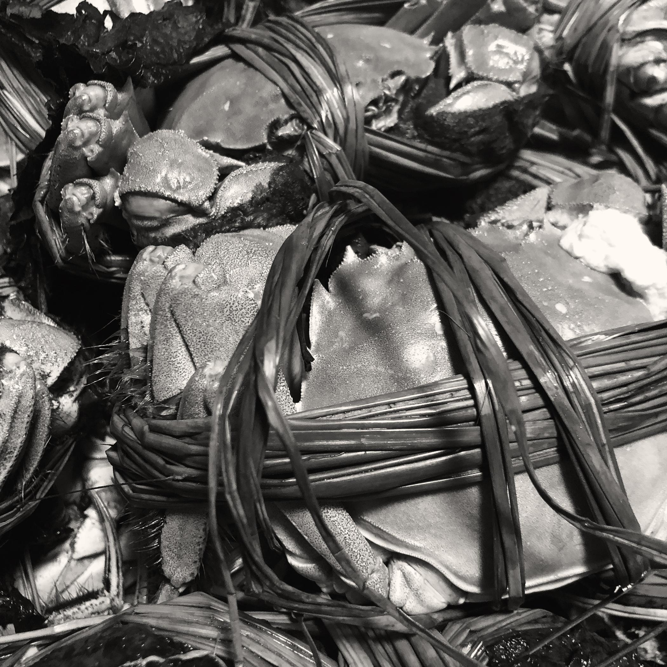
Texture
#texture #contrast #nature #naturallight #digphoto18 #fineartphotography #blackandwhite #instaart #composition

Slide 18
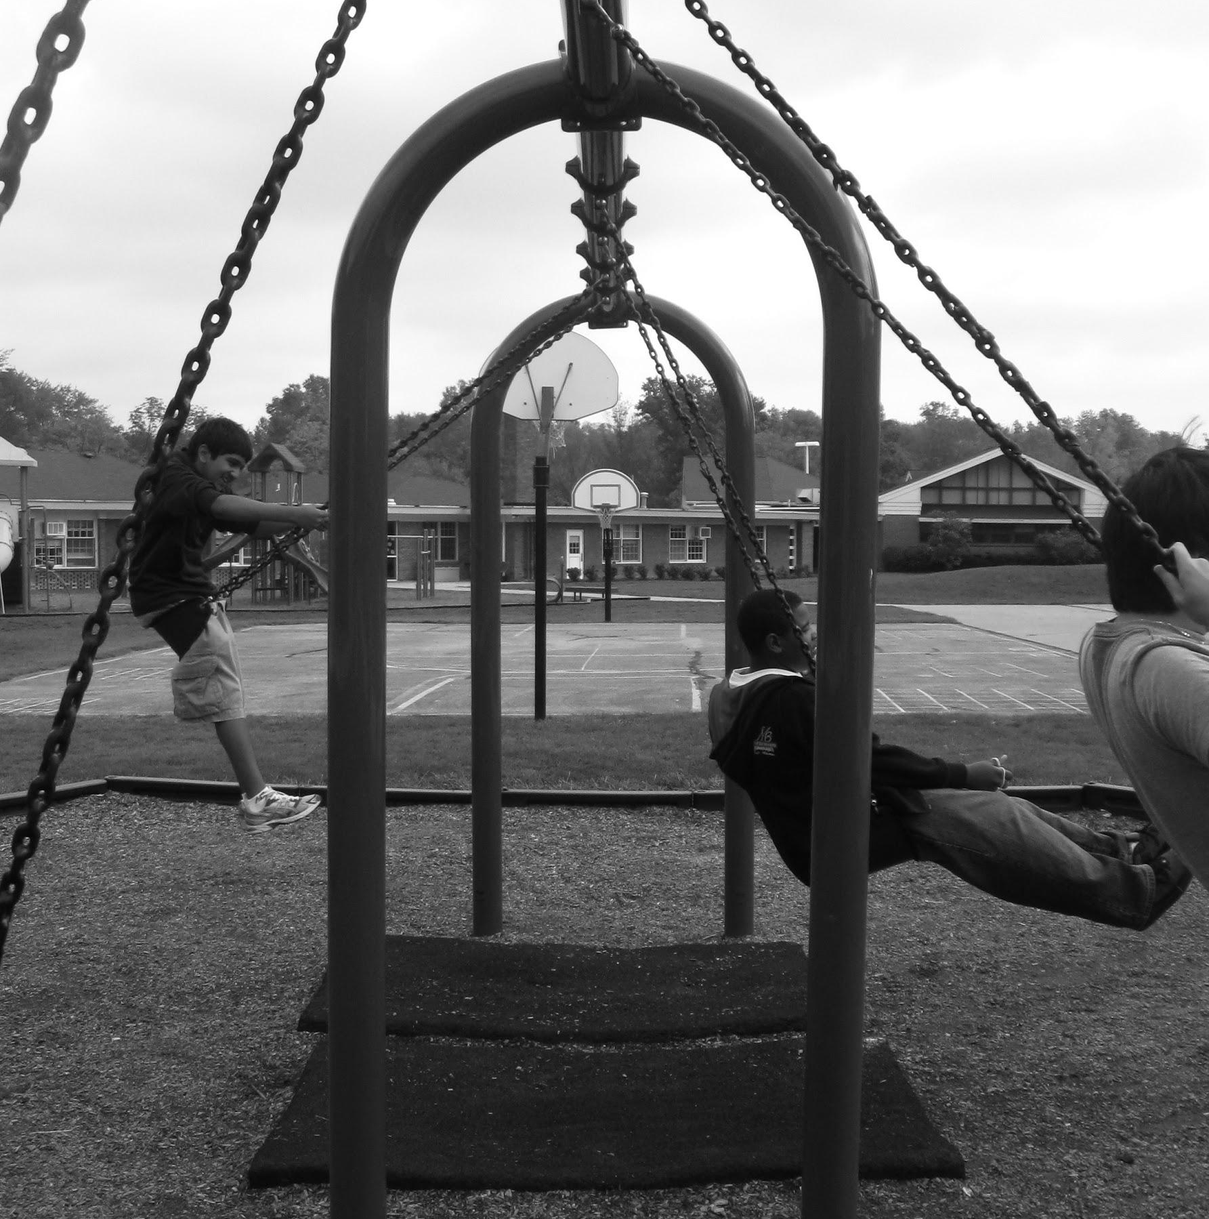
Balance
#balance #symmetry #assymetry #contrast #nature #naturallight #digphoto18 #fineartphotography #blackandwhite #instaart #composition
Notes:
Here is one example of principles, I usually spend the first three weeks working through and critiquing the elements and principles. I assign out of class photo shoots and spend time conferencing with each student individually. If you have a large class it may be helpful to have another assignment going on simultaneously. For example- a photo art history research project that can be done in class, allowing you to pull one student at a time while everyone else is working.

Slide 19
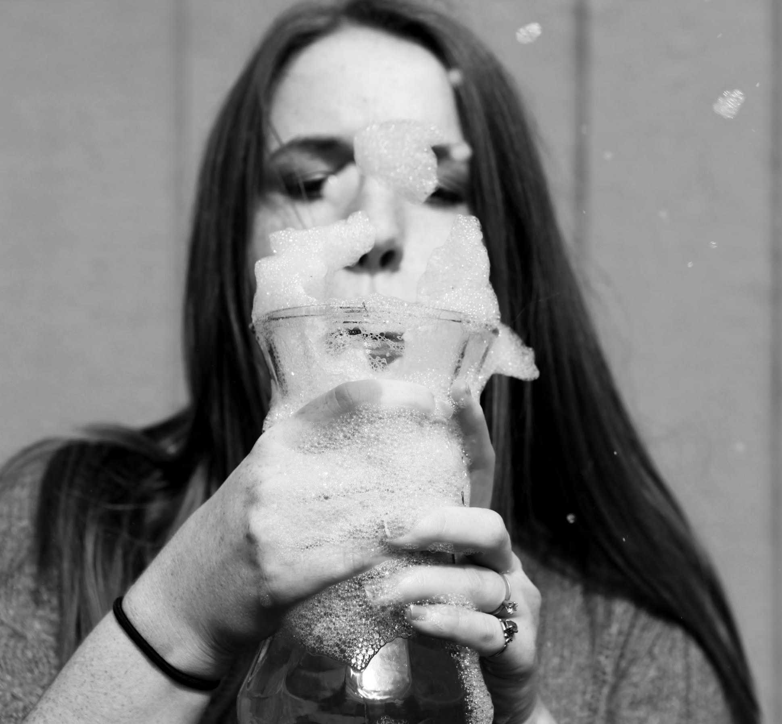
Balance
#balance #symmetry #assymetry #contrast #nature #naturallight #digphoto18 #fineartphotography #blackandwhite #instaart #composition #frozenaction #soap #bubbles

Slide 20
It’s your turn!
Notes:
Here comes the moment when you can try this out. I think this is important… so you can see how fast this happens.
Take 5 minutes and find an example of one of the elements, line, shape, texture, form, space. Go on out to the hallway, wherever you feel comfortable.

Slide 21
Post it to instagram ###
#digphoto19
Notes:
Use the native phone filters or the “inkwell” instagram filter to turn it black and white. Be sure to add #digphoto19 and your #element. List any others you can think of.
*Go to instagram and view hashtag* see the whole class all in one place
---Next we’ll move on to my favorite aspect of photography… conceptual photography

Slide 22
Project Prompts
--
Notes:
After we go round and round with the elements and principles I assign project prompts. These prompts typically take more planning and sometimes depend on the time of day. Now that they have compositional tools in their pocket they can continue to develop their photographic eye.

Slide 23
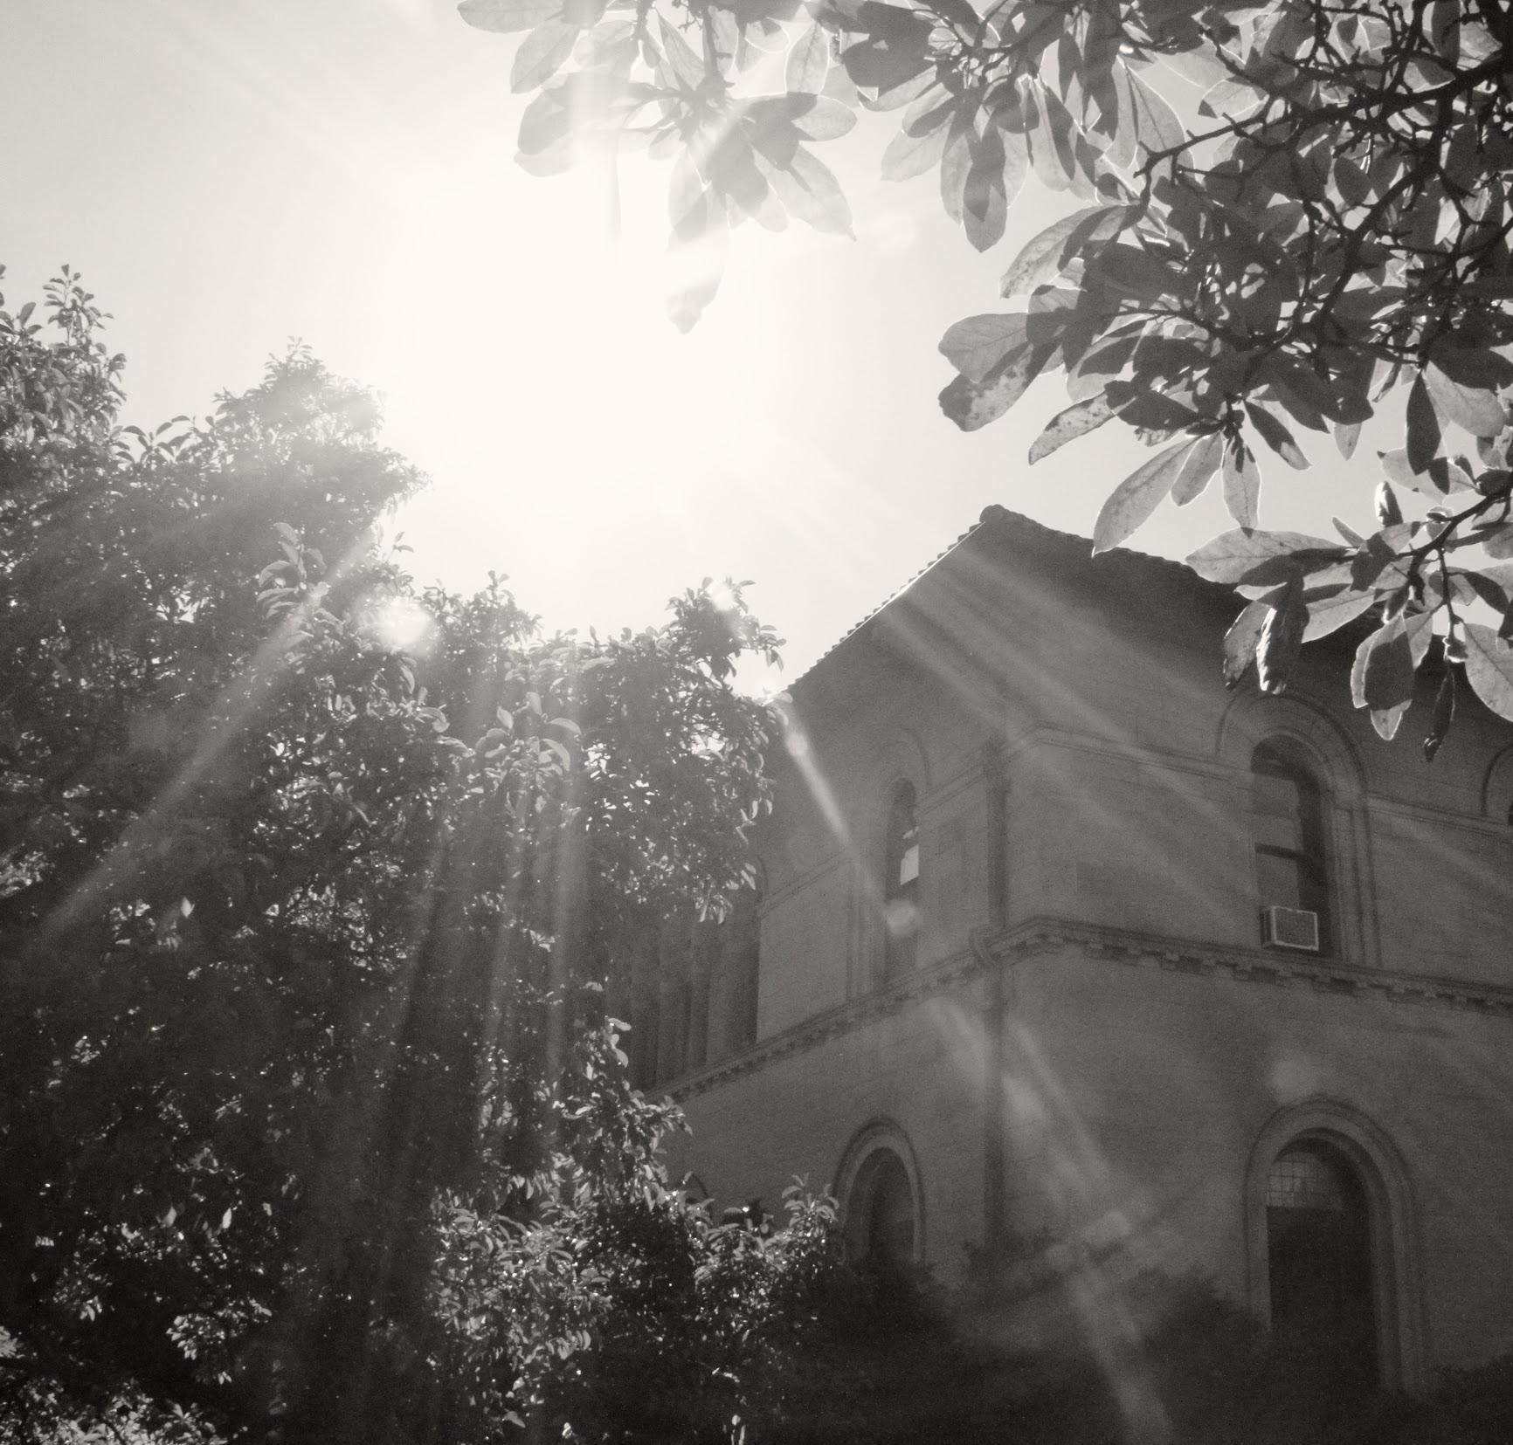
Project Prompts
Abstraction
Underneath
Backlighting/ negative space
When new meets old
Dramatic Light source
Big Sky
Reflection
Bokeh
Stare
Notes:
I have found that one prompt per week seems to work the best. There may be a little bit of downtime during class, but I find that to be a worthwhile trade off as they spend time on it over the weekend. I don’t mind letting the kids study for their math test if they are shooting for my class over the weekend.

Slide 24
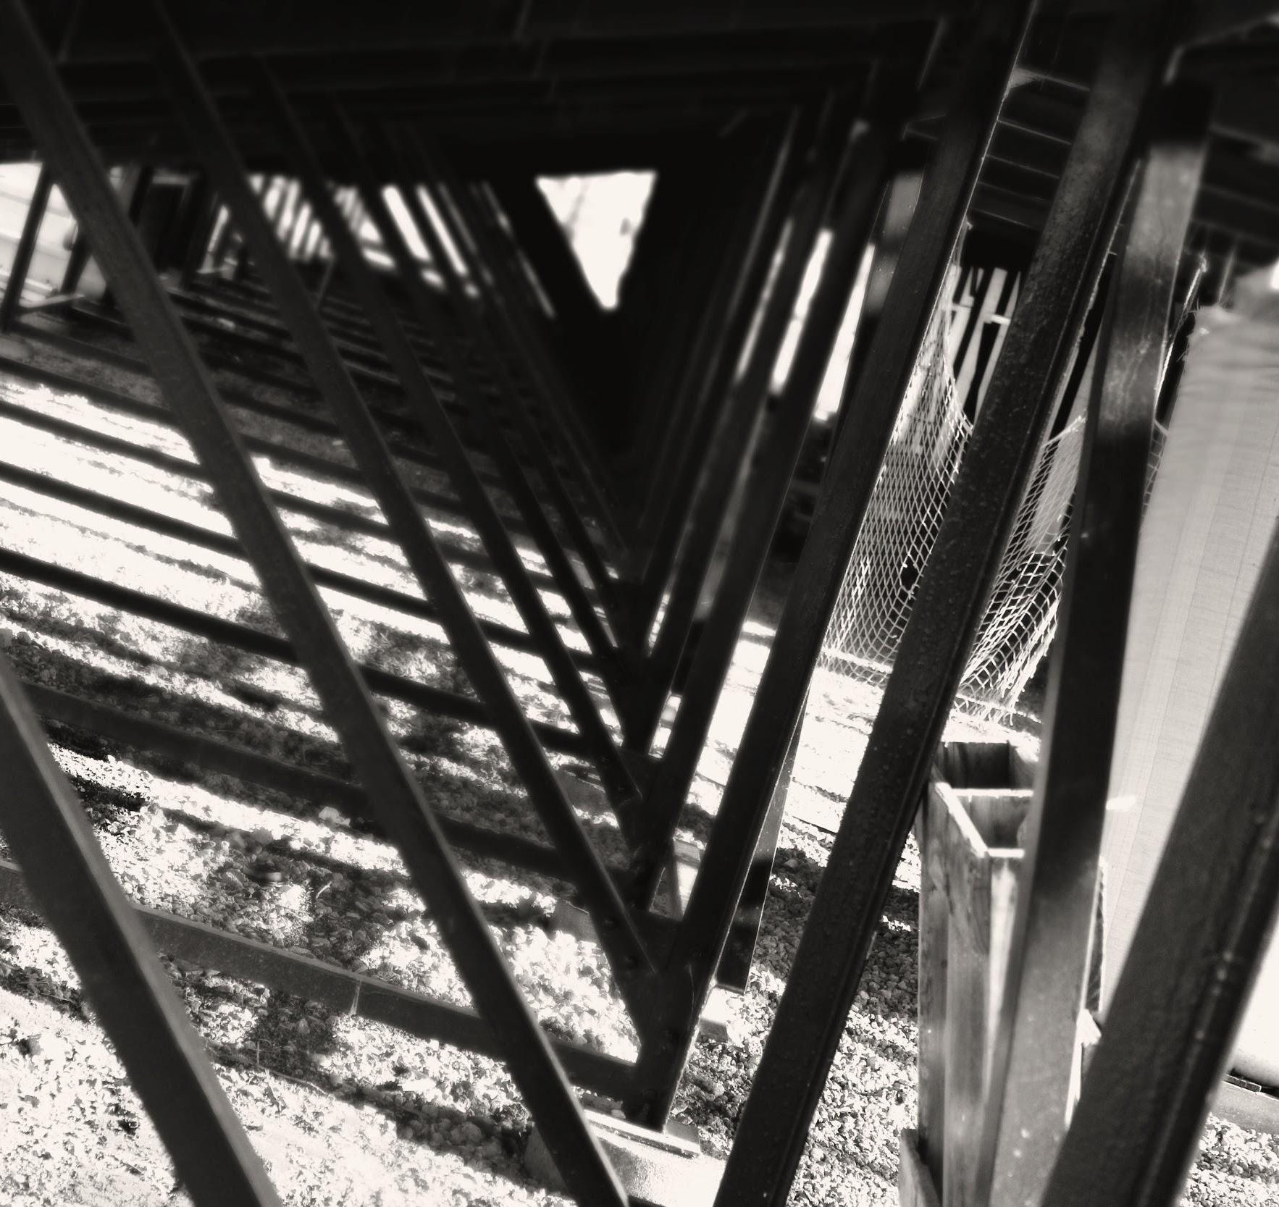
Abstraction
Abstraction
Underneath
Backlighting/ negative space
When new meets old
Dramatic Light source
Big Sky
Reflection
Bokeh
Stare

Slide 25
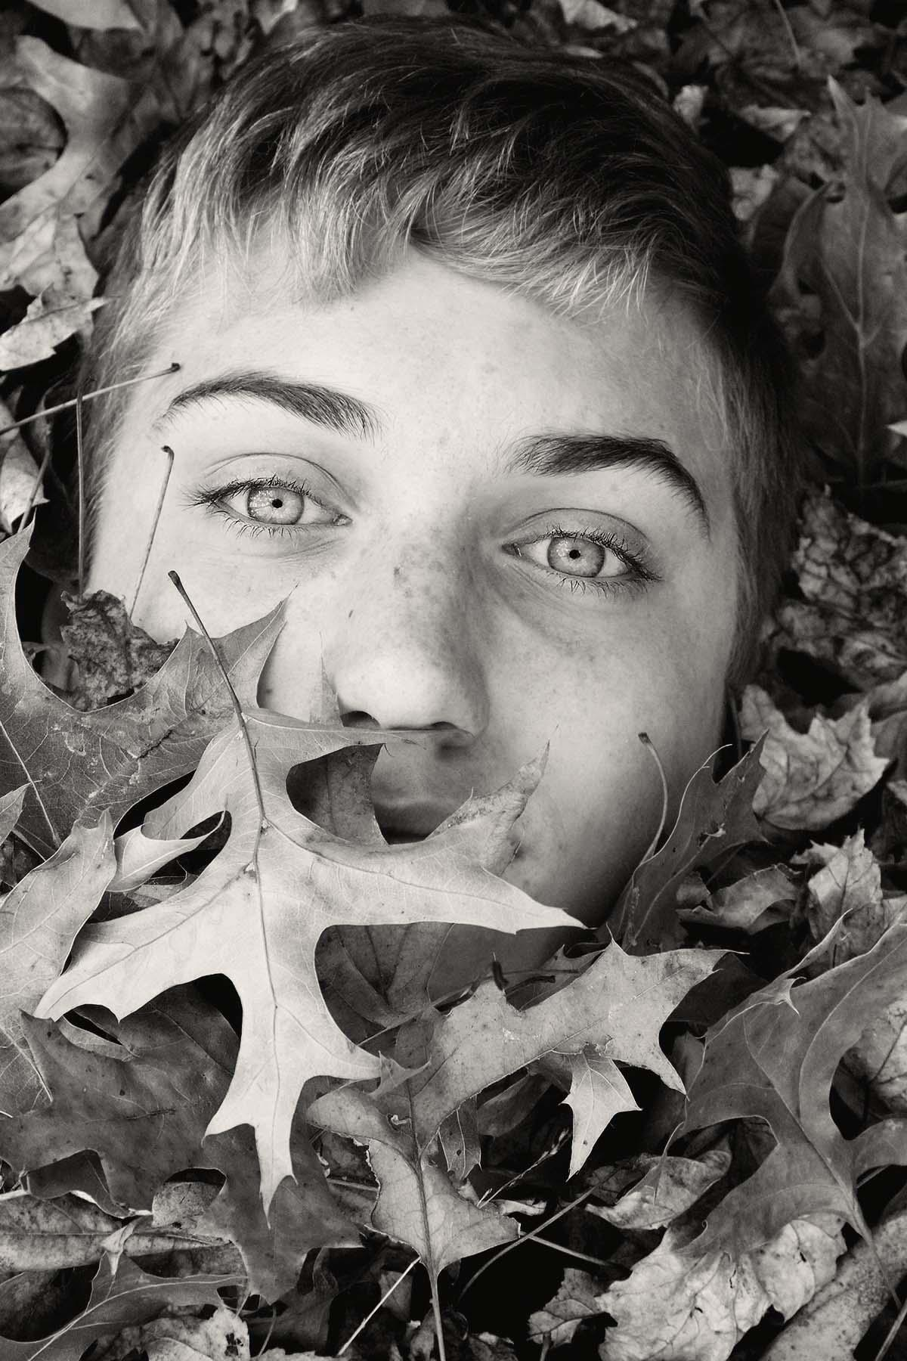
Underneath
Abstraction
Underneath
Backlighting/ negative space
When new meets old
Dramatic Light source
Big Sky
Reflection
Bokeh
Stare

Slide 26
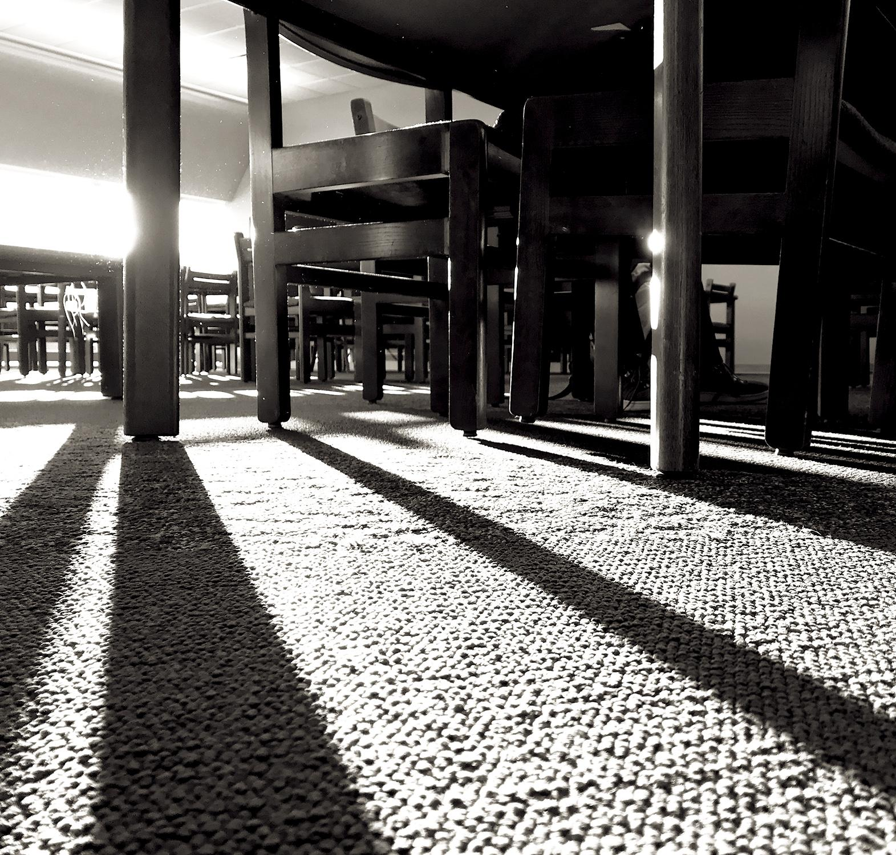
Underneath
Abstraction
Underneath
Backlighting/ negative space
When new meets old
Dramatic Light source
Big Sky
Reflection
Bokeh
Stare

Slide 27
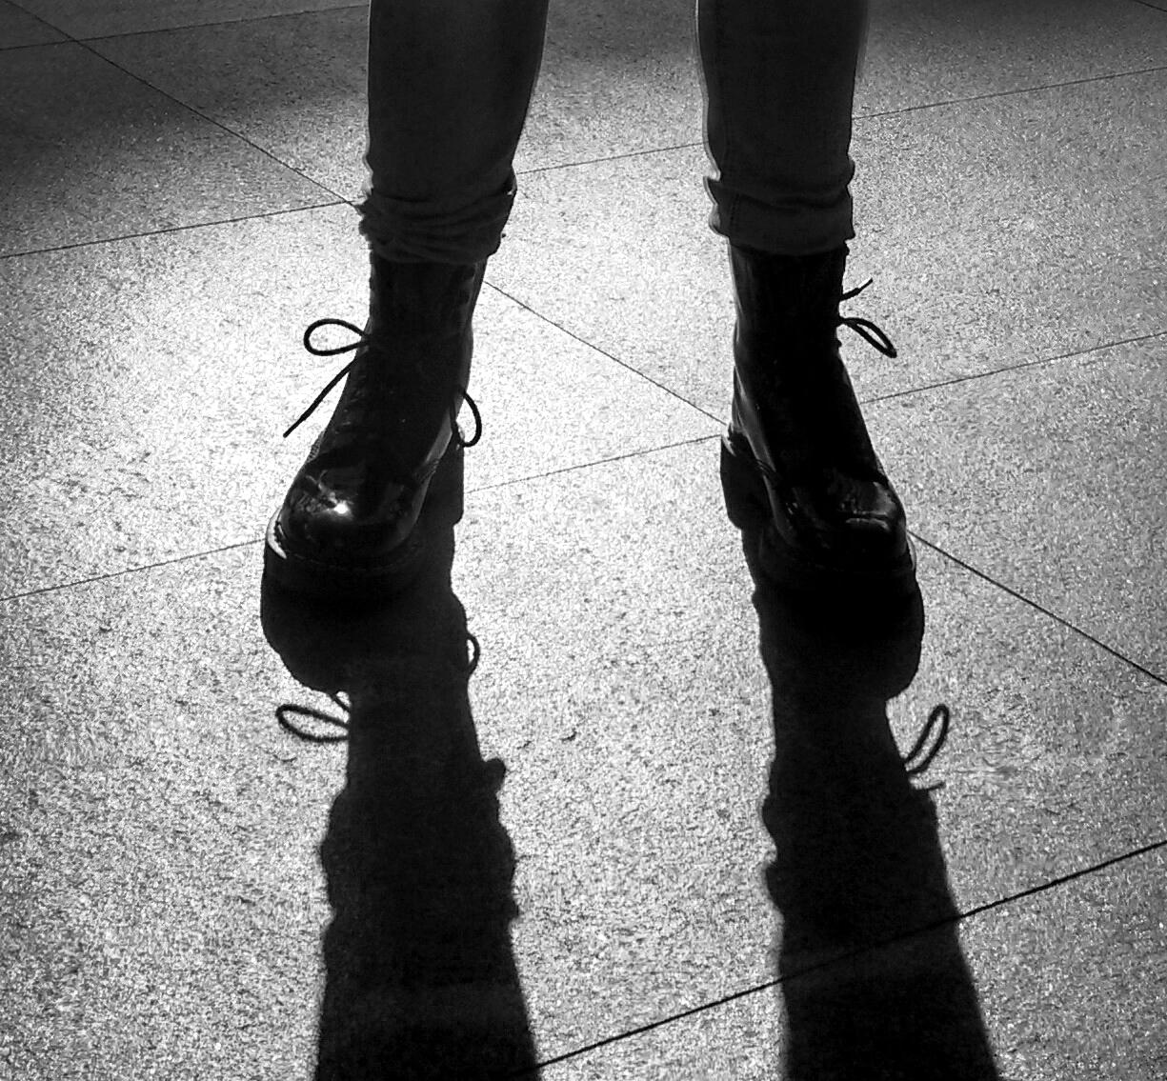
Backlighting and Negative Space
Abstraction
Underneath
Backlighting/ negative space
When new meets old
Dramatic Light source
Big Sky
Reflection
Bokeh
Stare

Slide 28
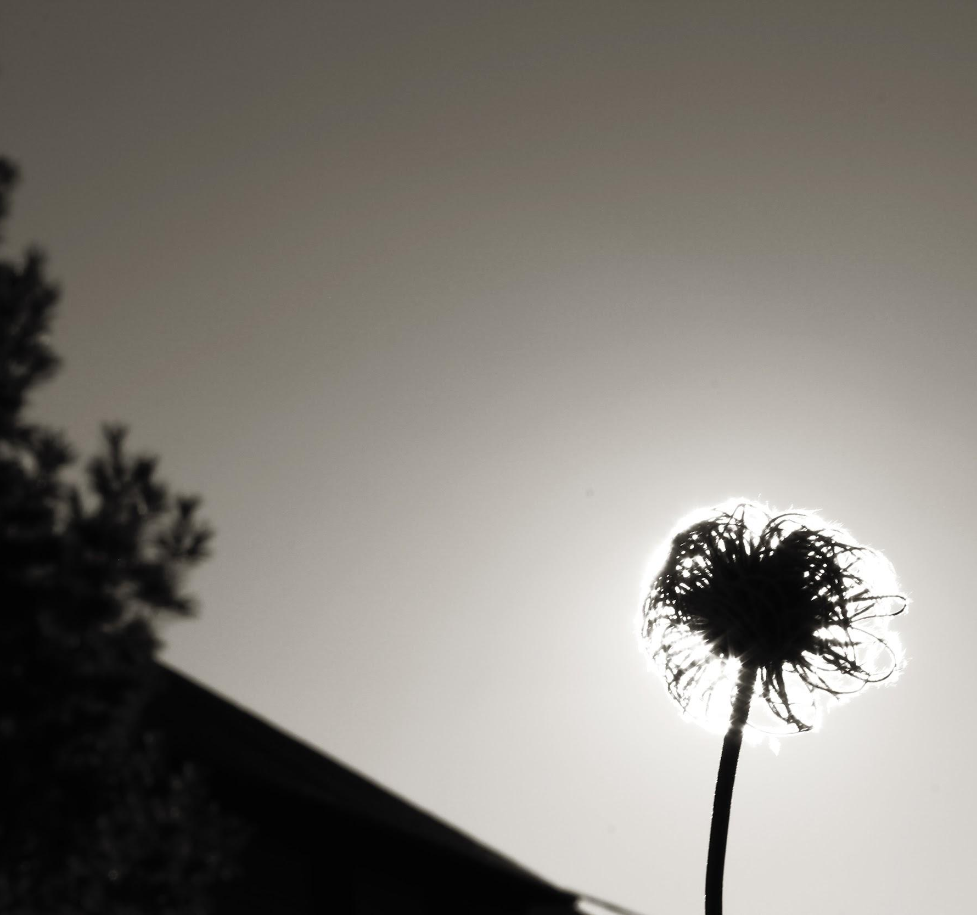
Backlighting and Negative Space
Abstraction
Underneath
Backlighting/ negative space
When new meets old
Dramatic Light source
Big Sky
Reflection
Bokeh
Stare

Slide 29

Backlighting and Negative Space
Abstraction
Underneath
Backlighting/ negative space
When new meets old
Dramatic Light source
Big Sky
Reflection
Bokeh
Stare

Slide 30

Where New
Meets Old
Abstraction
Underneath
Backlighting/ negative space
When new meets old
Dramatic Light source
Big Sky
Reflection
Bokeh
Stare

Slide 31
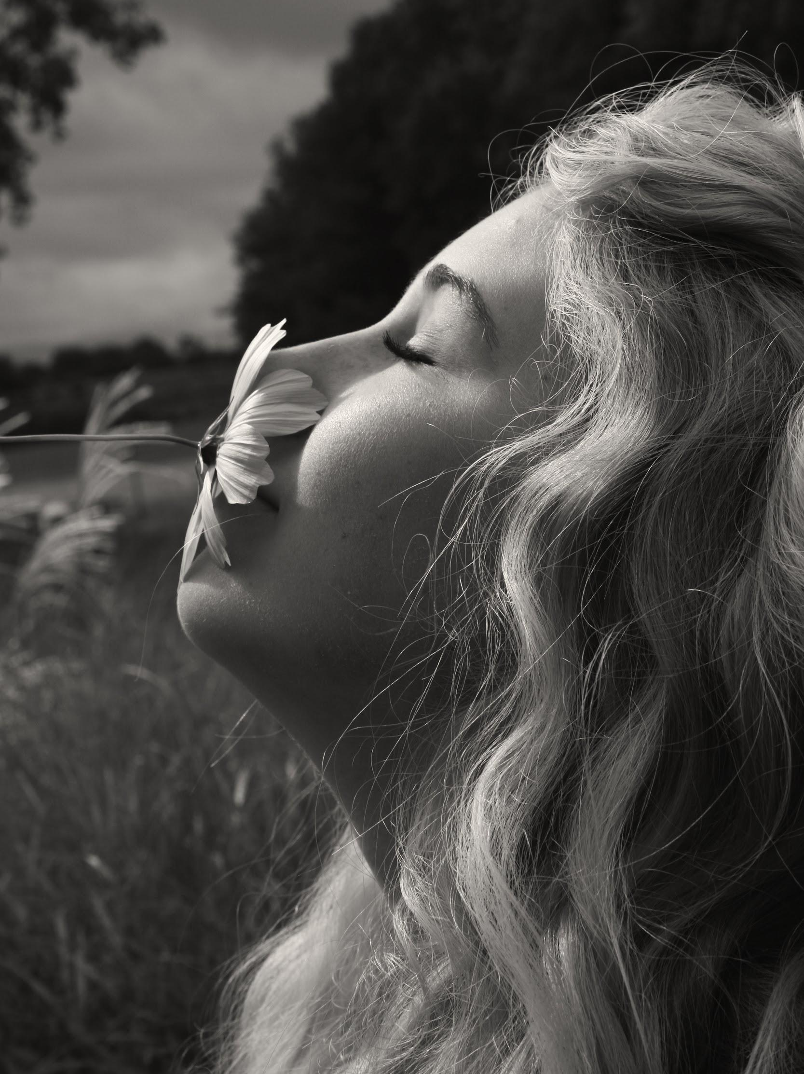
Dramatic Light
Abstraction
Underneath
Backlighting/ negative space
When new meets old
Dramatic Light source
Big Sky
Reflection
Bokeh
Stare

Slide 32
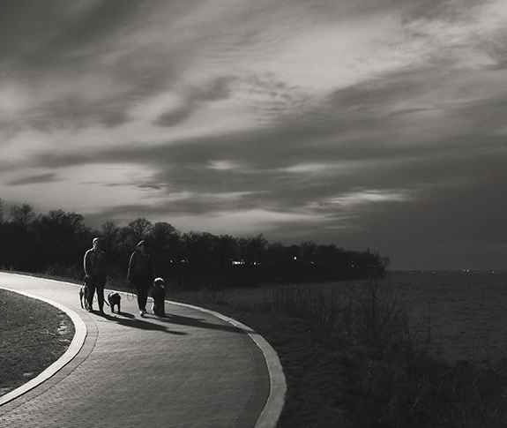
Big Sky
Abstraction
Underneath
Backlighting/ negative space
When new meets old
Dramatic Light source
Big Sky
Reflection
Bokeh
Stare

Slide 33
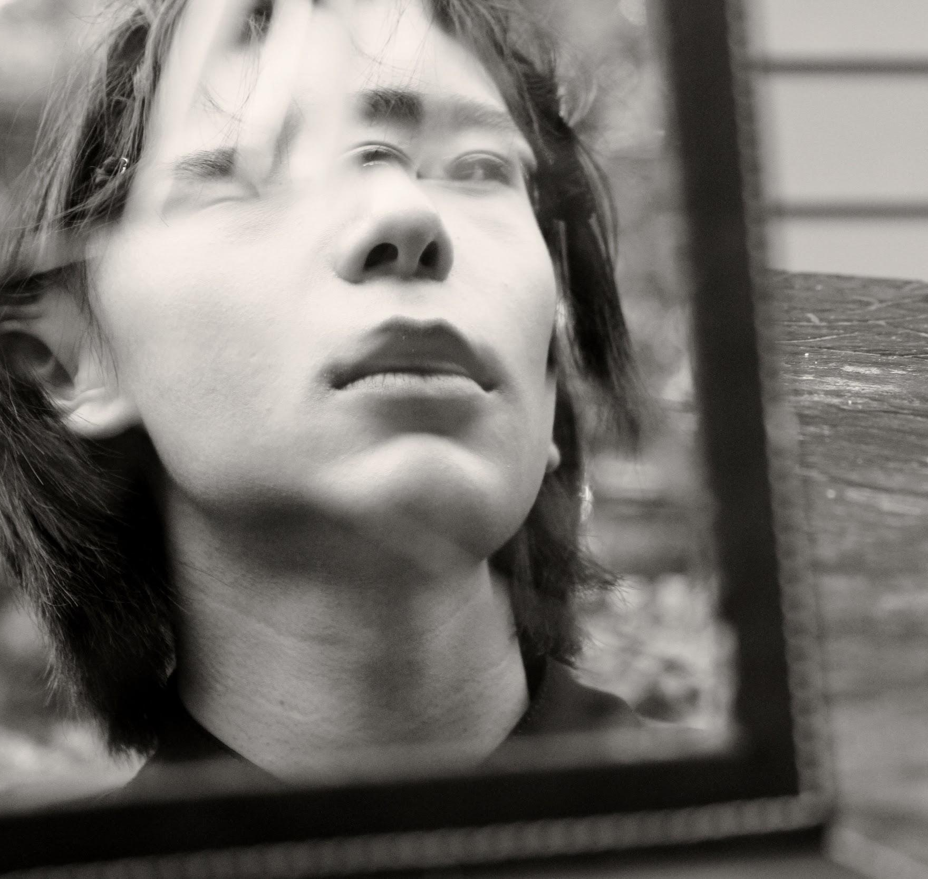
Reflection
Abstraction
Underneath
Backlighting/ negative space
When new meets old
Dramatic Light source
Big Sky
Reflection
Bokeh
Stare

Slide 34
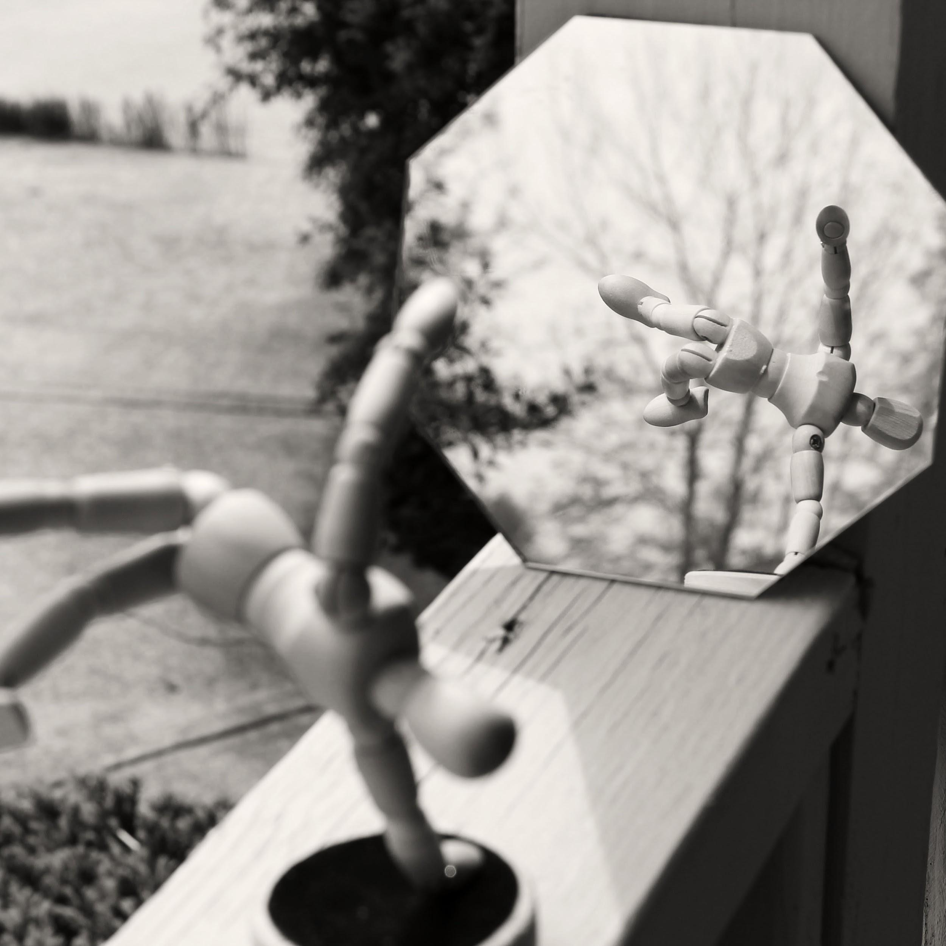
Reflection
Abstraction
Underneath
Backlighting/ negative space
When new meets old
Dramatic Light source
Big Sky
Reflection
Bokeh
Stare

Slide 35
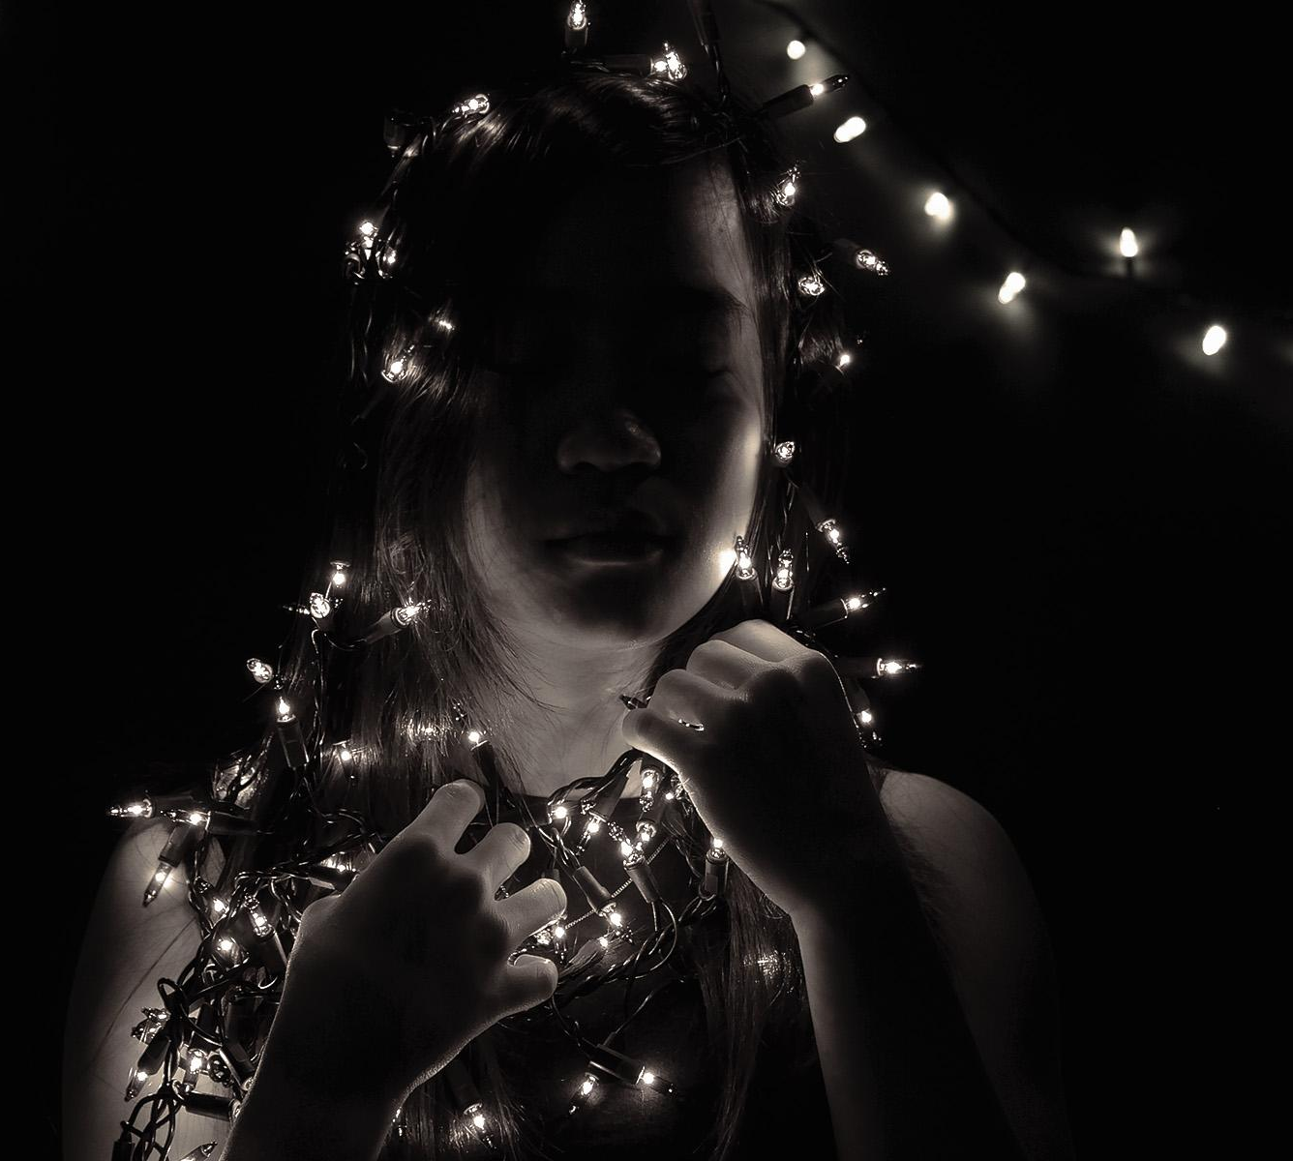
Bokeh
Abstraction
Underneath
Backlighting/ negative space
When new meets old
Dramatic Light source
Big Sky
Reflection
Bokeh
Stare

Slide 36
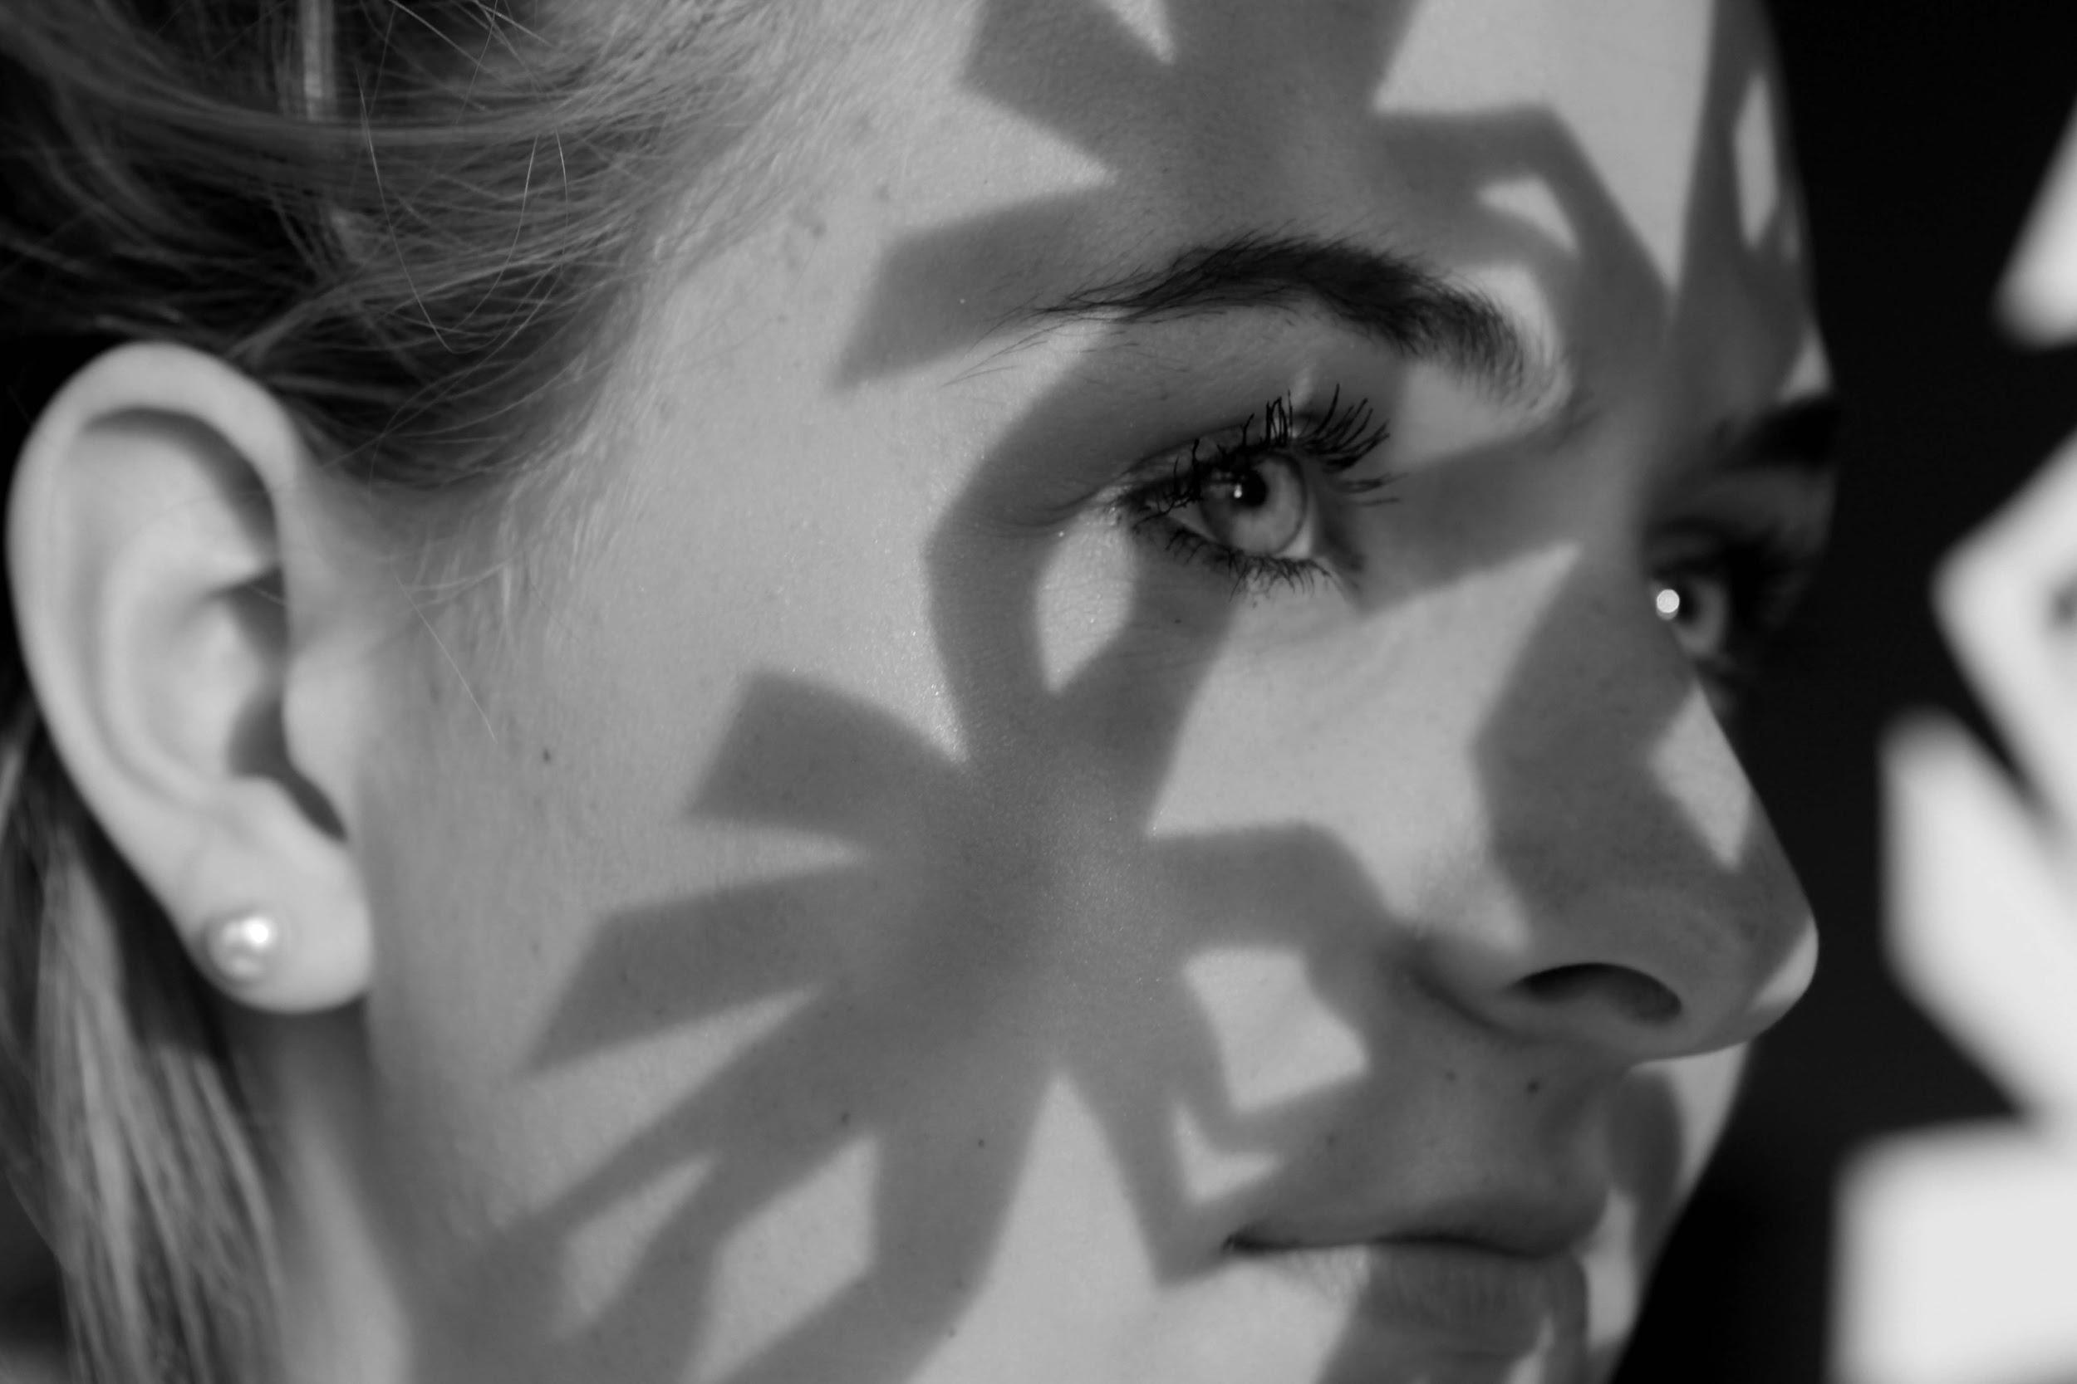
Stare
Abstraction
Underneath
Backlighting/ negative space
When new meets old
Dramatic Light source
Big Sky
Reflection
Bokeh
Stare

Slide 37

Stare
Abstraction
Underneath
Backlighting/ negative space
When new meets old
Dramatic Light source
Big Sky
Reflection
Bokeh
Stare

Slide 38
Concept
--
Notes:
What is Concept? How does one define concept?
-wait for response

Slide 39
Concept
-ideas-
Notes:
Ideas- The intangible, the essence of emotion, the foundation of discovery, curiosity, creativity.
As art educators were are tasked with the burden of tapping into creativity, many say creativity cannot be taught -you either are creative or your not, this is simple not true. Creativity can be taught, but it takes time and persistence.

Slide 40
Brainstorming
Allow time for brainstorming …
Include the think sheet in the project grade
Notes:
After assigning the prompts I will again sit with each student -sometimes in small groups of three if we are short on time. I will brainstorm with them and give them ideas of locations they may be able to shoot, or arrange a peer model for the concept at large. Describe how to find and utilize proper lighting -(placing subject near window can impact the emotional message in the photo)

Slide 41
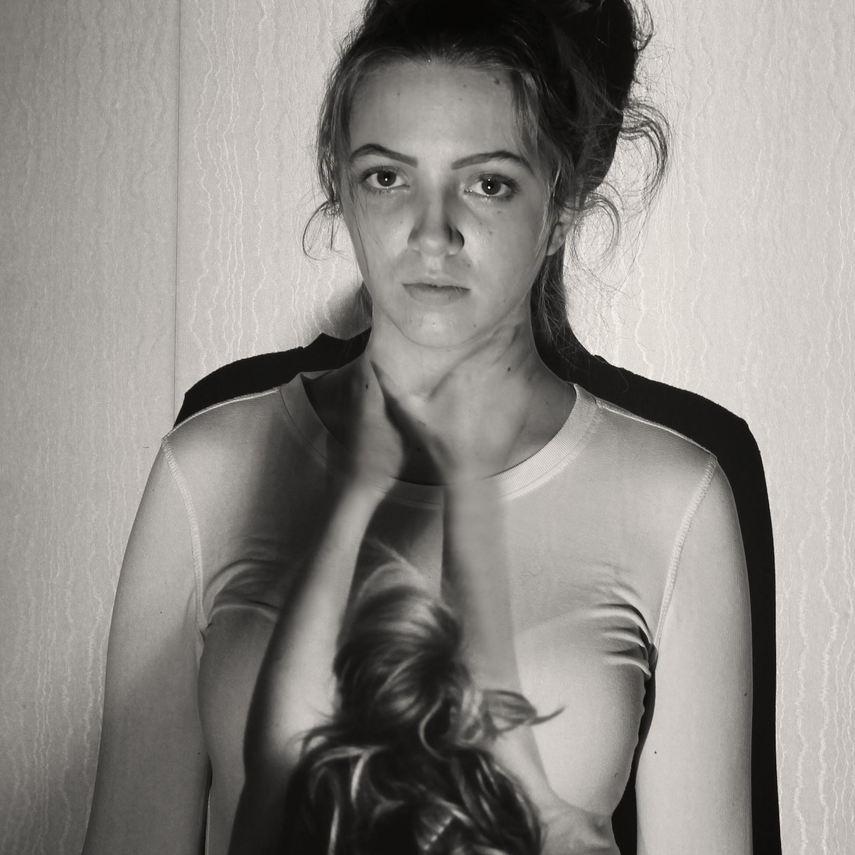
Non Literal-
Self Portrait
Notes:
If conceptual photography is like running a 5k… then this one is like winning a marathon. In my experience this project is really hard, but it is incredibly meaningful. I use this as my final project and every year it is by far the best critique.
This project is particularly unique for one simple reason…. It cannot be googled. This is a prompt that requires inner reflection and is unique to the individual. I have had students try to google this, and they don’t get to far.
Some students come up with their idea immediately, they didn’t know how badly they needed to express their thoughts, others try to fight it- they are not ready to expose their inner core. This is wear the gift of creativity really changes peoples lives. If we as teachers can use conceptual art to give our students a voice through visual communication we have done our job. By the time we get to this critique my students are talking about the elements and principles, the lighting, the exposure, the rule of thirds, but their primary focus is the effectiveness of the concept and how the viewer may or may not be connecting as the artist intended. This connection to concept turns a beginner photographer into a fine artist.
This particular student had recently lost her mother, and asked me if she could use her cousin as a surrogate for herself so she could take the photos. So essentially the non literal aspect of this project was using a model other than herself. She photographed her model and then projected the photo on a wall. The next step was for the model in real time to hold her hands up to the projection as if restricting her airway.

Slide 42
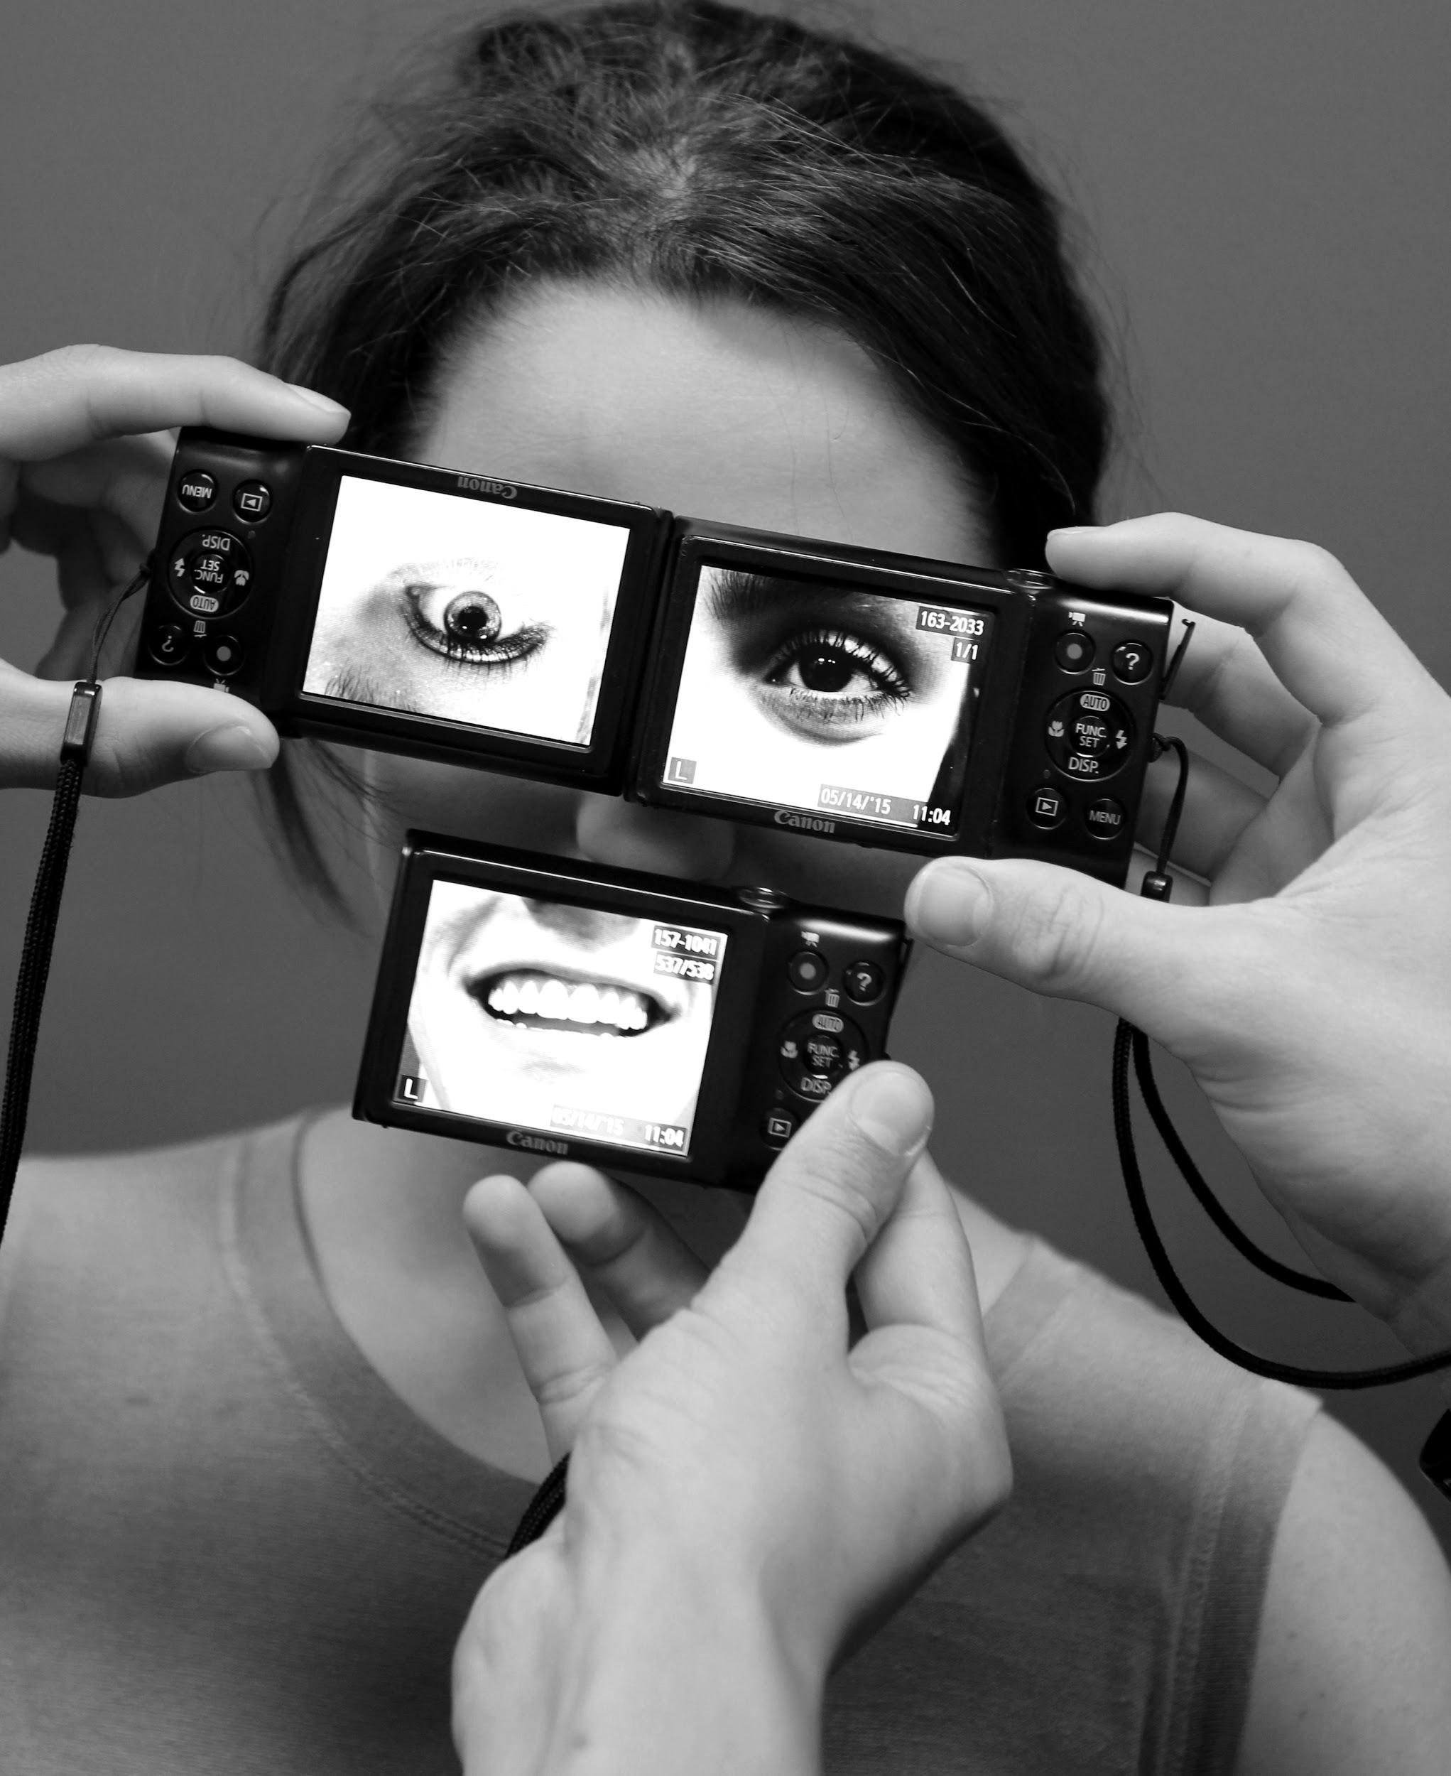
Non Literal-
Self Portrait
Notes:
This student was addressing her personas, her private persona and her public persona. You put a smile on your face no matter if you feel upside down and twisted inside. Each of the photos on the cameras are different people. She did this to address the many facets of the human psyche.

Slide 43

Non Literal-
Self Portrait
Notes:
This student had suffered a personal tragedy that left her emotionally scarred, she ripped off the petals of the daisy to signify her incomplete, somewhat empty sense of self she had.

Slide 44
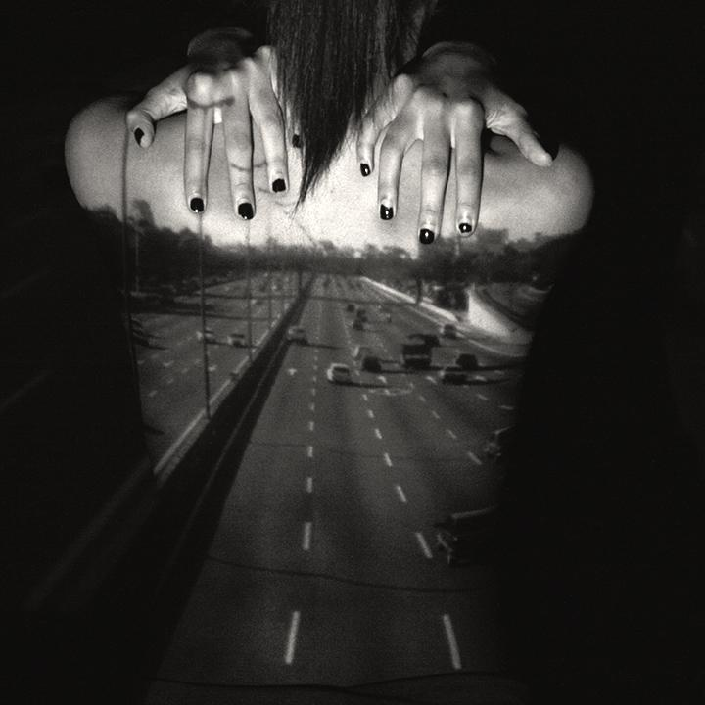
Non Literal-
Self Portrait
Notes:
This is the same student as the previous photo, only this was over a year later. She has become much stronger. She choose the image of an 8 lane highway projected on a bare back. With the models hands placed over the shoulders in a protective position.

Slide 45
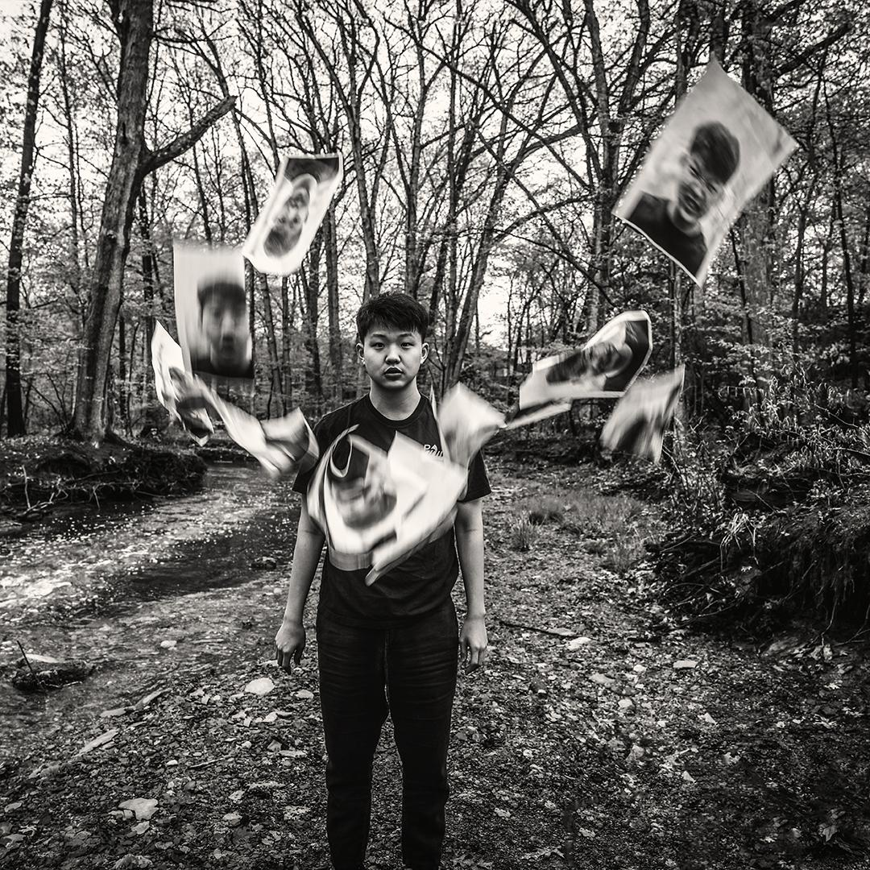
Non Literal-
Self Portrait
Notes:
This is the photo I will leave you with. This student took many photos of himself making different faces, hard to tell, but most of them are smiling. He set the camera on a timer, ran to the front of the viewfinder, threw the papers in the air and then posed ina stoic yet melancholic stance. He is tense, mad, and direct all at the same time. His concept was “happy on the outside, make friends be a part of society, misunderstood and lonely on the inside.

Slide 46
#thankyou
#theend
--
#follow4follow
carolyn_ballou
Notes:
Follow me I’ll follow back! Thank you for coming!!
Text your email to me if you want this presentation

Slide 47
ballouc@lakeridgeacademy.org
--
216-849-8262
Notes:
Follow me I’ll follow back! Thank you for coming!!
Text your email to me if you want this presentation

