Slide 1
Lab Group
collaborative composing
for anyone and everyone
Colin Holter
Executive Director

Slide 2
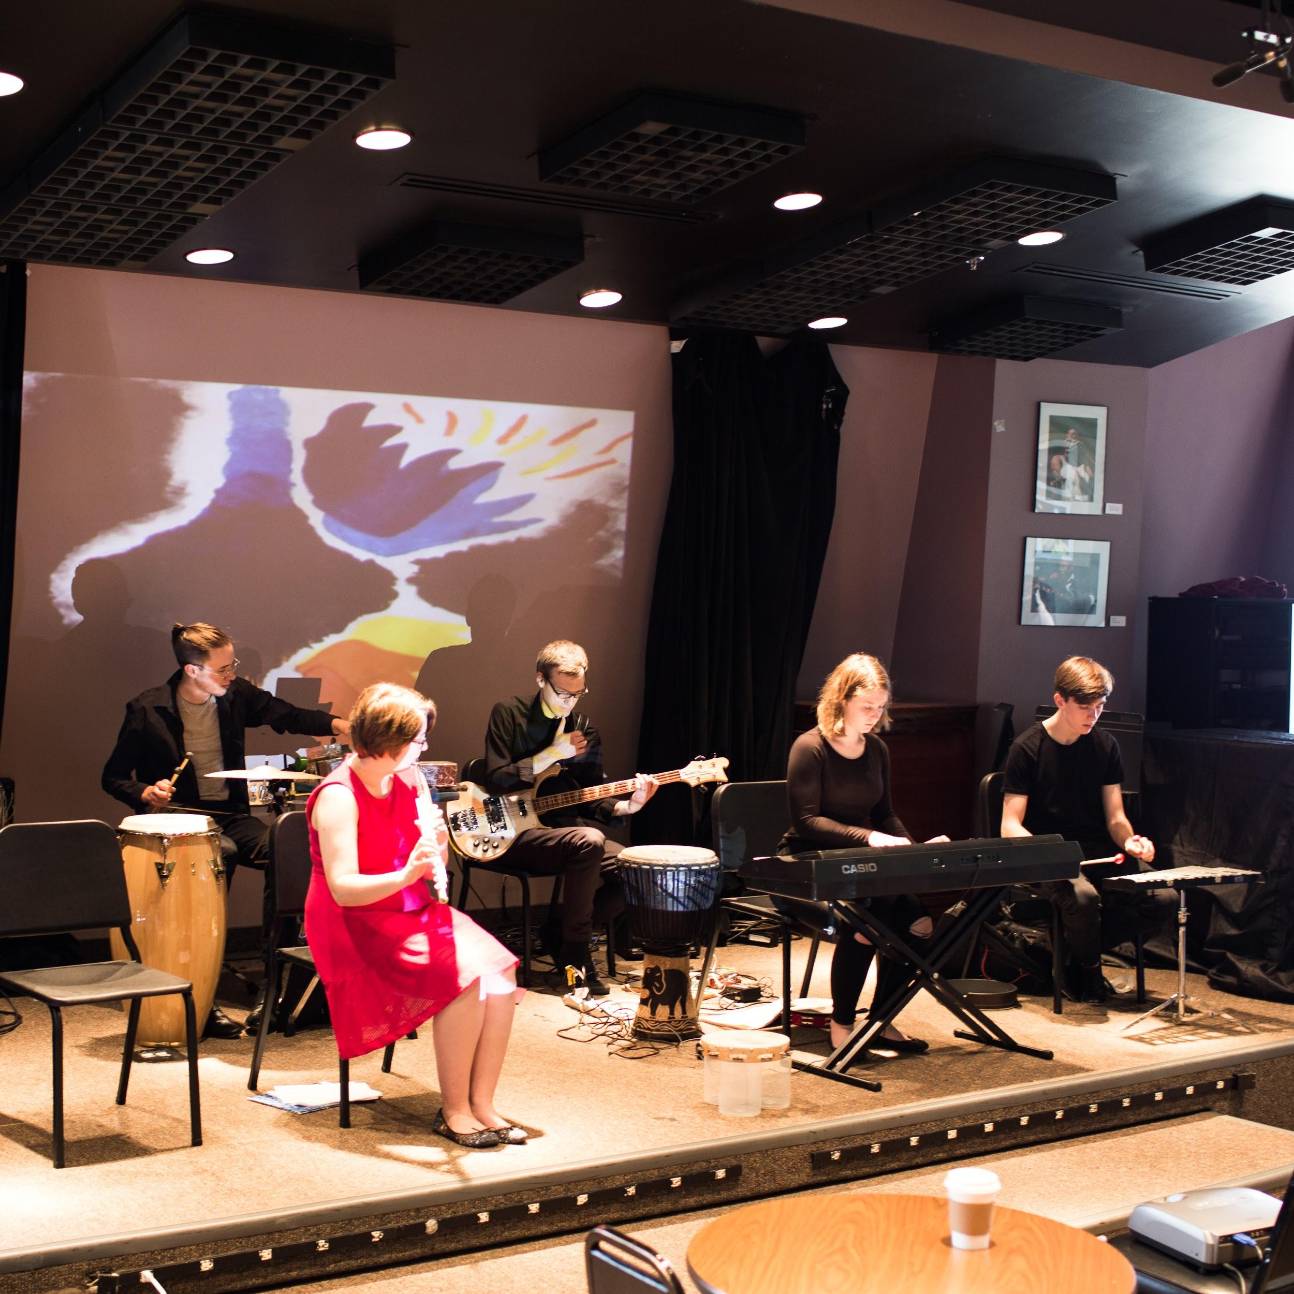
Background
Lab Group is a collaborative composing ensemble: the rep is invented by the members.
We launched Lab Group in 2017 to replace our more traditional Young Composers’ Program.
Lab Group’s activities have been supported by the League of American Orchestras, the Ohio Arts Council, and the Bascom Little Fund.

Slide 3
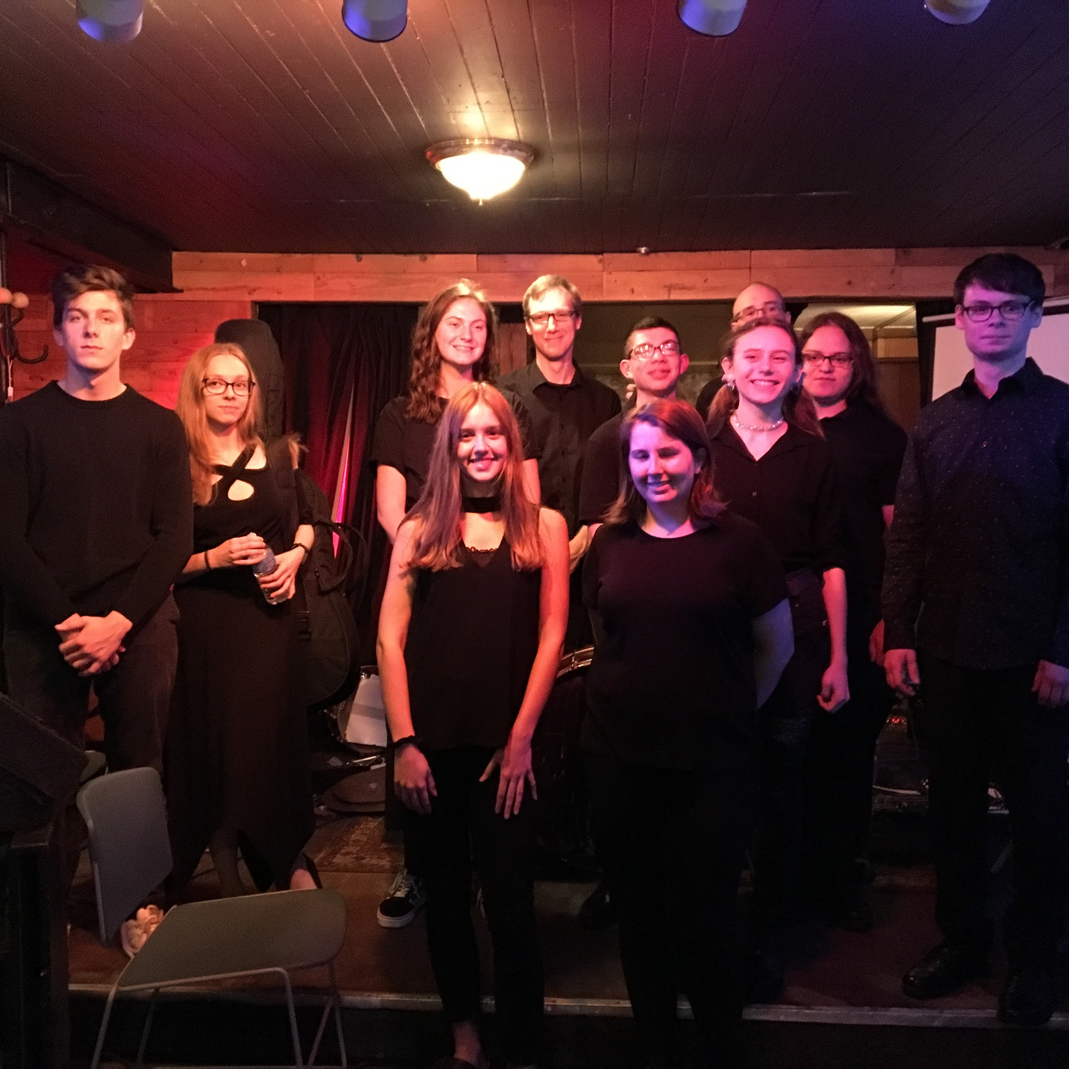
Membership
At the end of 2017-18, Lab Group had 4 members; at the end of 2018-19, it had 9 (just about the perfect size).
Lab Group’s 2018-19 musicians (pictured) come from Avon Lake, Elyria, Oberlin, Sheffield, and Wooster.

Slide 4
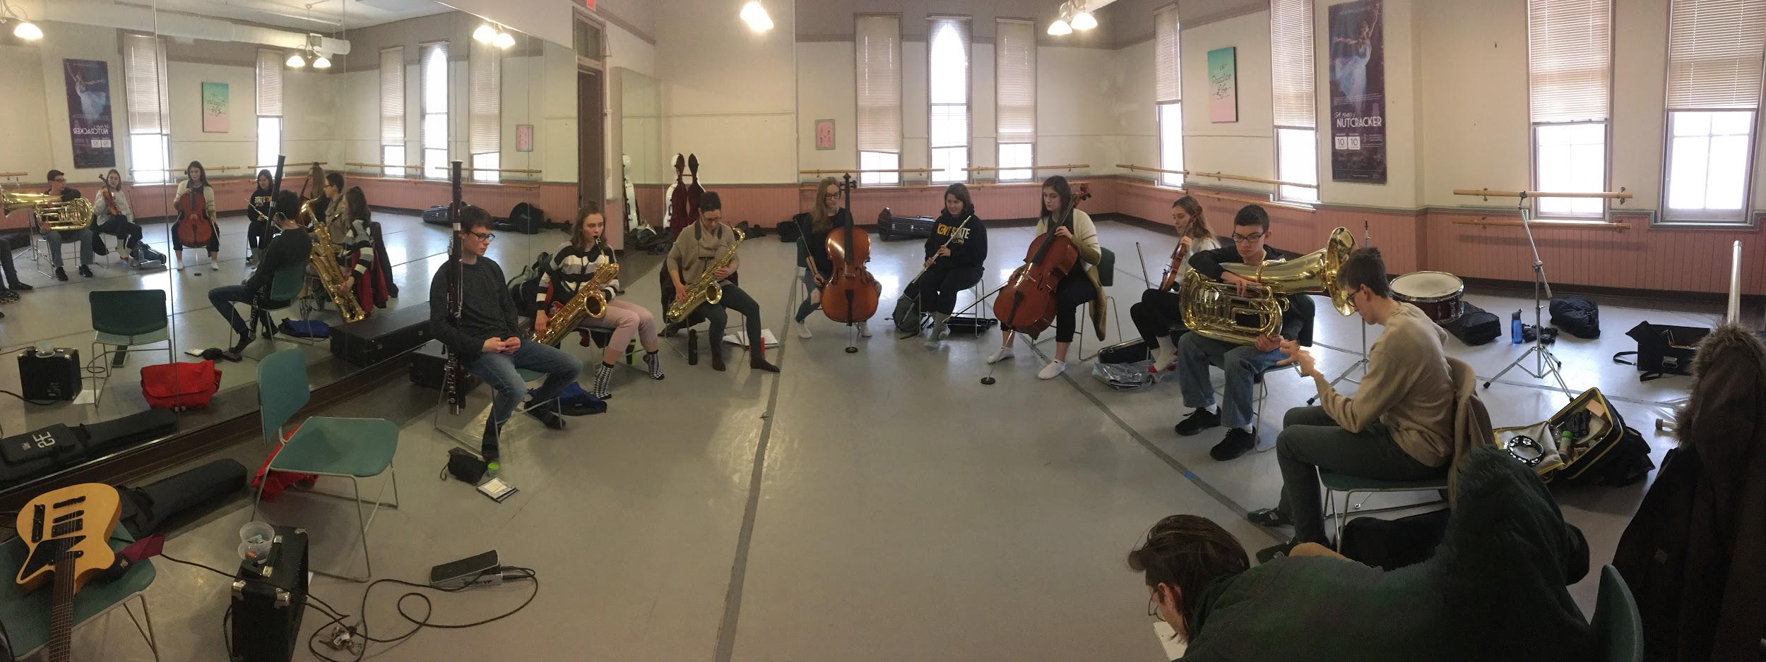
Method
Lab Group draws on techniques from the areas of improvisation, traditional and experimental composition, and even dance and theatre.
We also train extensively, hold several guest masterclasses, and give four performances per season (one in December and three in May).

Slide 5
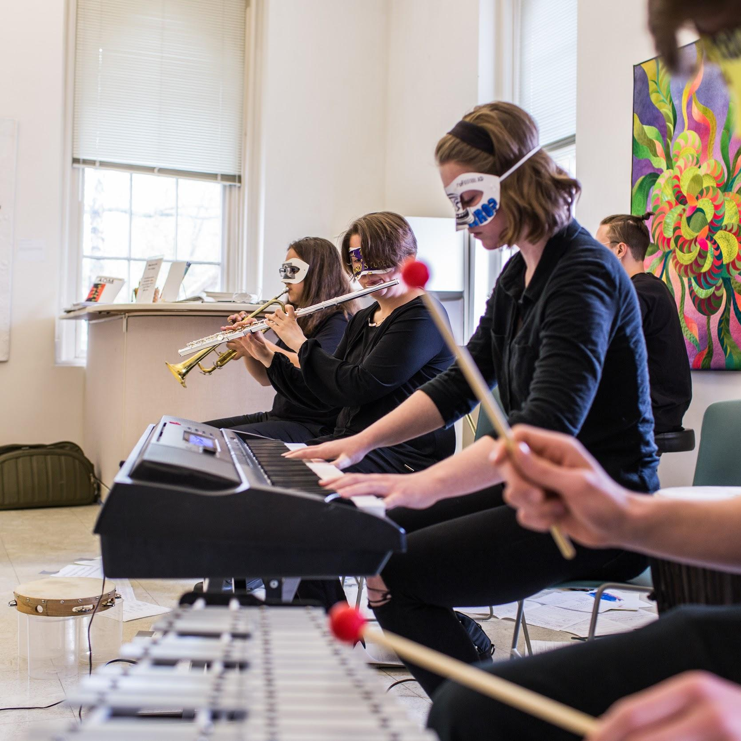
Principles
Openness
Consensus
Empiricism

Slide 6
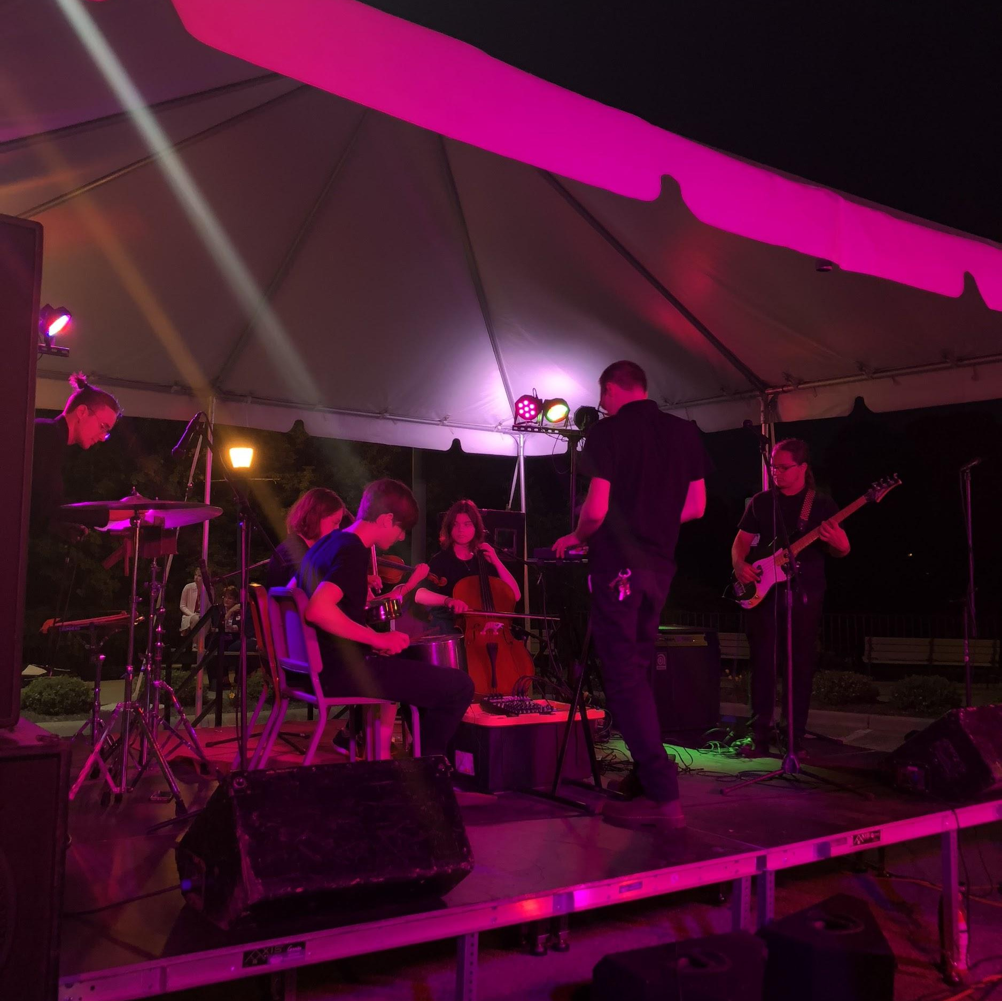
Openness
John Cage used to talk about “here comes everybody,” a reference to Joyce’s Finnegan’s Wake.
This doesn’t mean “anything goes:” it means that we have to work deliberately to remain open to unforeseen possibilities.
“The emotion of jump!”

Slide 7
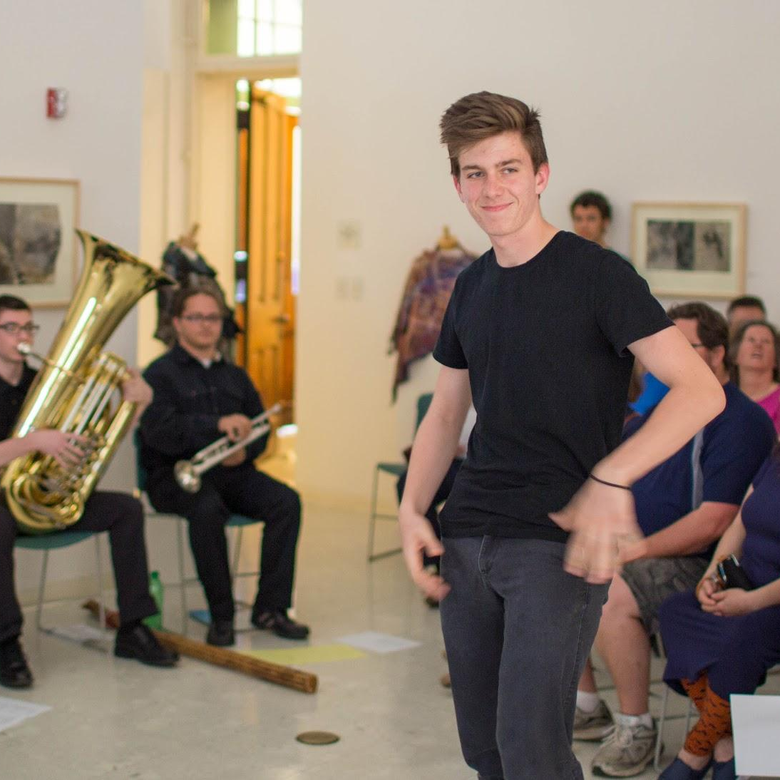
Consensus
Lab Group functions by consensus. We do our best to flatten the hierarchy of a traditional music-making ensemble and empower all participants.
This can be a challenge with high-school musicians, but it’s an important way for them to grow into useful life skills.

Slide 8
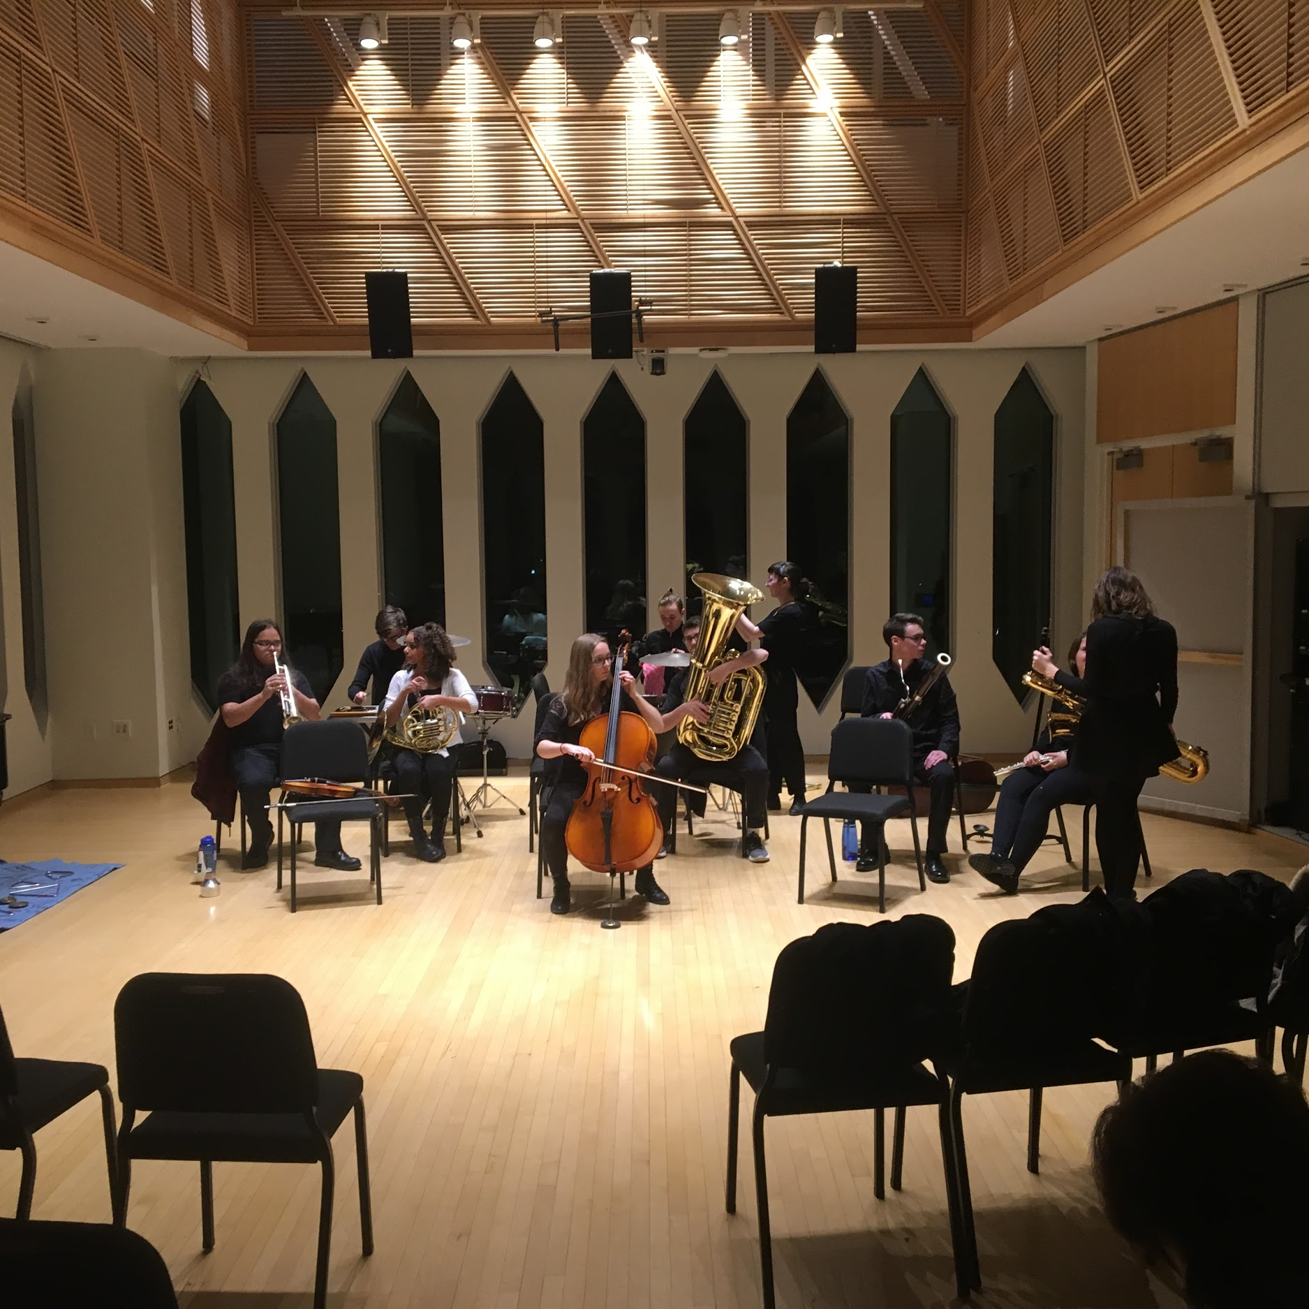
Empiricism
Because all Lab Group meetings take place in the rehearsal studio with instruments, we can try out ideas as soon as they’re introduced.
This only works if everyone is willing to put forth a good-faith effort even on ideas that they’re not excited about.

Slide 9
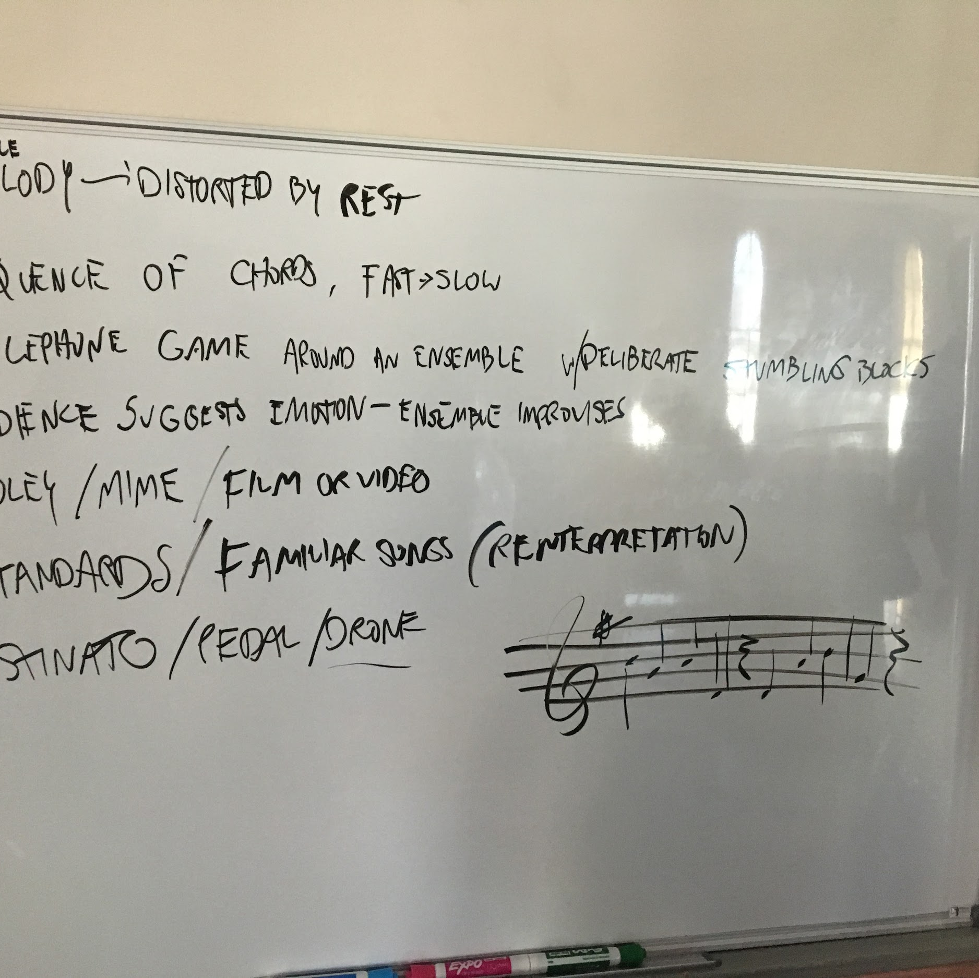
Make an artwork!
Performance,
object, or
text that
shows evidence of its creators (i.e., you) and
whose value can be articulated.

Slide 10
Thanks!
If you have questions about NOYO or Lab Group, please feel free to contact me at cholter@noyo.org.

