Slide 1
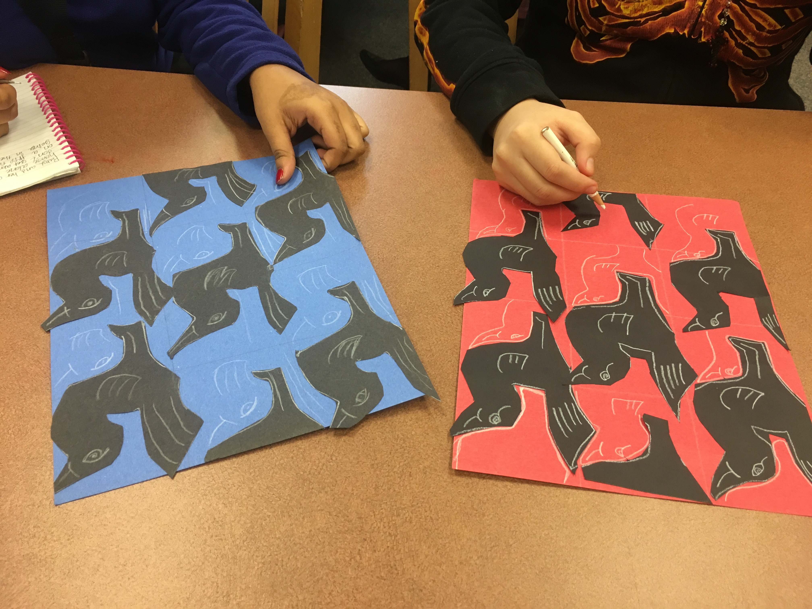
Deepening Learning by Combining Art
with Science, ELA, Social Studies and
Math
by Teaching Artist George Woideck

Slide 2
The Process:
The Teacher's Need or Idea+
Educational Standards +
Creative Inspiration, Provided by the
Teaching Artist, Arts Teacher
or Teacher
=
The Project

Slide 3
Learning about transformations by making Escher-style tesselations

Slide 4
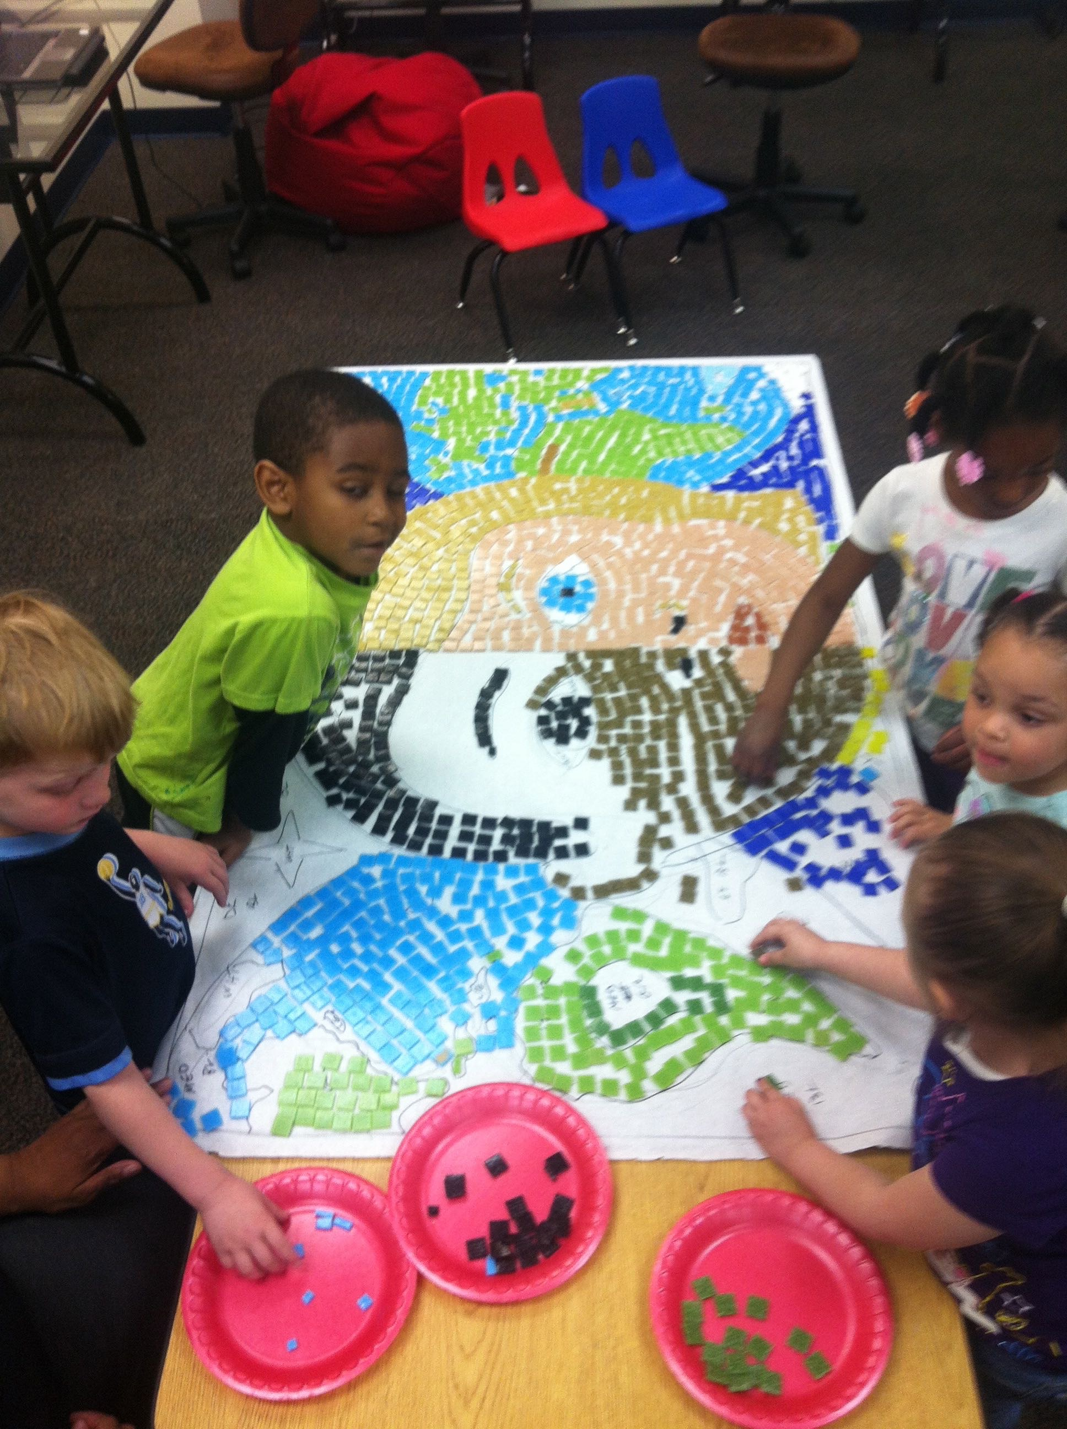
Preschool mosaic makers

Slide 5
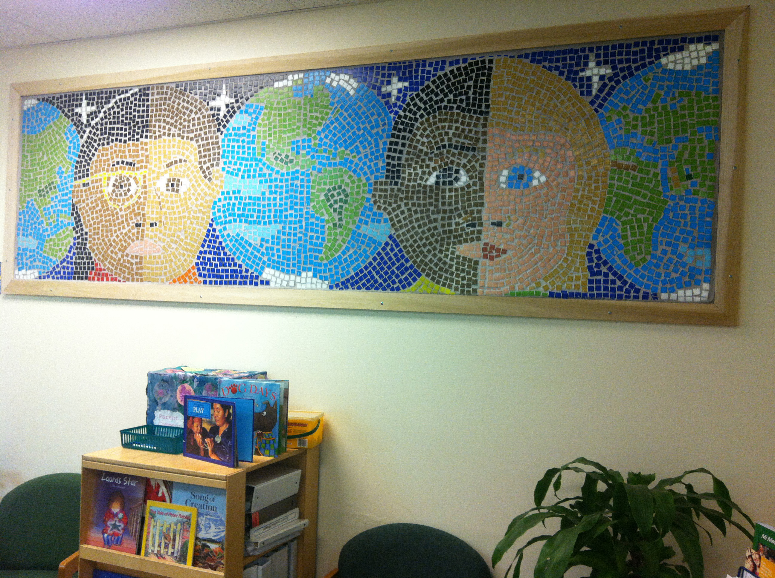
Our Children, Their World preschool mosaic

Slide 6
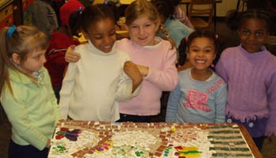
Kindergarten mosaic makers

Slide 7
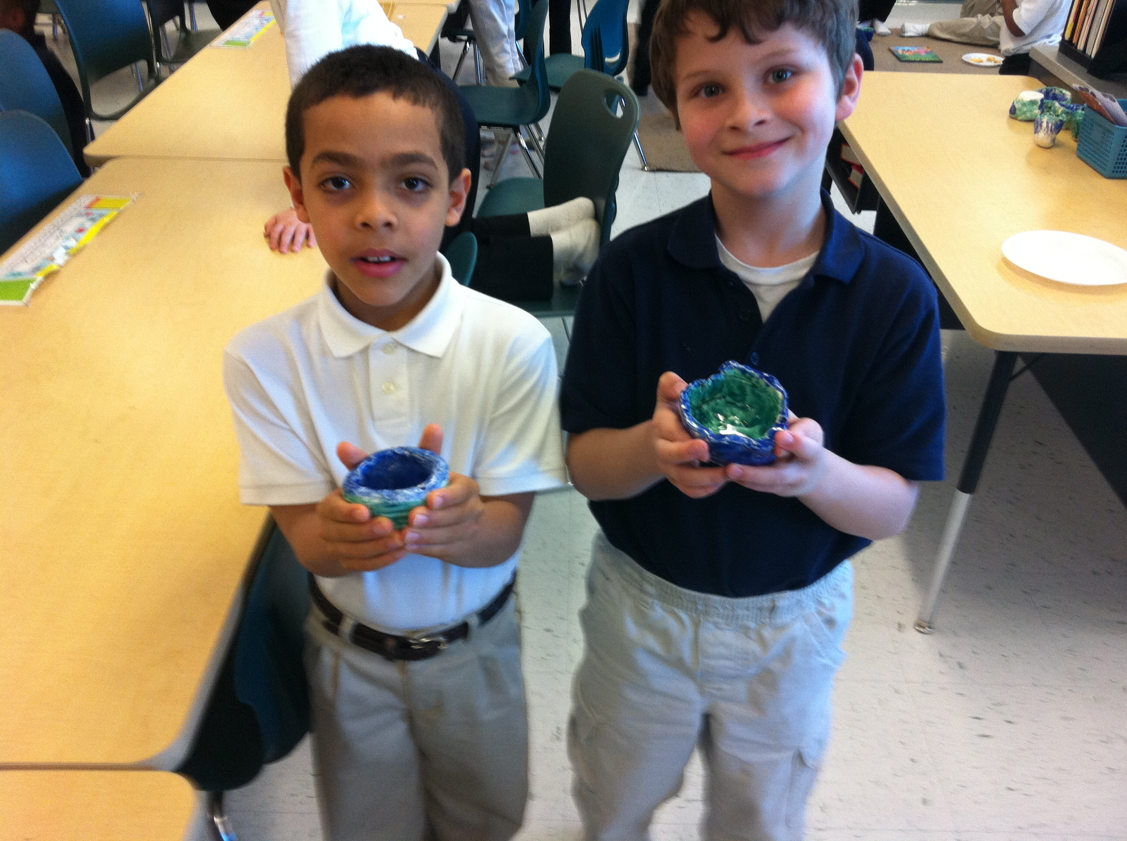
Learning about Japanese culture by participating in the Tea Ceremony

Slide 8
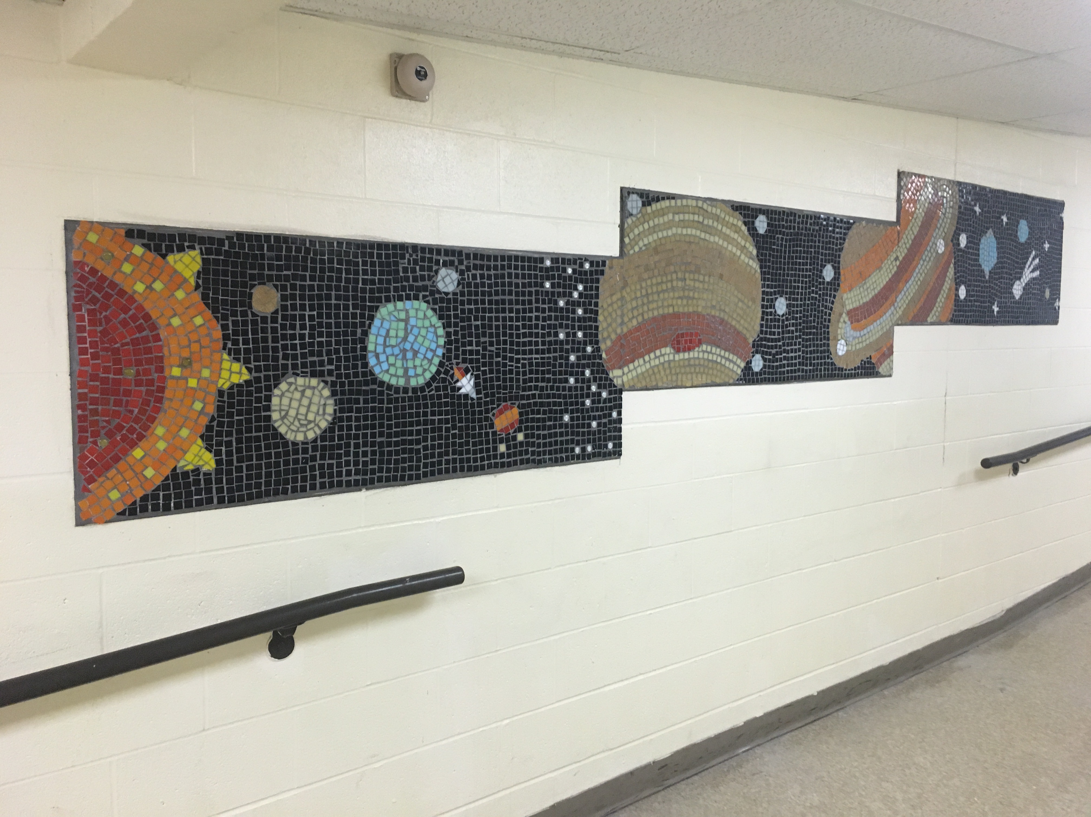
The Solar System mosaic (with Pluto) at Firelands Elementary

Slide 9
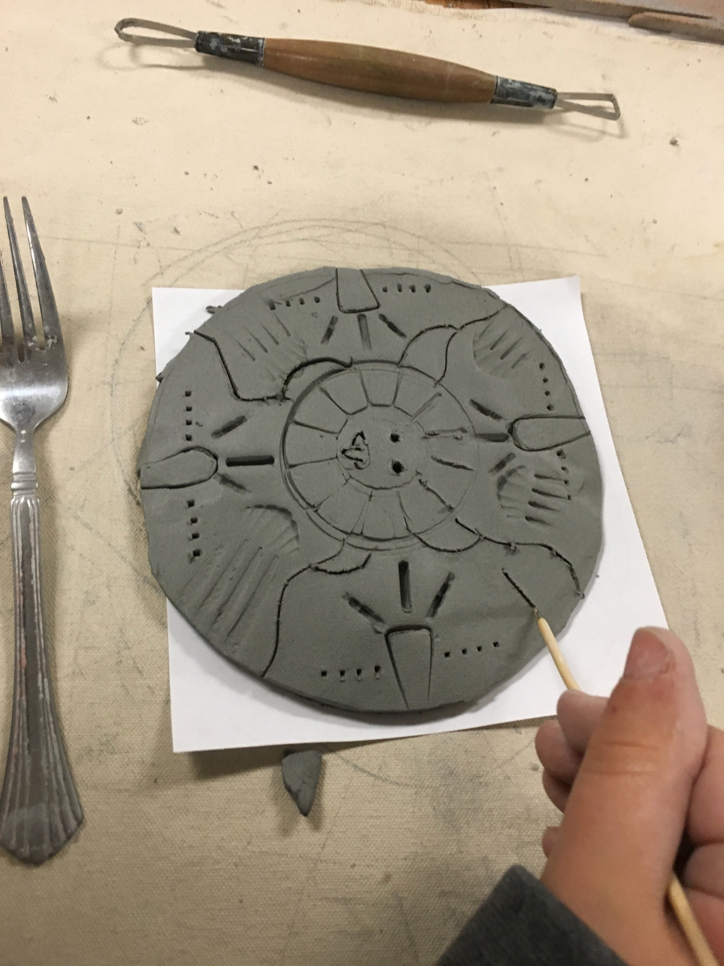
Learning about the Aztecs by making a sun disc from clay

Slide 10
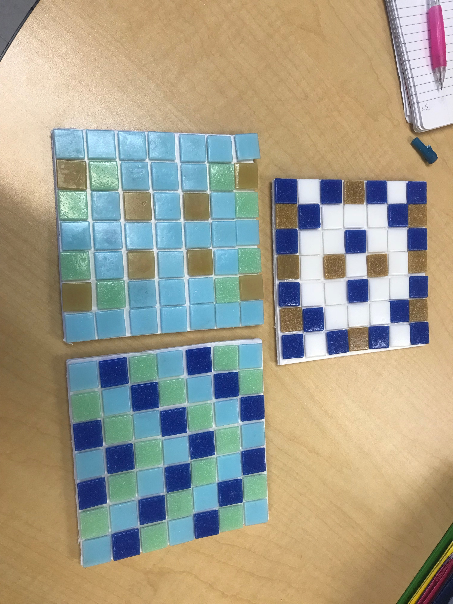
Making symmetrical mosaics

Slide 11
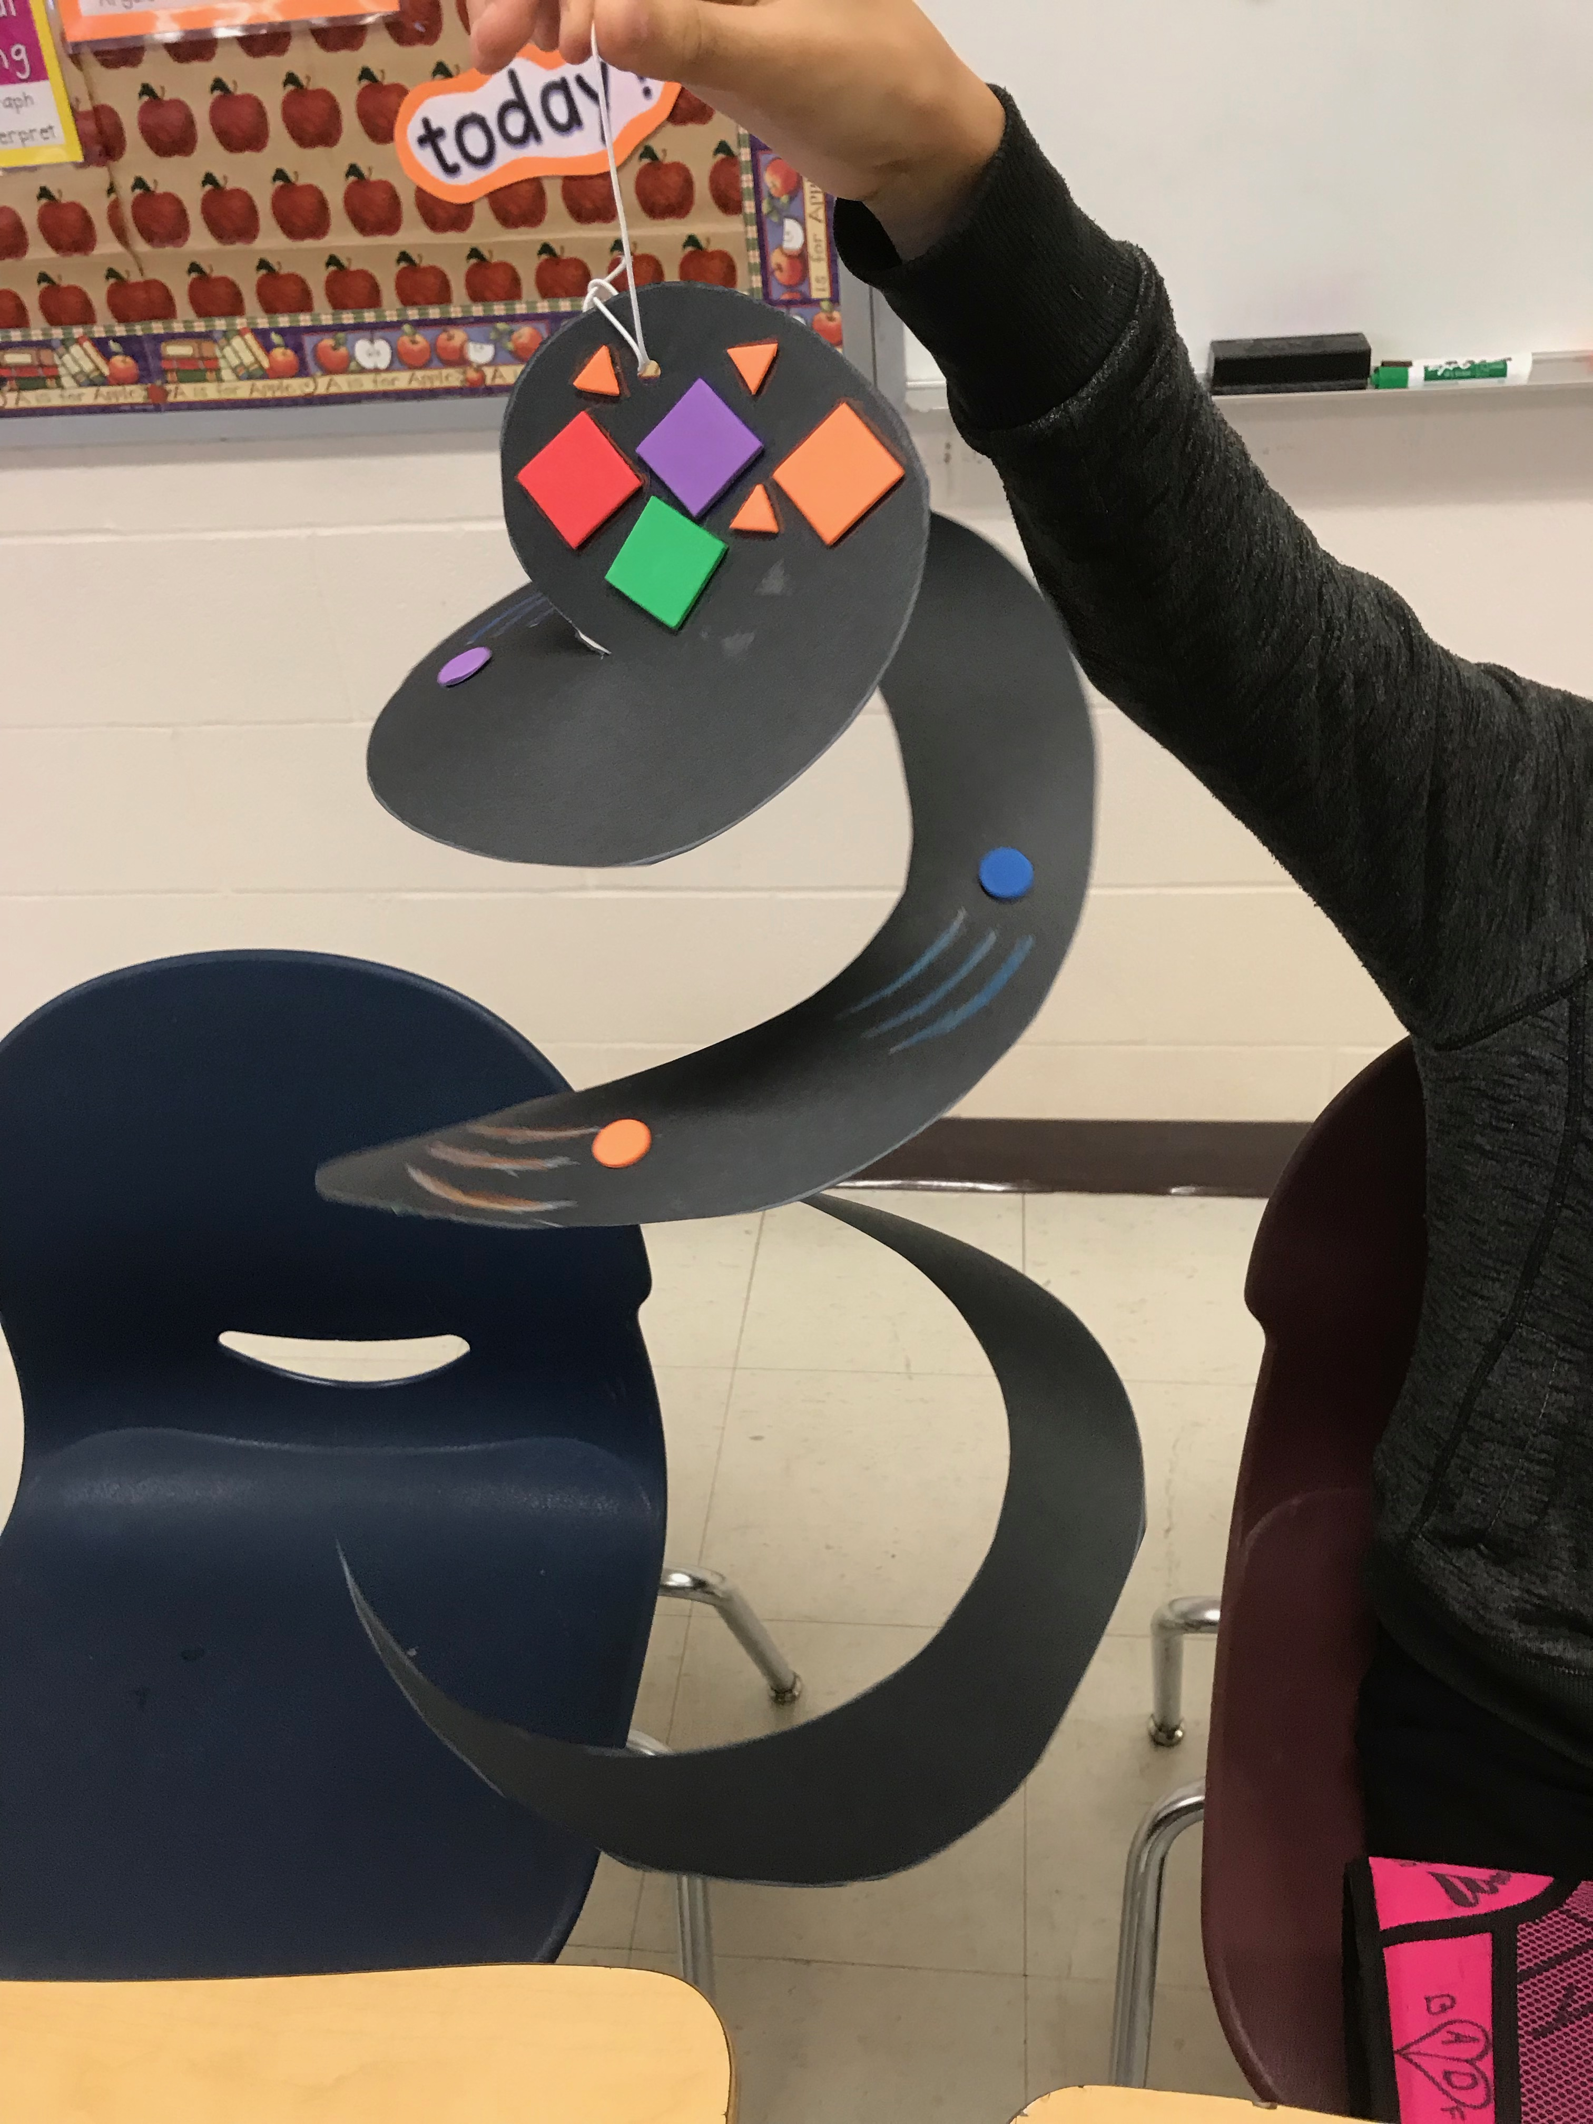
Learning about atoms by making a wind spinner

Slide 12
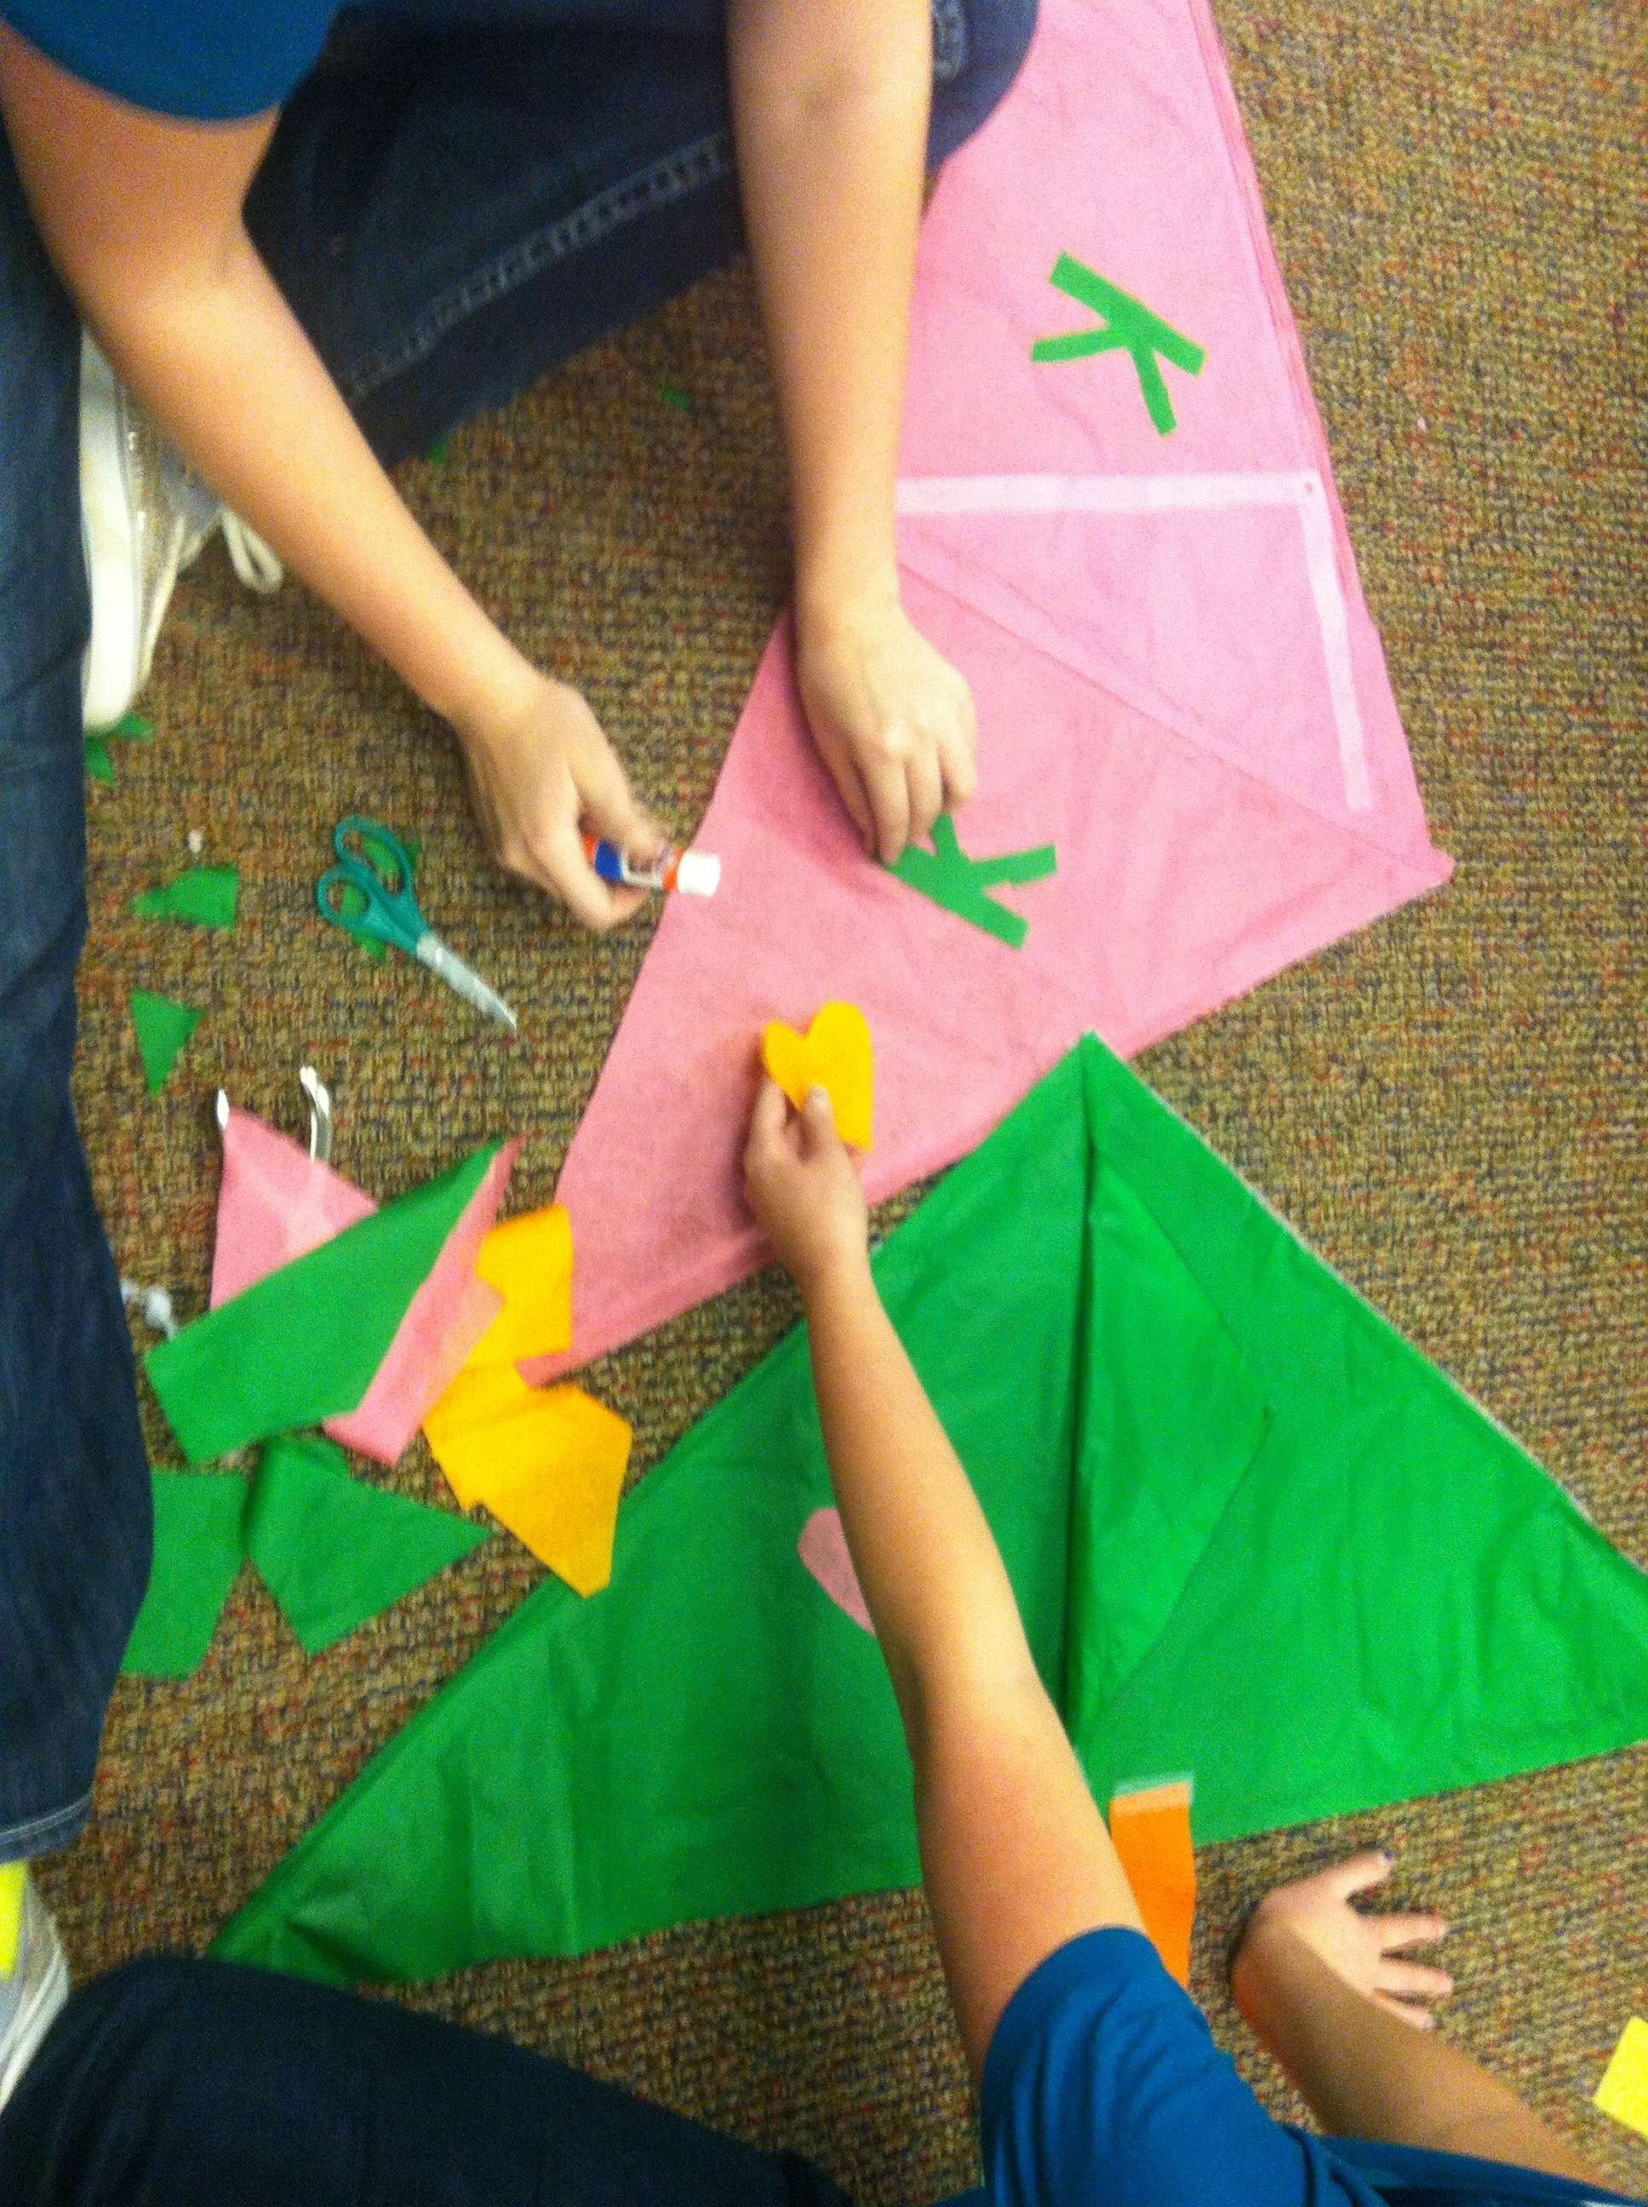
Learning about the physics of flight by making kites

Slide 13
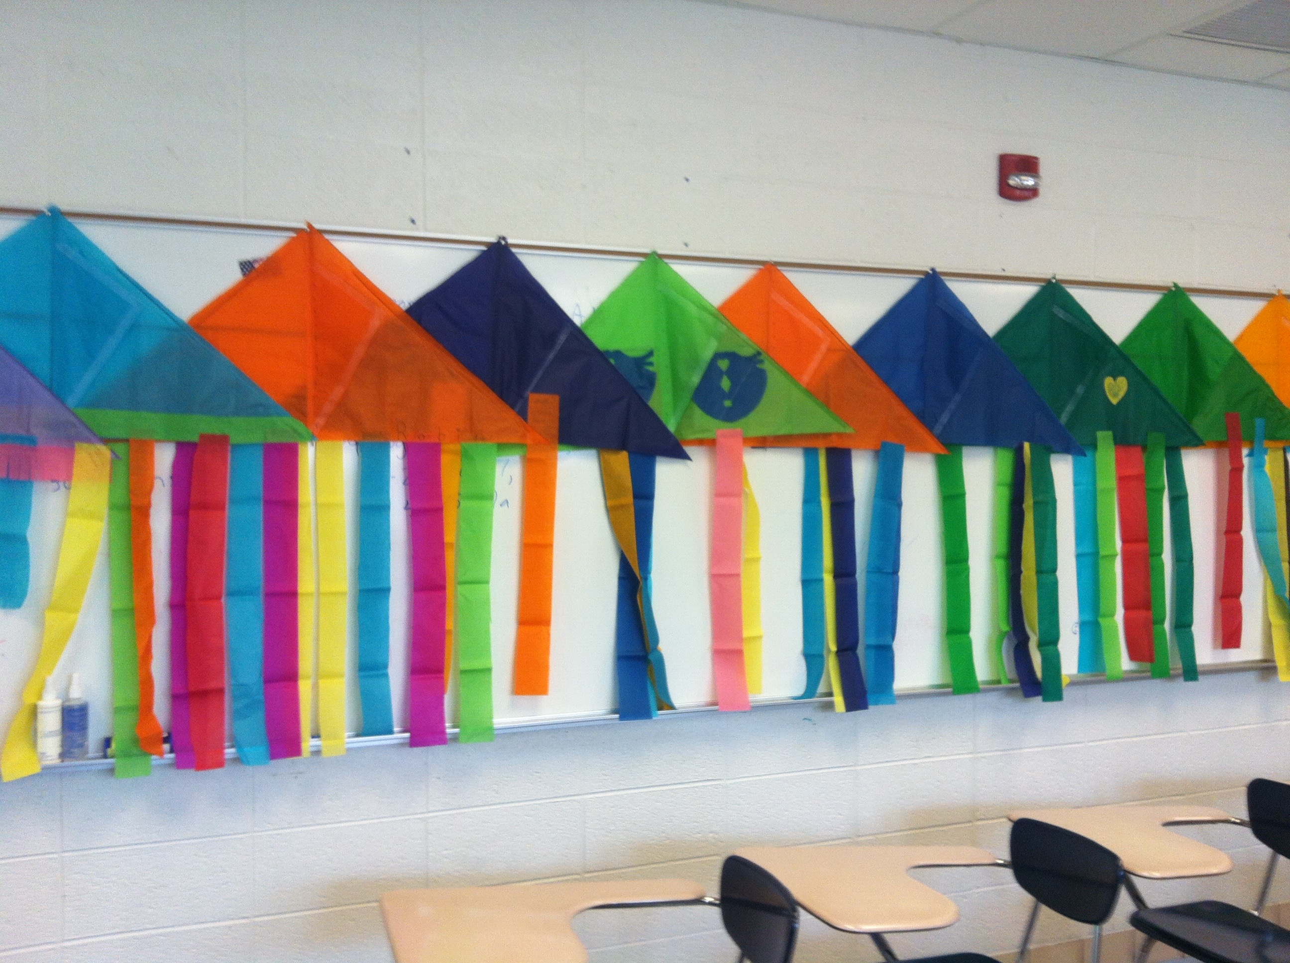
Finished kites on display

Slide 14
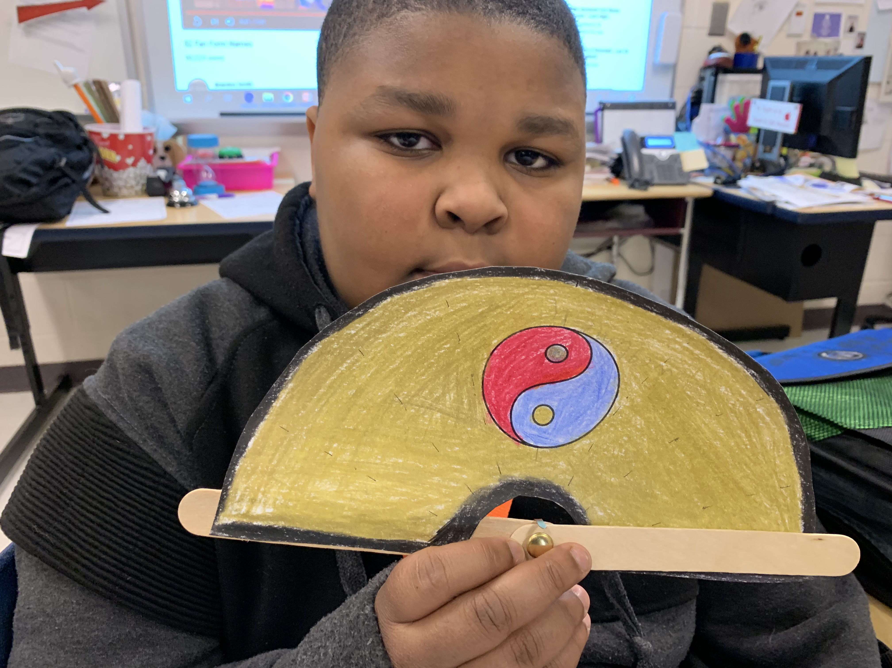
Learning about Chinese culture

Slide 15
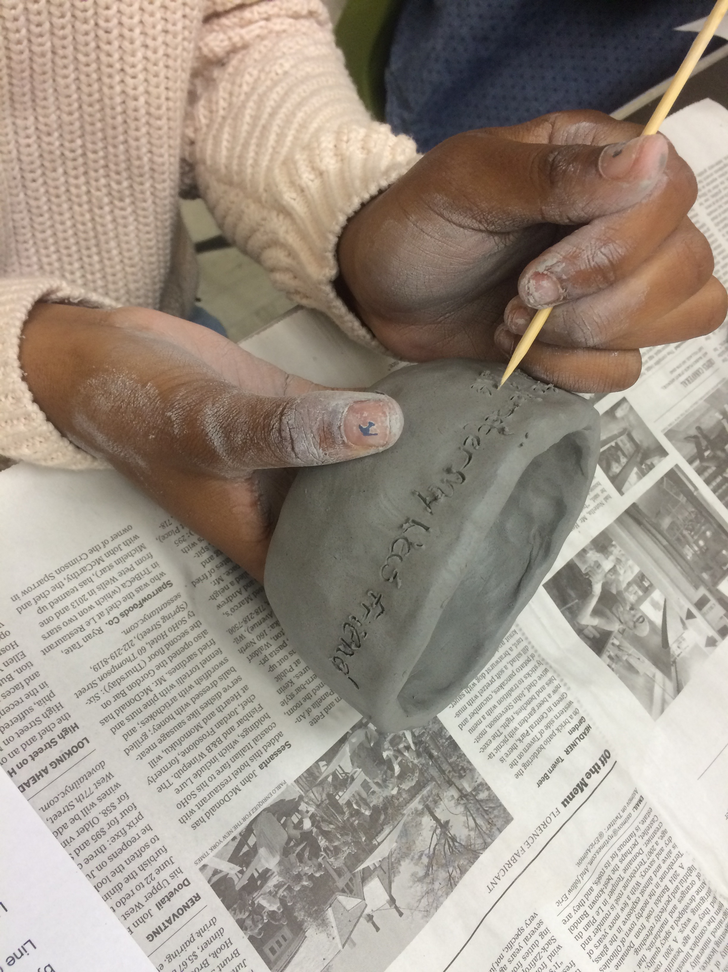
Writing poetry on pottery in the style of enslaved Dave Drake AKA Dave the Potter

Slide 16
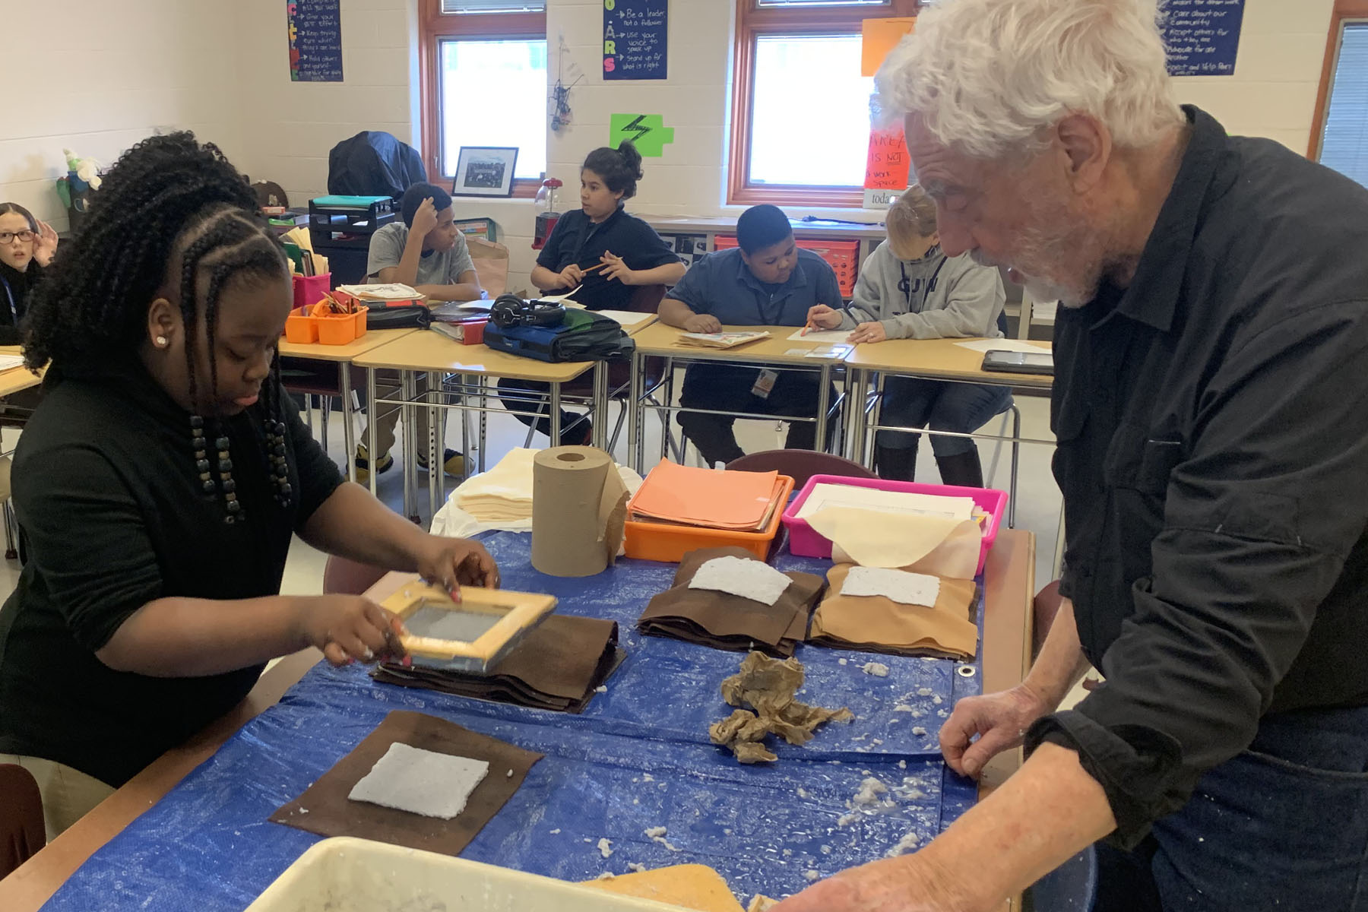
Learning about the history of writing by making paper

Slide 17
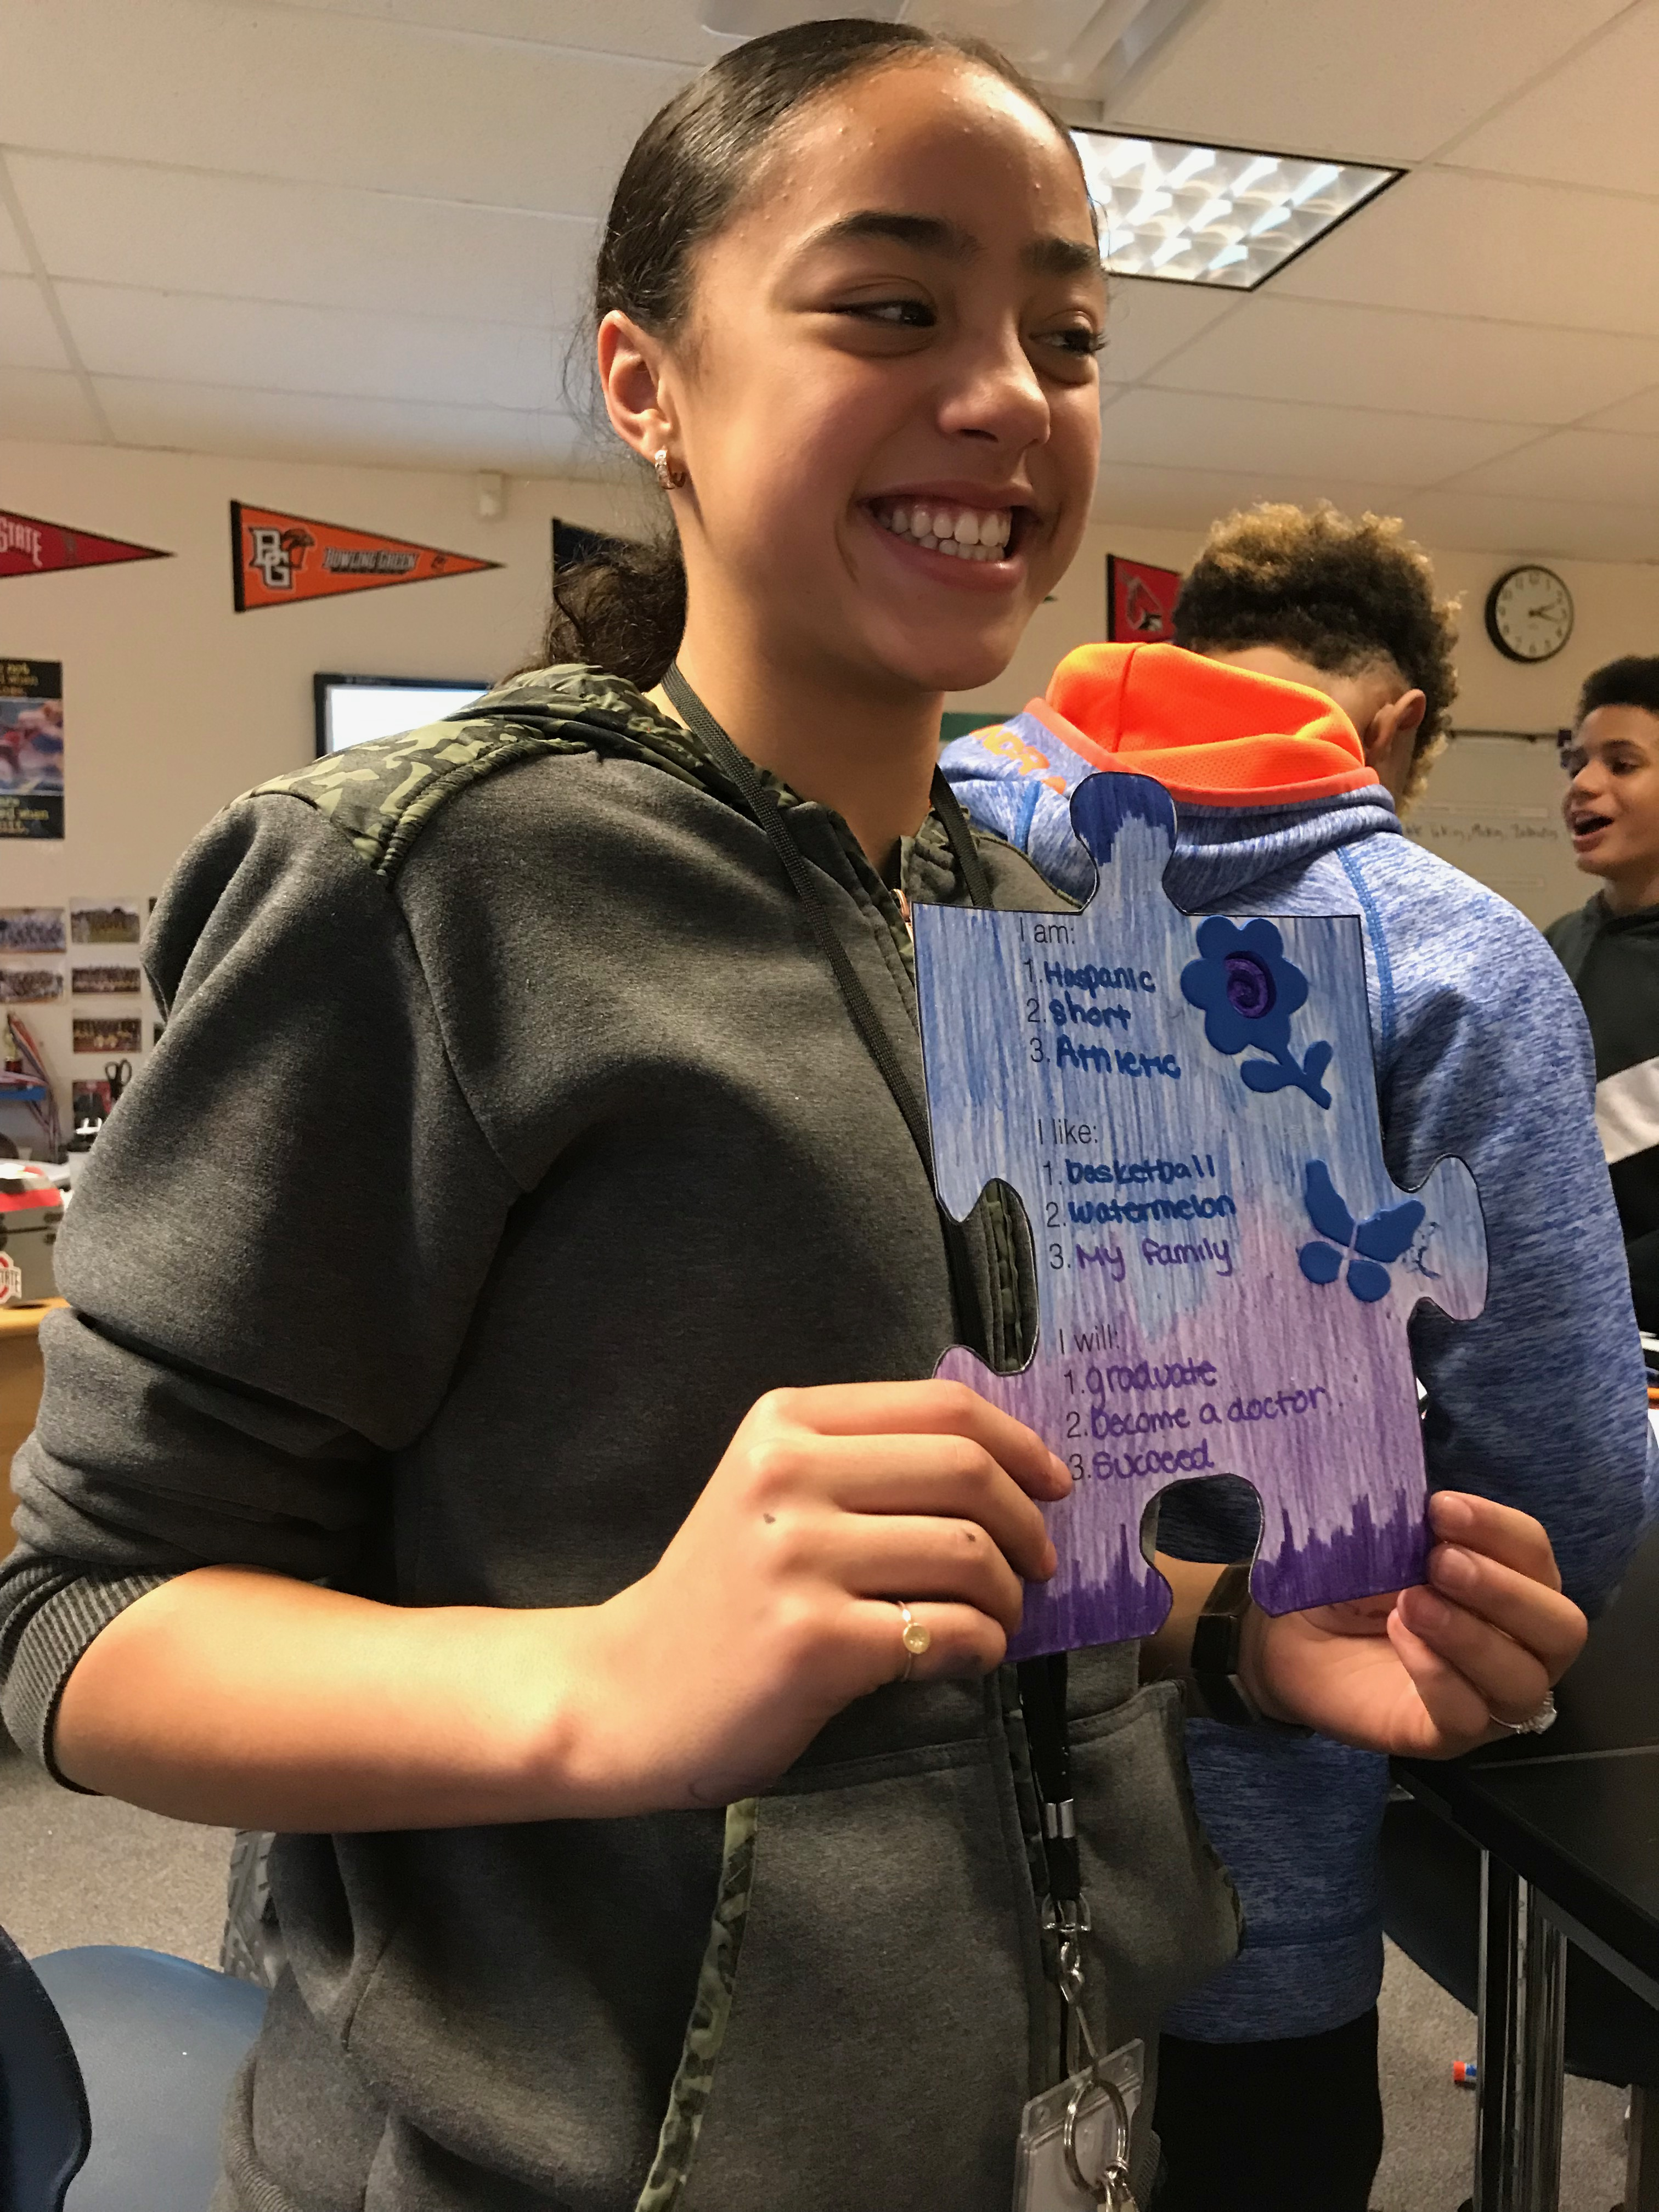
Creating an individual puzzle piece for the anti-bullying project Where do You Fit in the Puzzle?

Slide 18
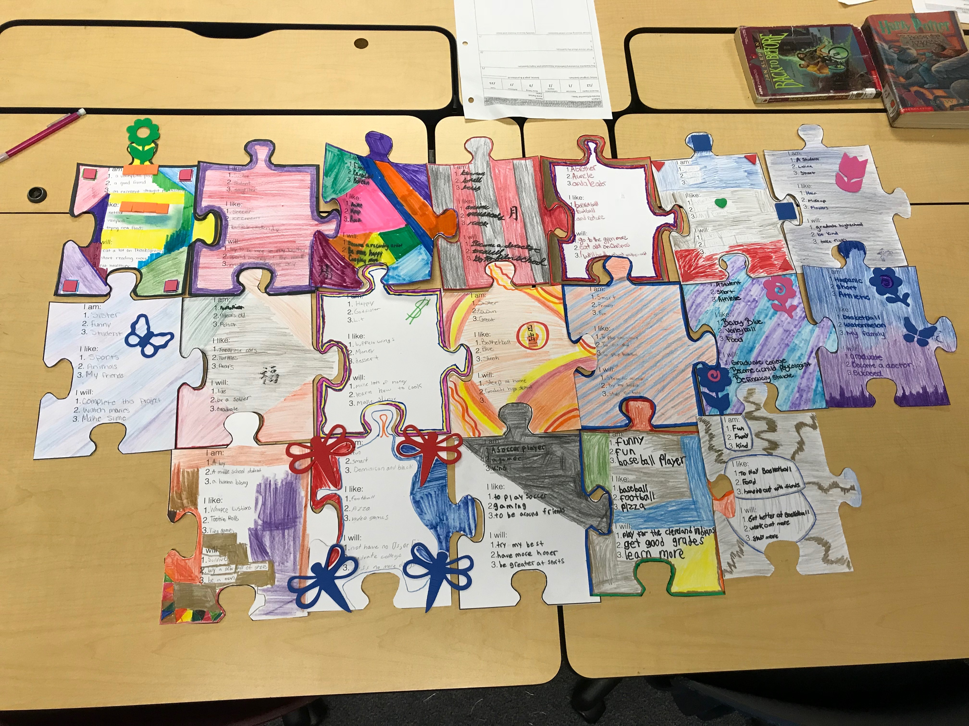
Anti bullying project Where do You Fit in the Puzzle? assembled

Slide 19
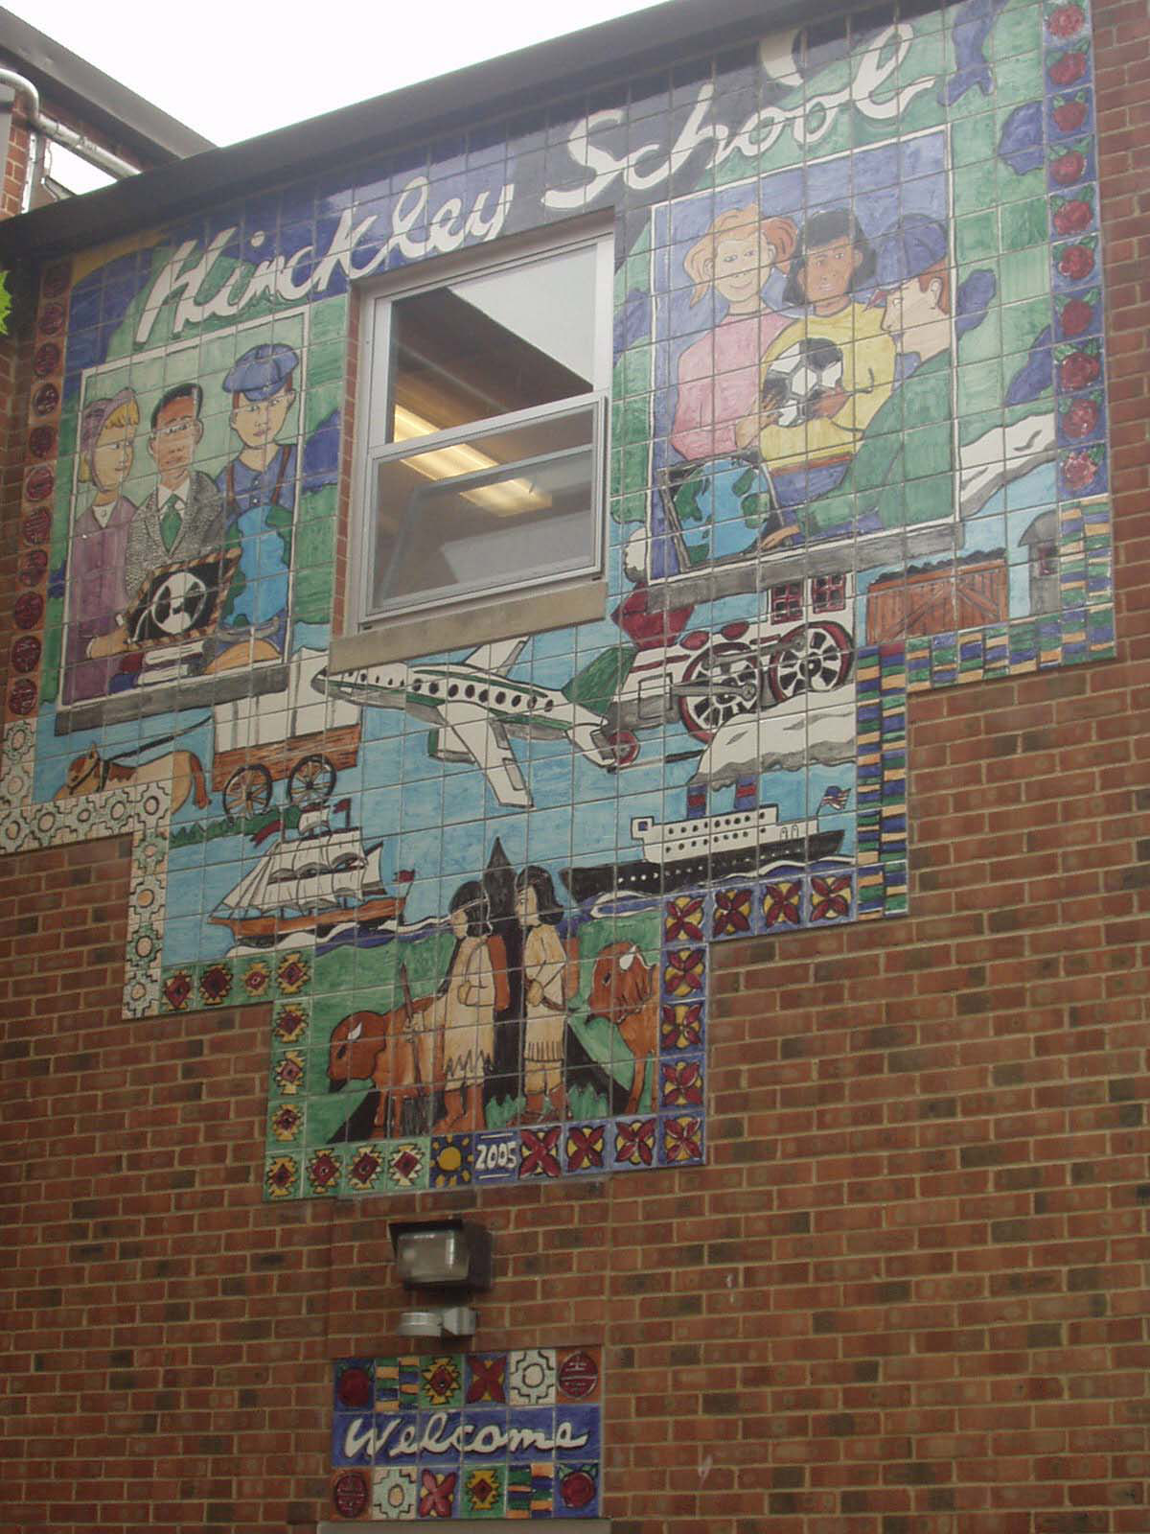
Ceramic tile mural celebrating immigration and migration

Slide 20
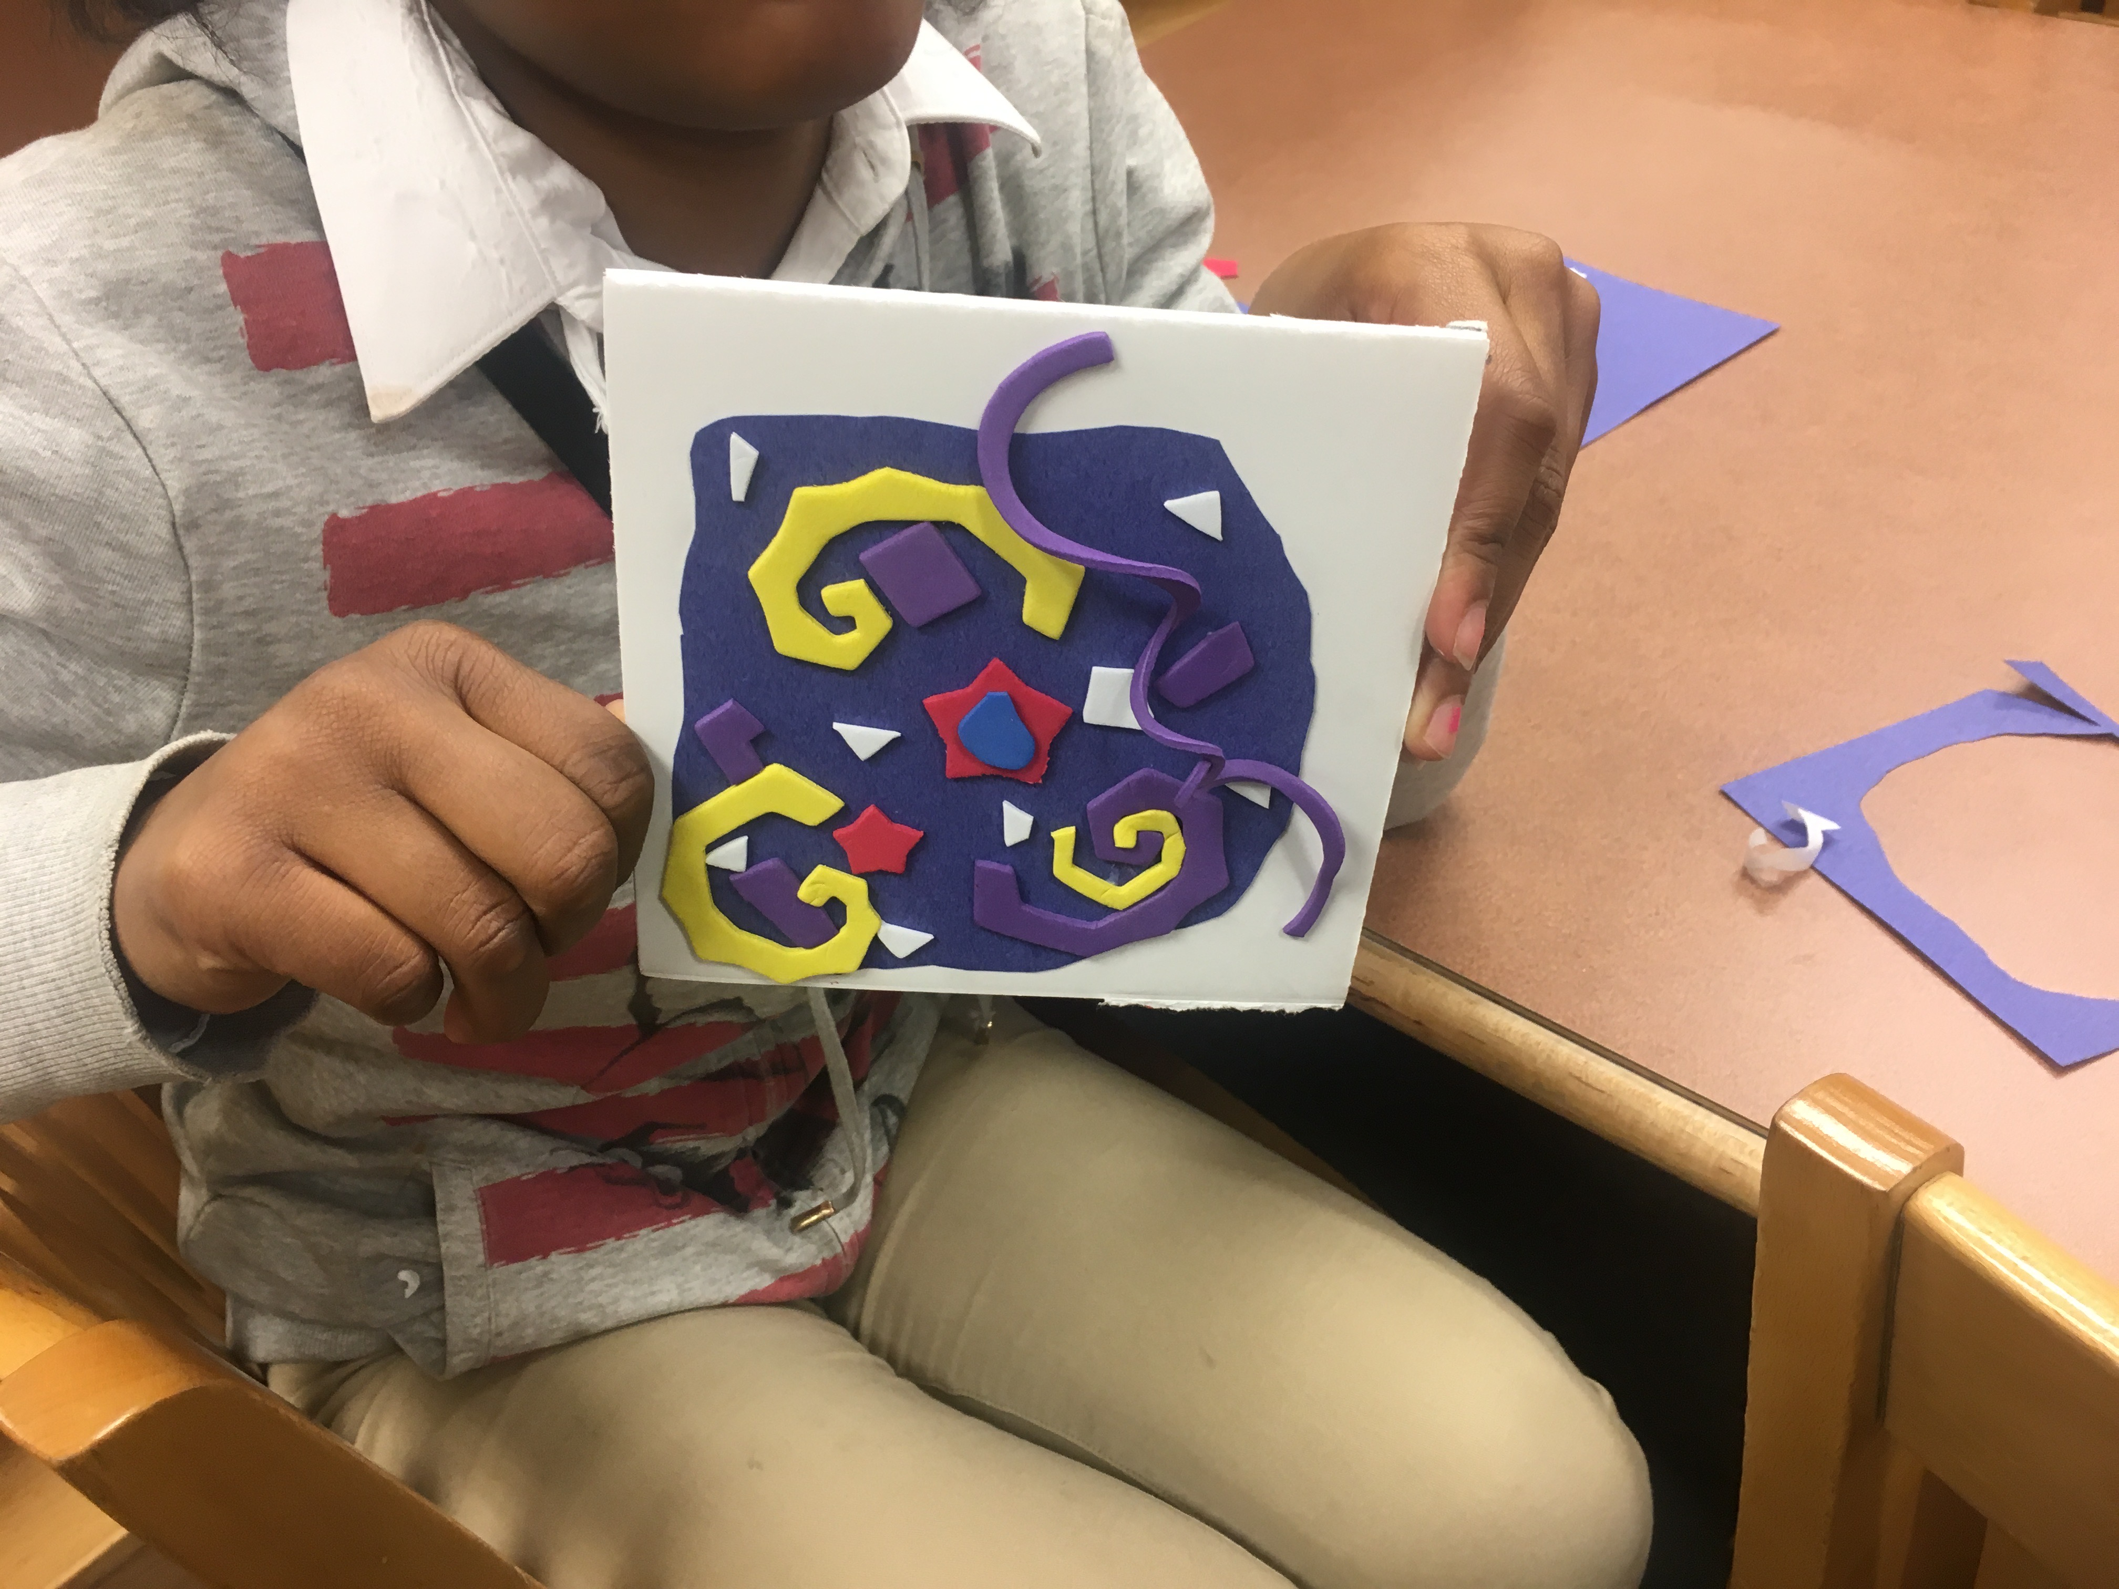
Learning about animal and vegetable cells

Slide 21
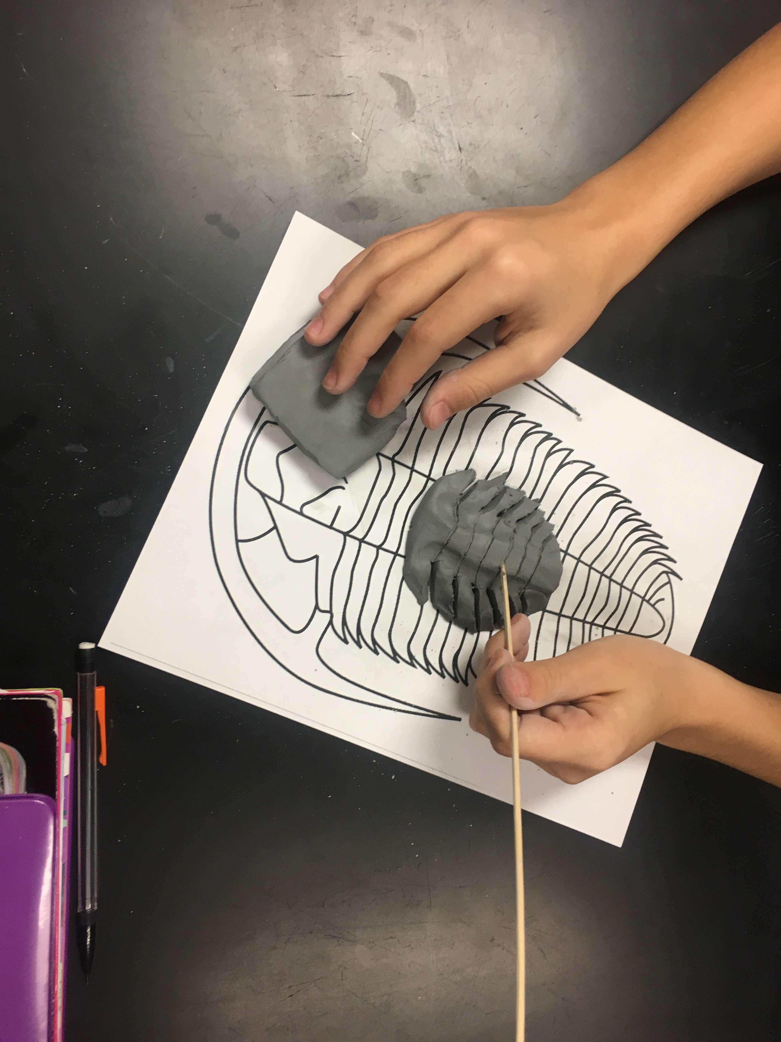
Creating the index fossil trilobite from clay

Slide 22
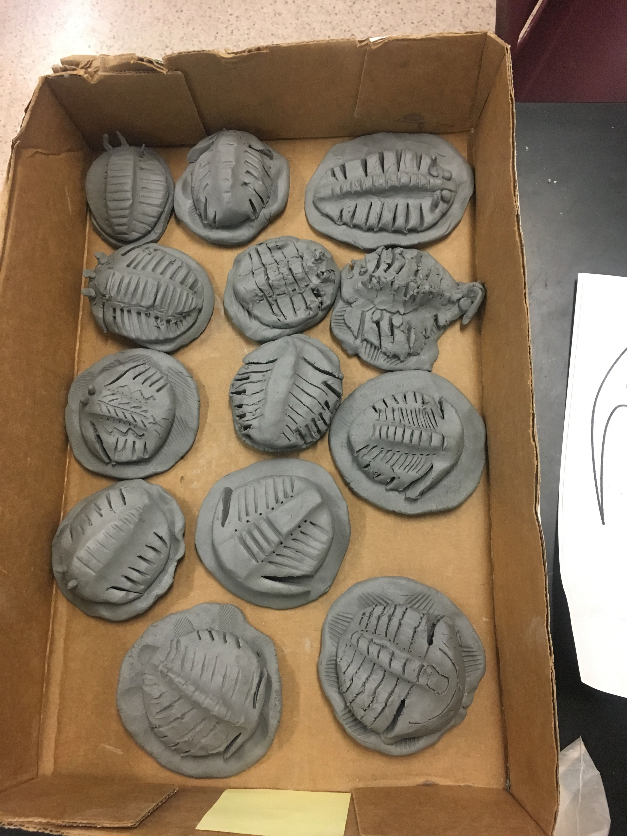
Trilobite sculptures ready for drying and firing

Slide 23
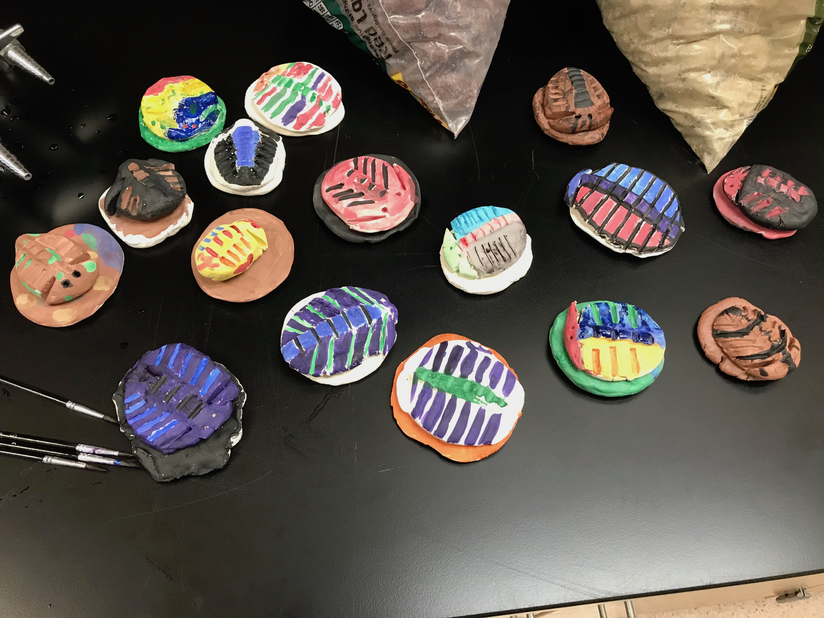
Painting the trilobites

Slide 24
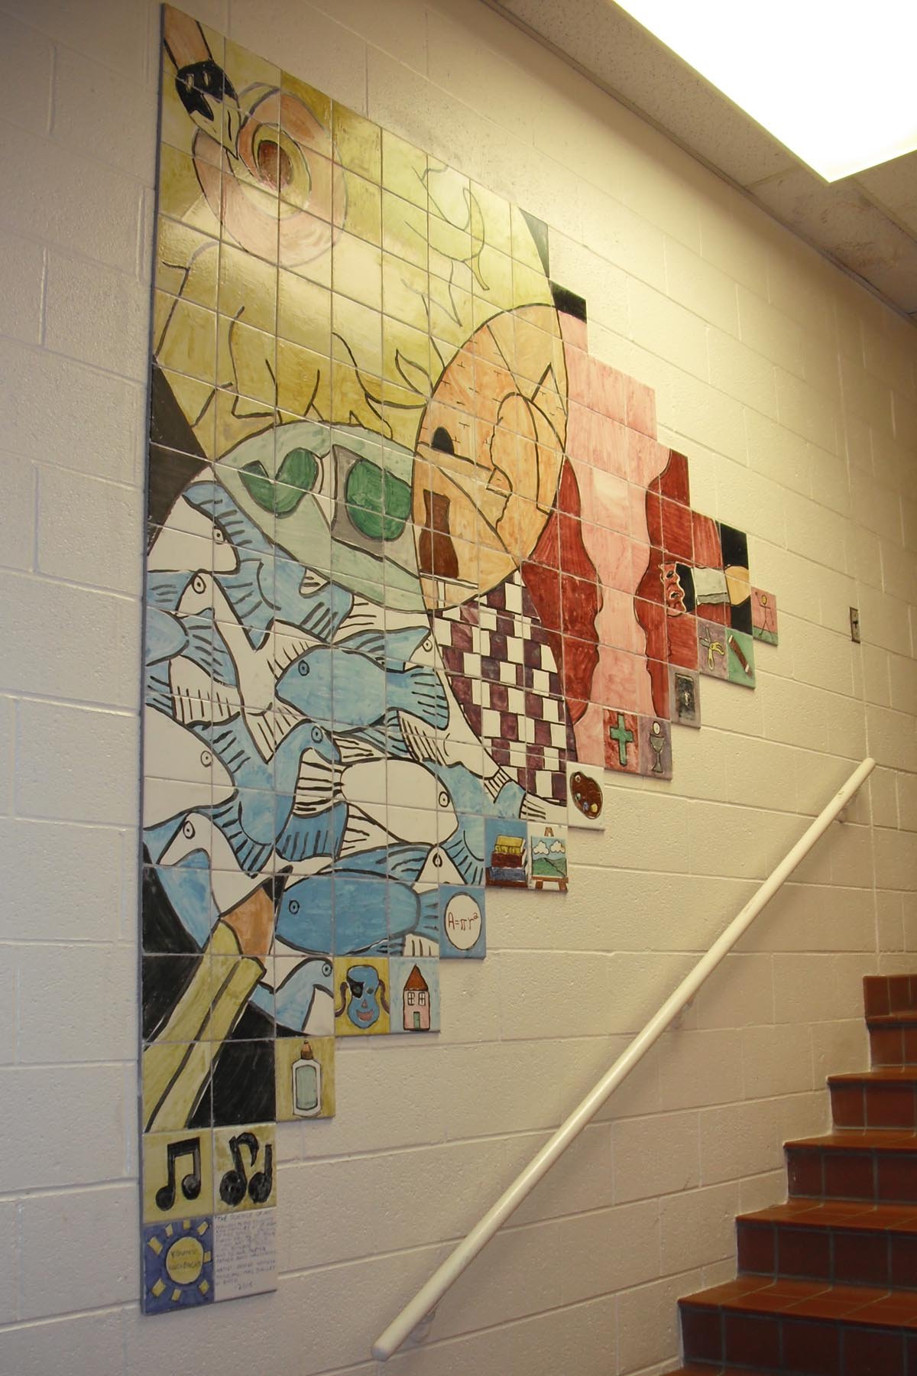
The Science of Art middle school ceramic tile mural

Slide 25
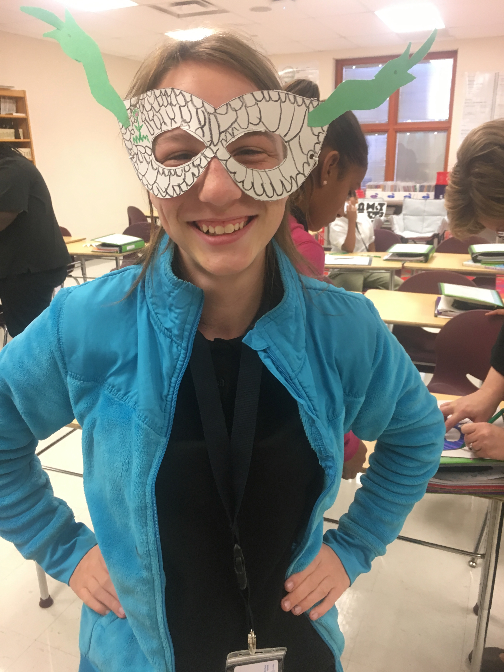
Making Medusa mask while learning about Greek Mythology

Slide 26
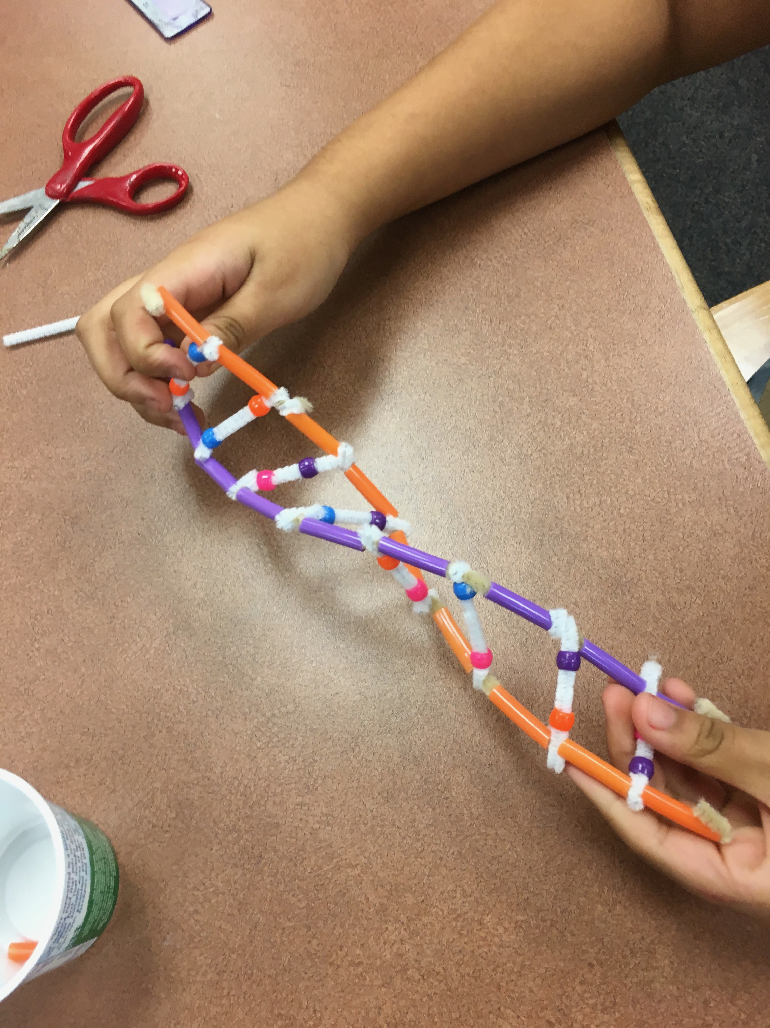
Learning about DNA by making a double helix

Slide 27
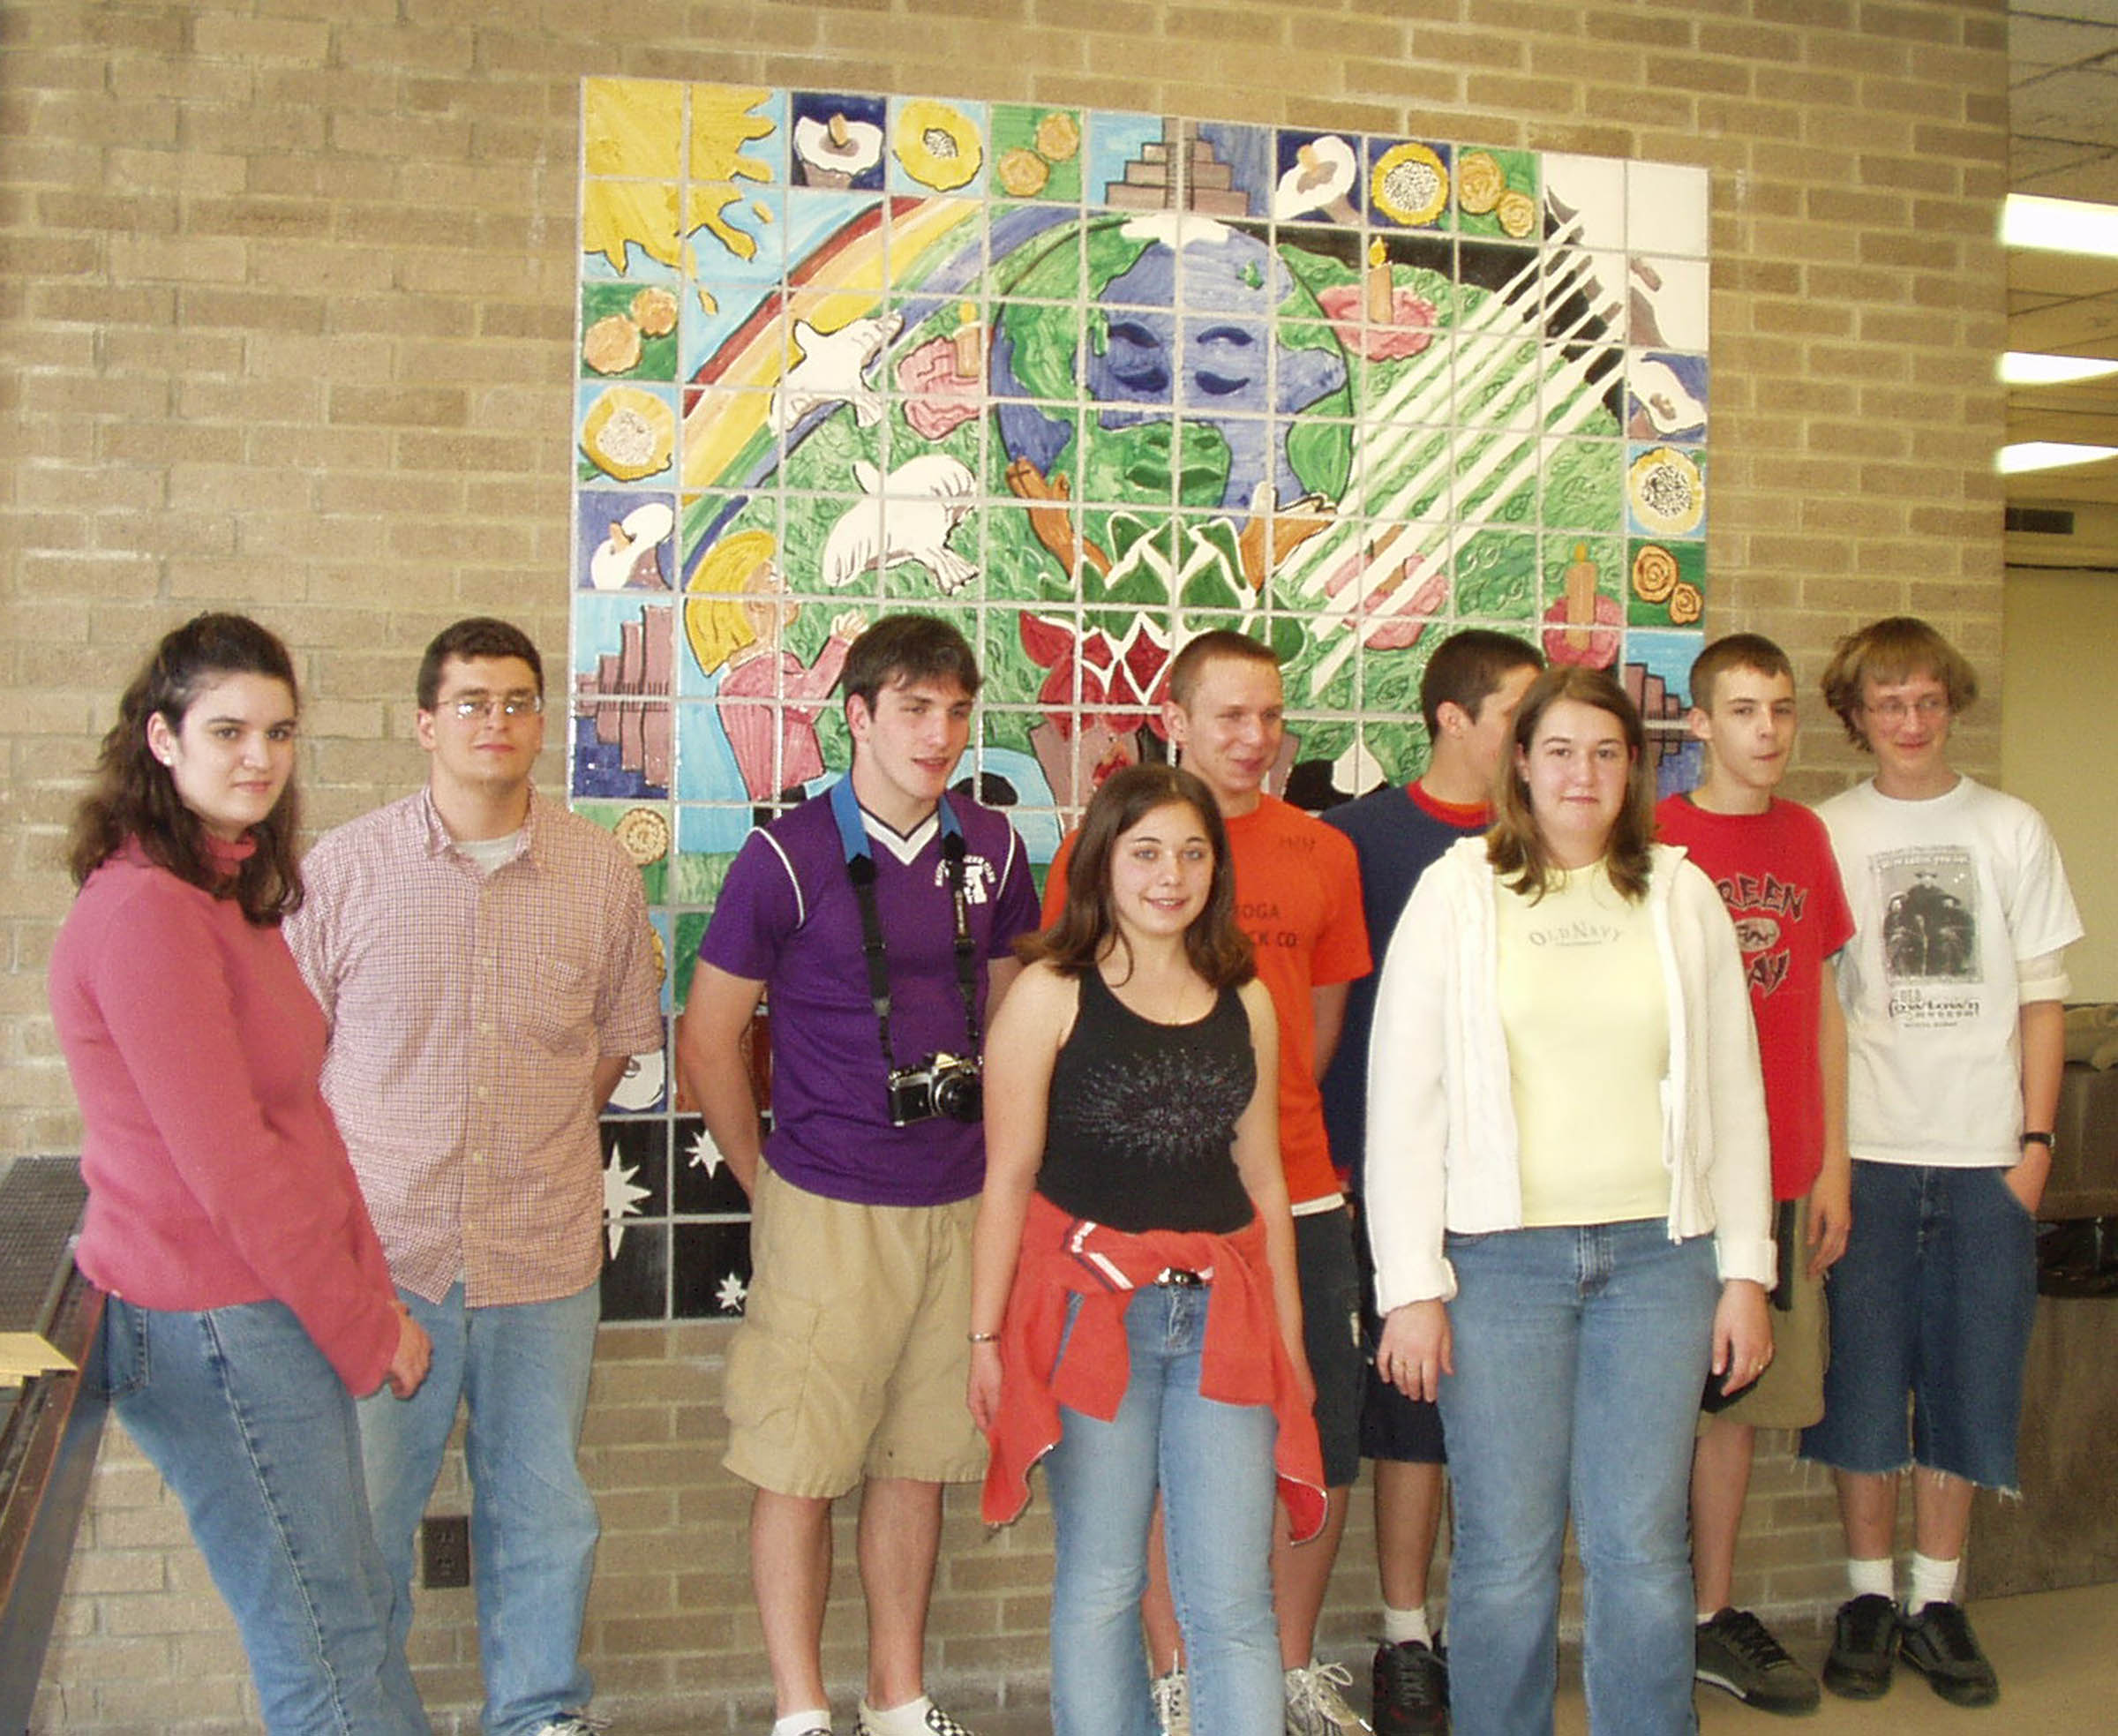
High school students who created the Arbol de la Vida ceramic tile mural

Slide 28
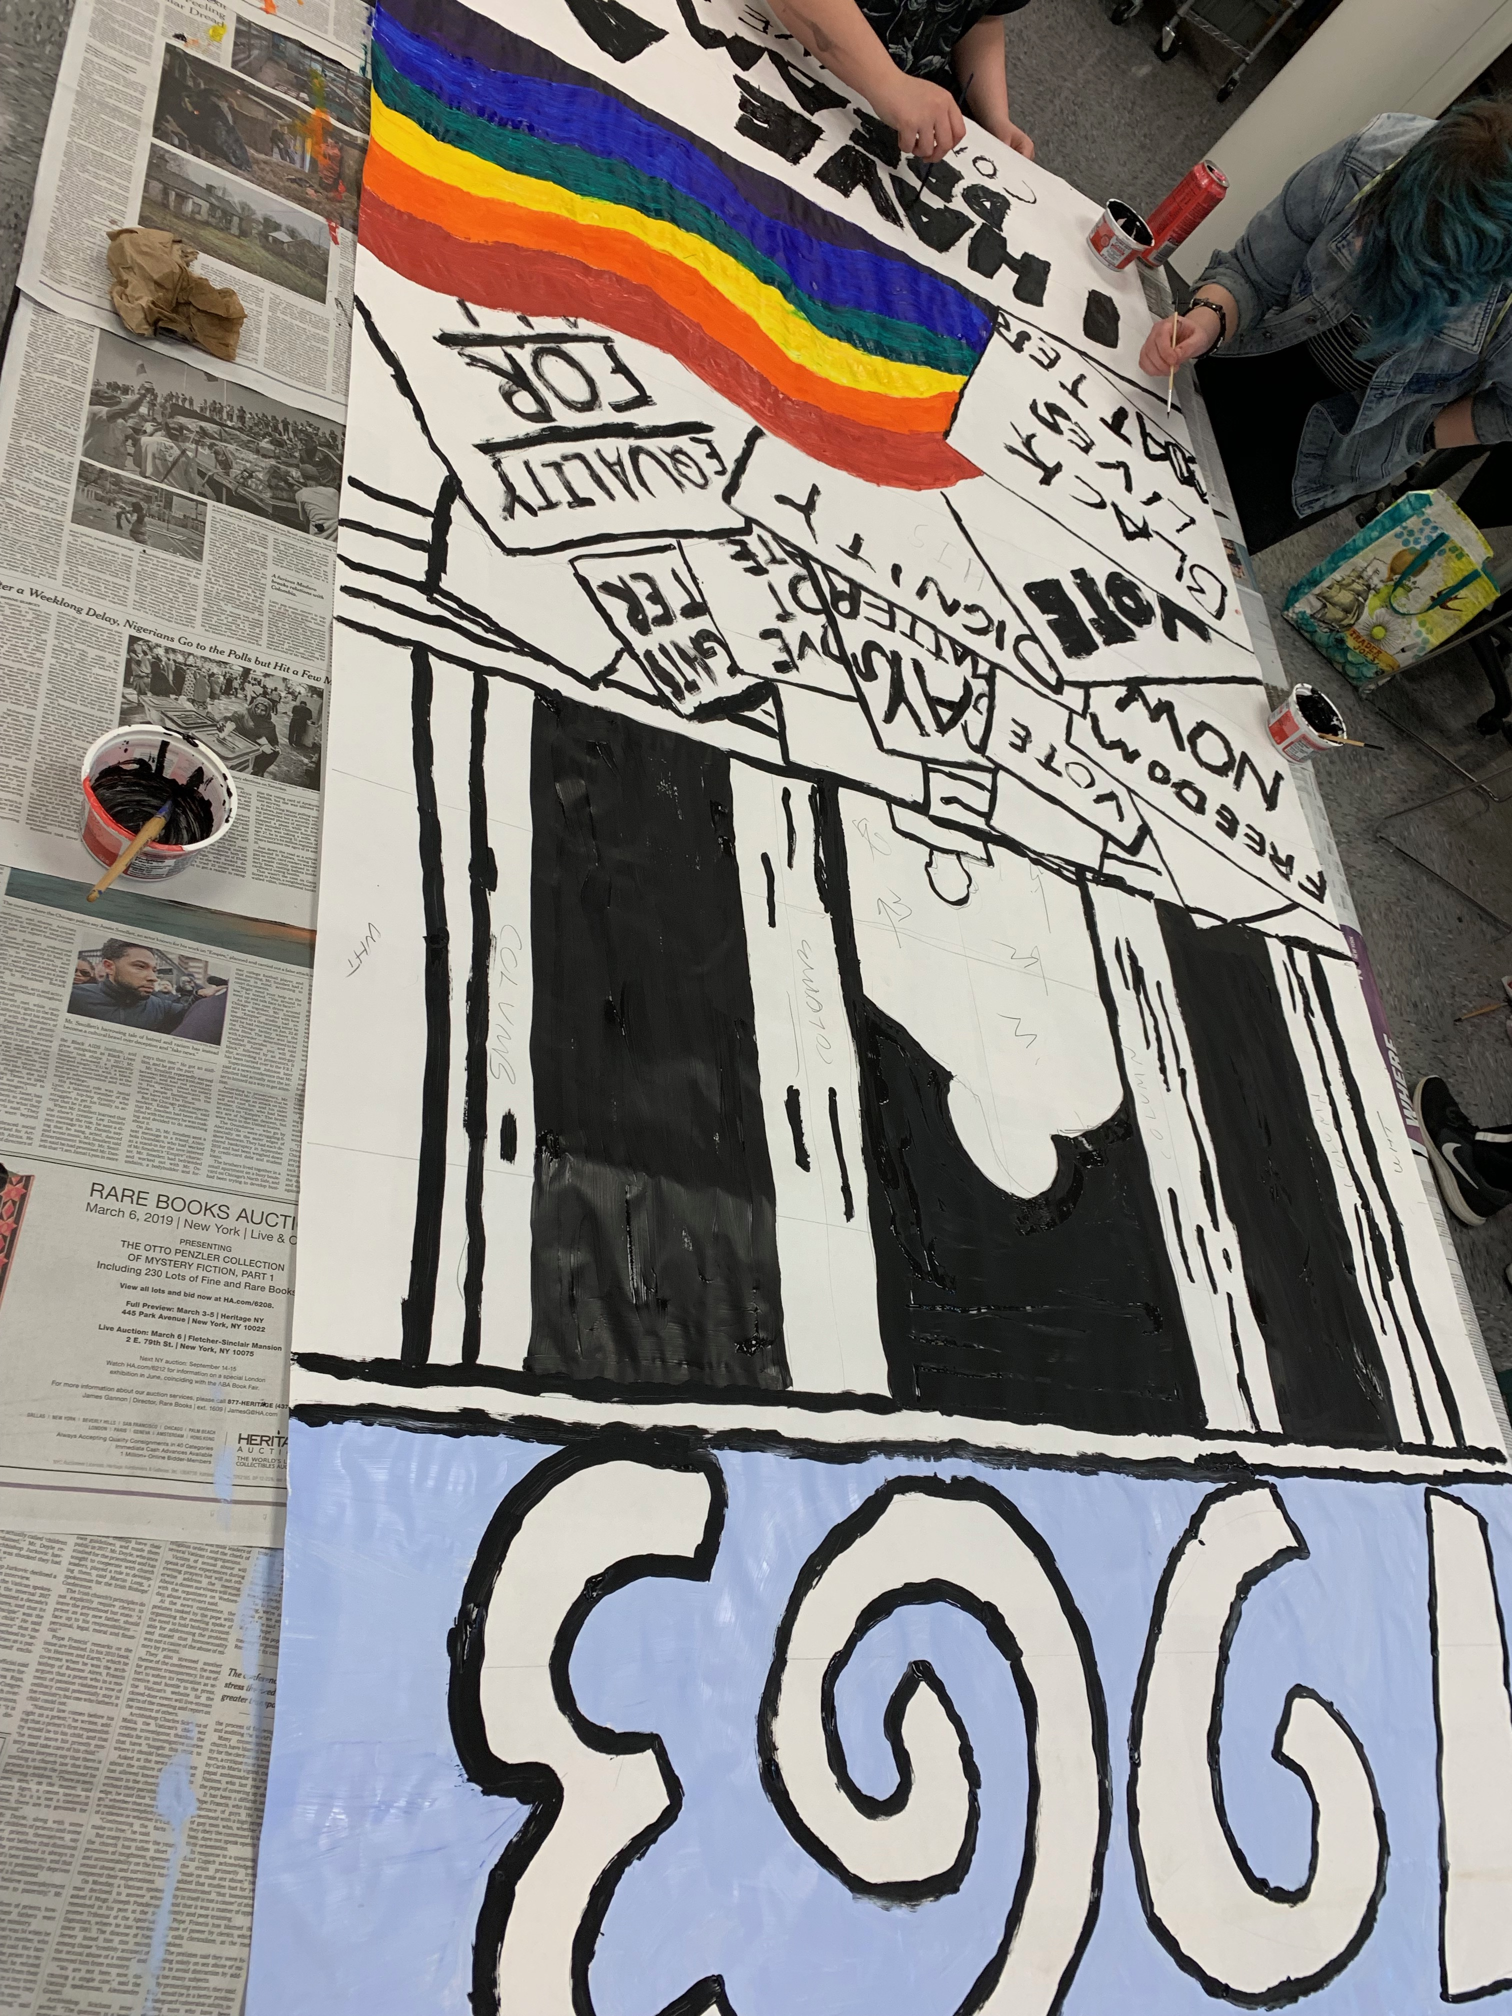
Decorating the 1963 banner for Black History Month

Slide 29
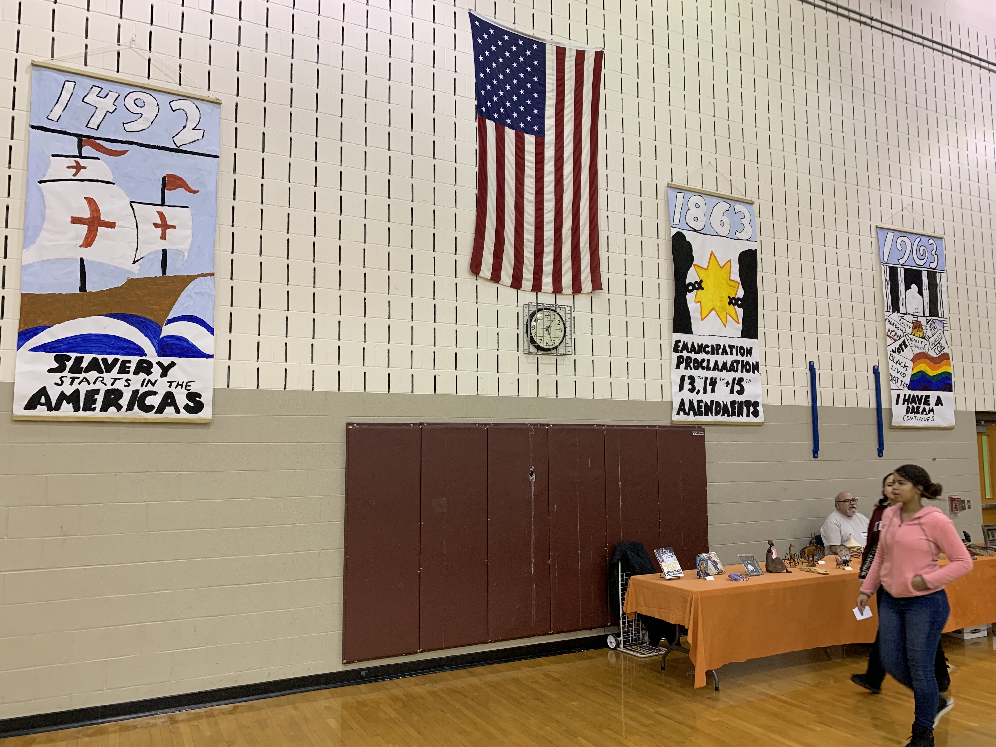
Three banners created for the culminating event of Black History Month

Slide 30
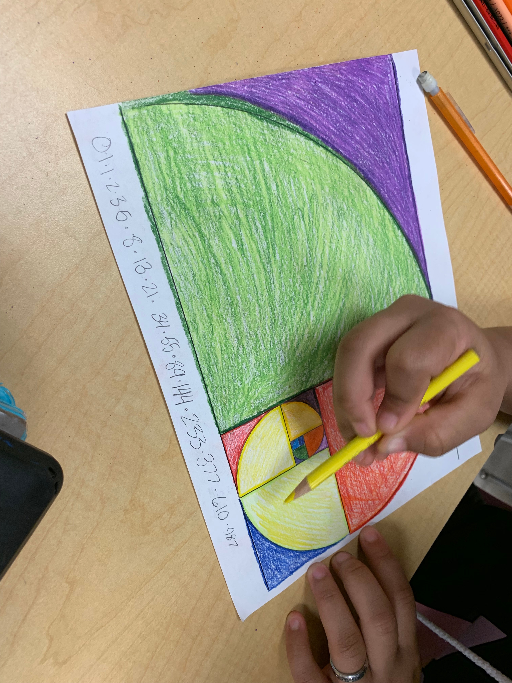
Decorating a spiral created from the Fibonacci sequence

Slide 31
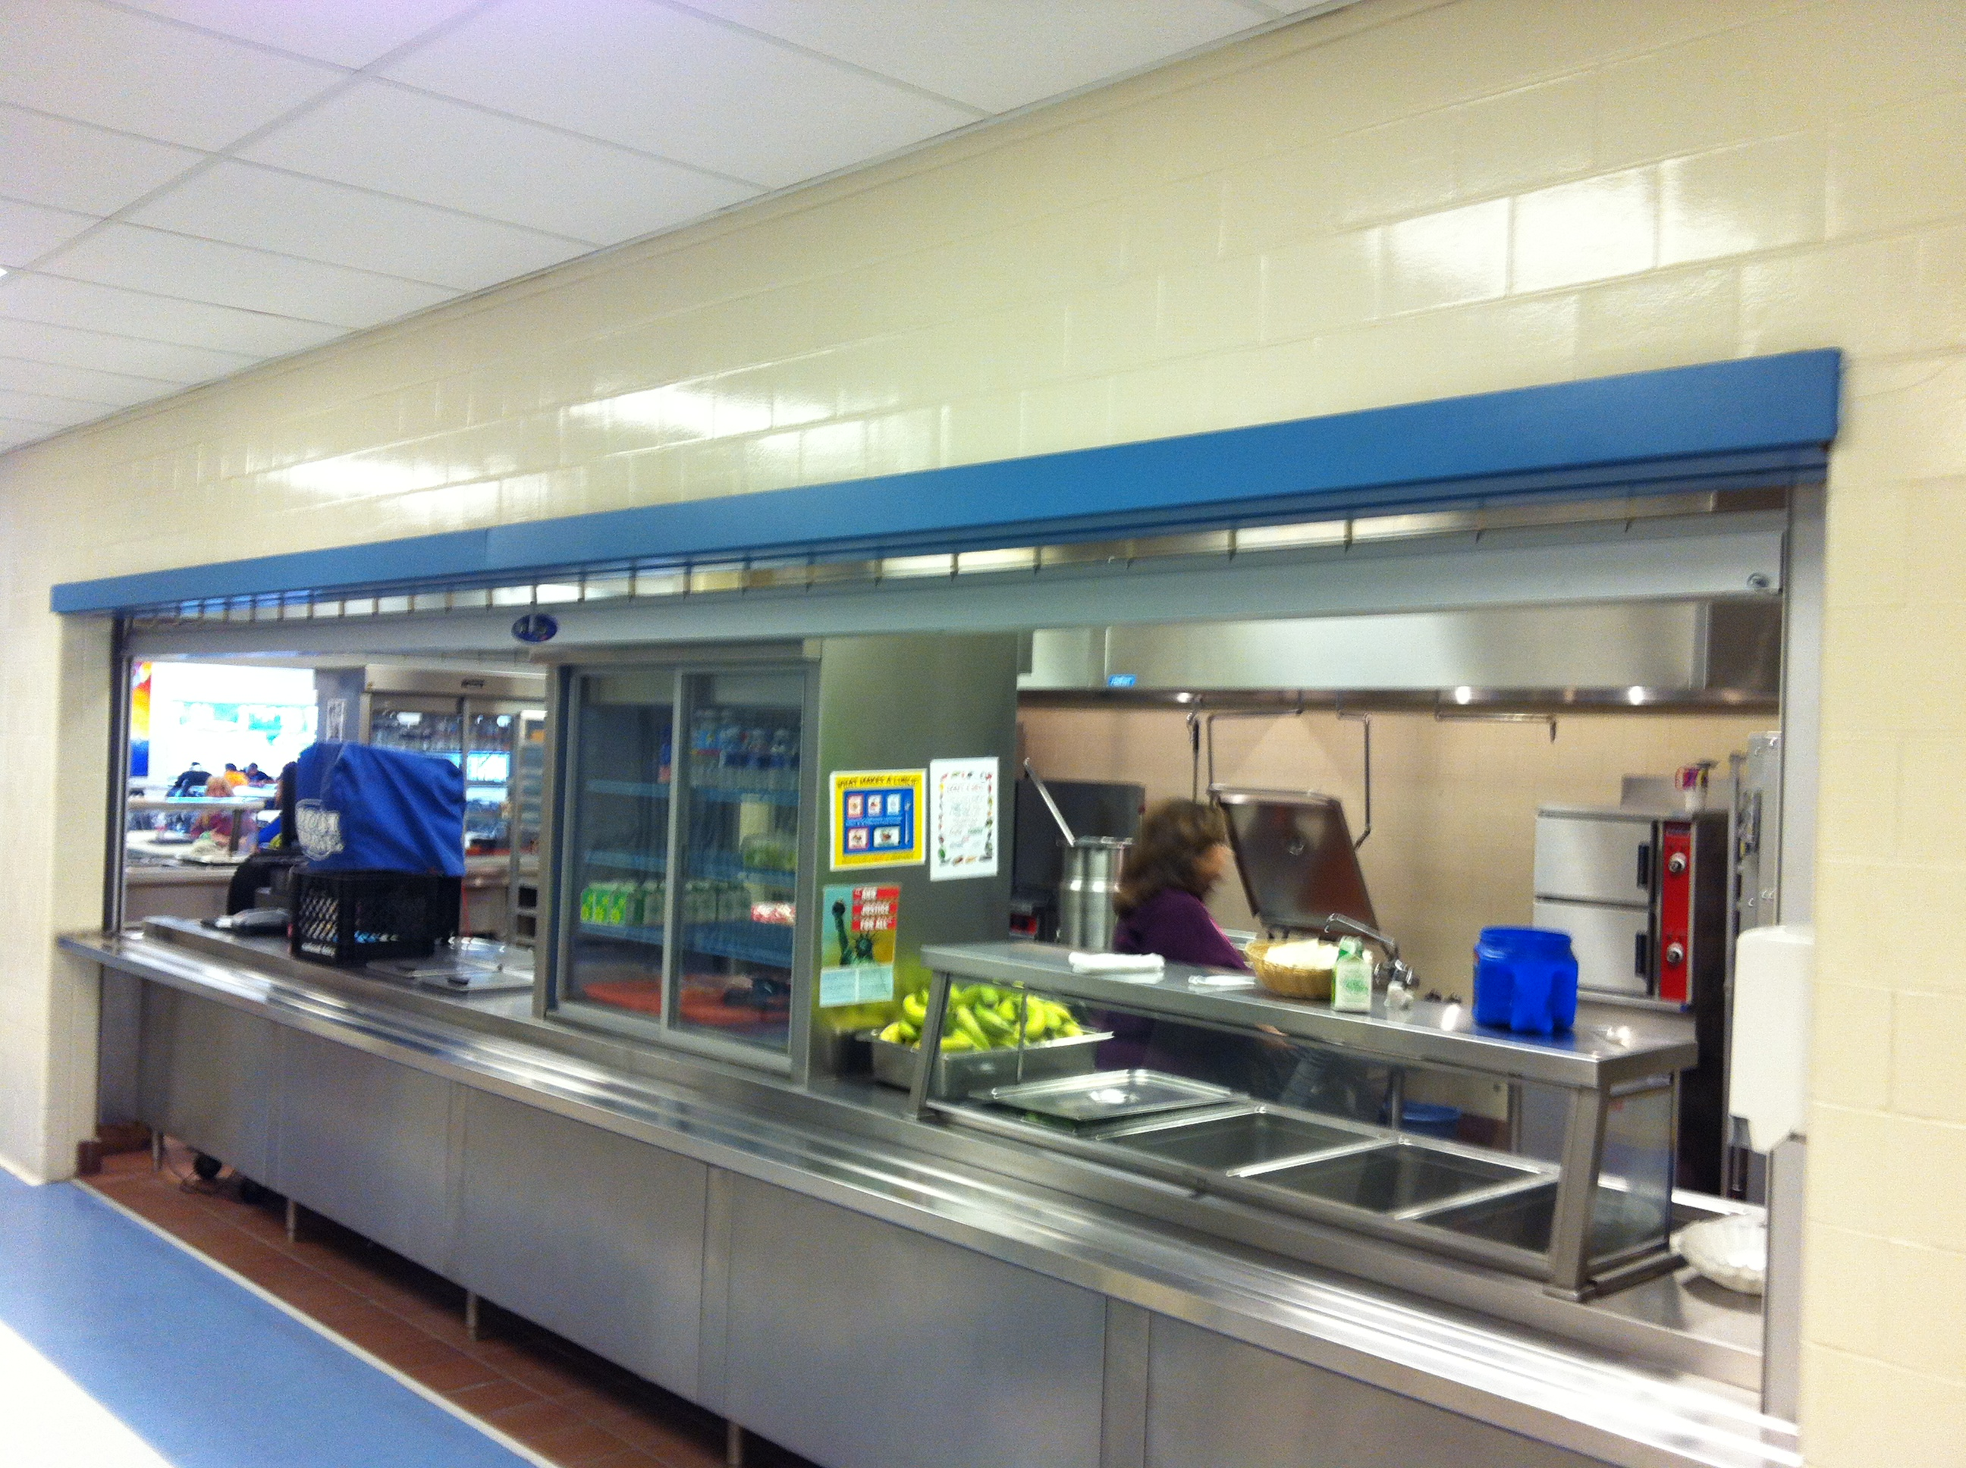
Before picture of the serving hatch at the cafeteria of Clearview High School

Slide 32
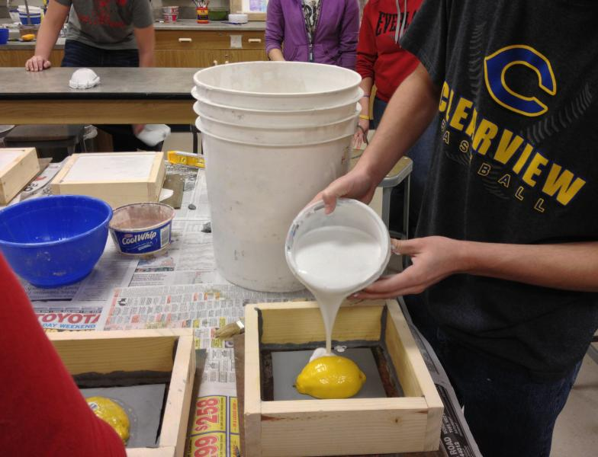
Making plaster molds from real fruits and vegetable

Slide 33
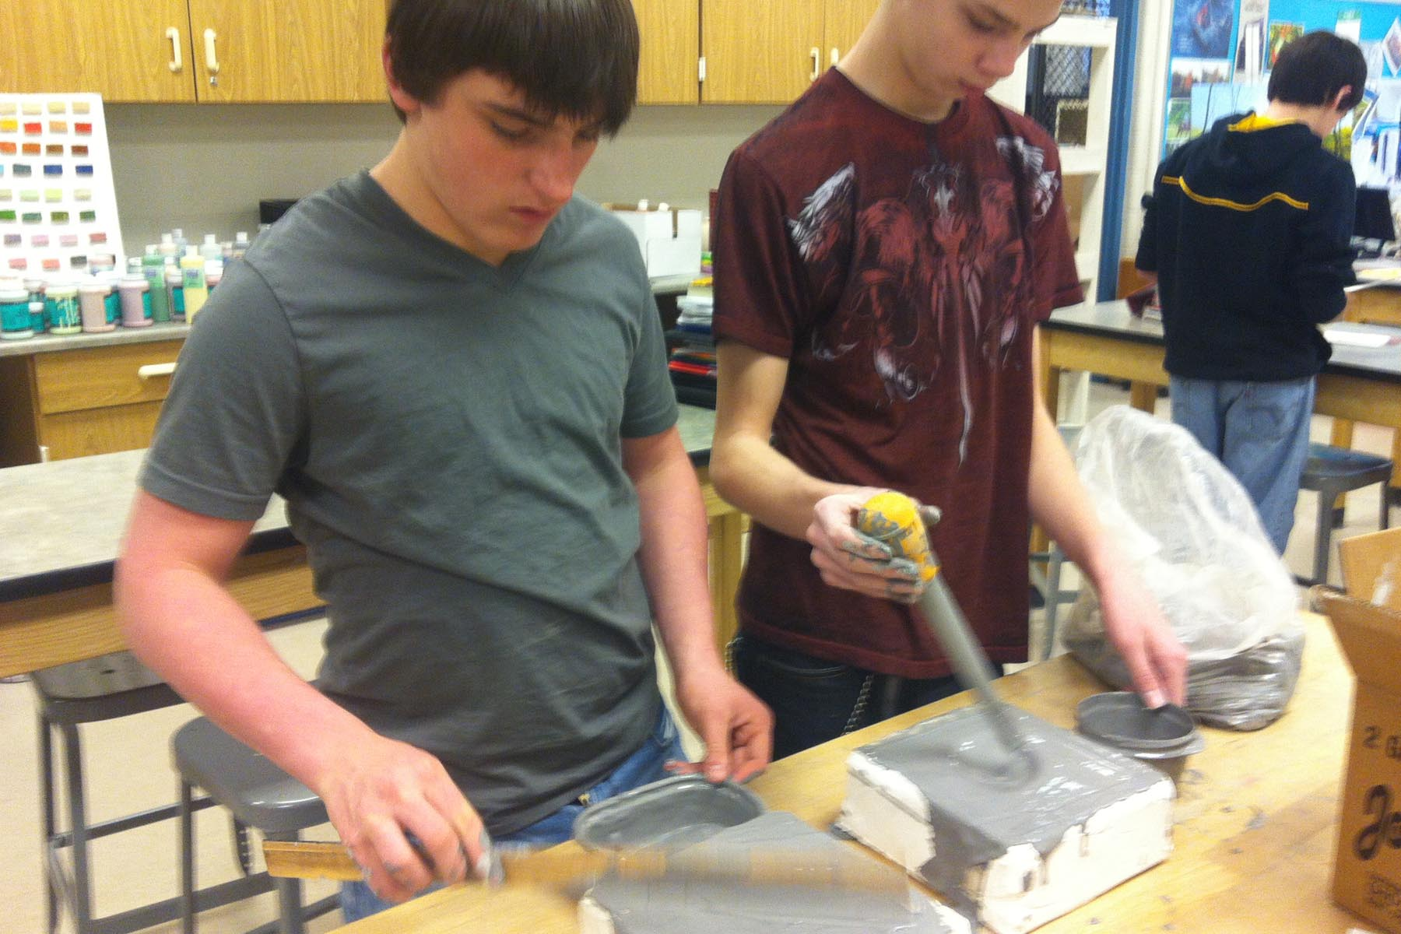
Using the molds to make tiles

Slide 34
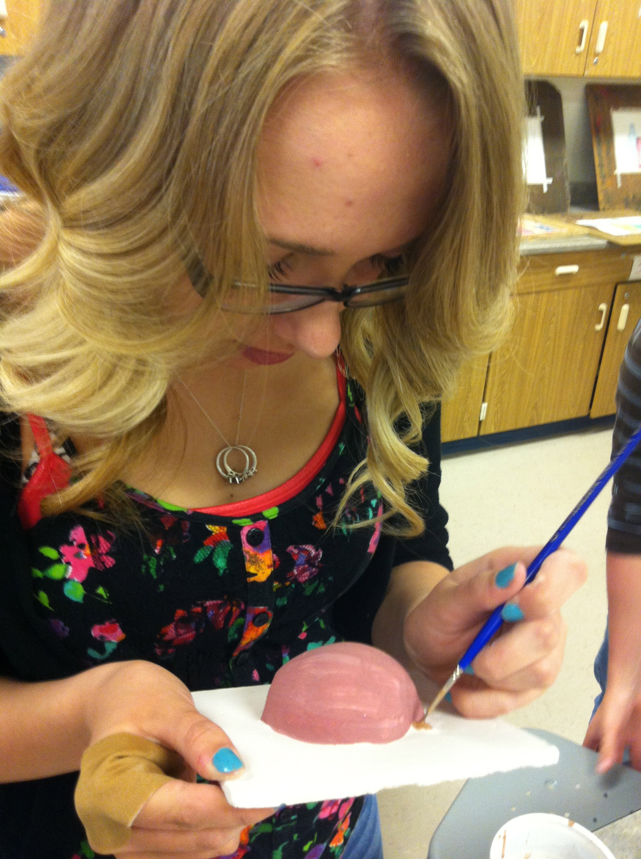
Decorating a tile with majolica glaze

Slide 35
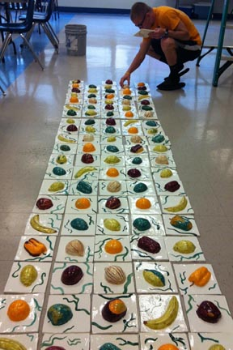
Laying out the tiles before installation

Slide 36
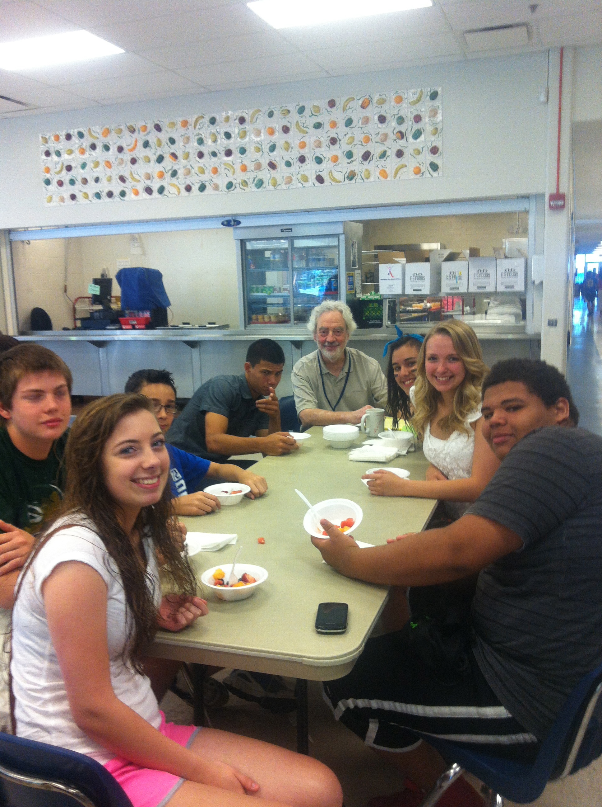
Healthy breakfast with the students who helped create the tile mural

Slide 37
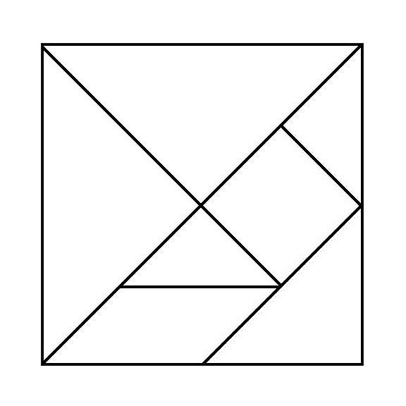
Tangram

