Slide 1

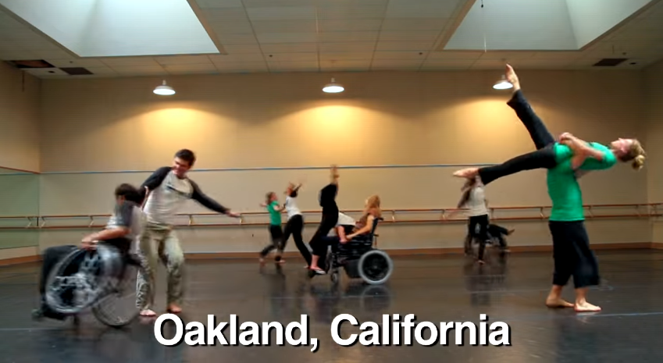


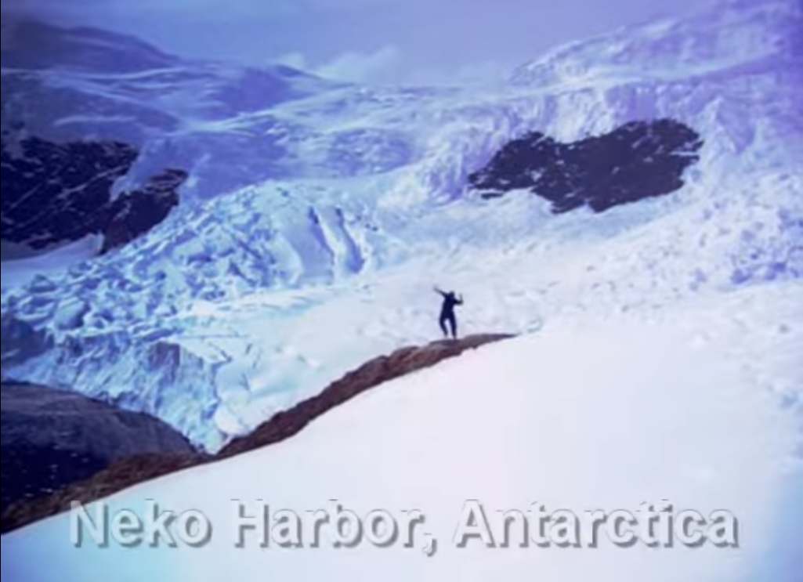
Where the Heck is Matt?
2012

Slide 2

Understanding Creativity 2:
The Seven I’s
Dr. Jennifer Groman
Ashland University
jgroman@ashland.edu
If you would like a copy of my two PowerPoint presentations, put your name and email address on the card in your bag and put it in my singing bowl before you leave.

Slide 3
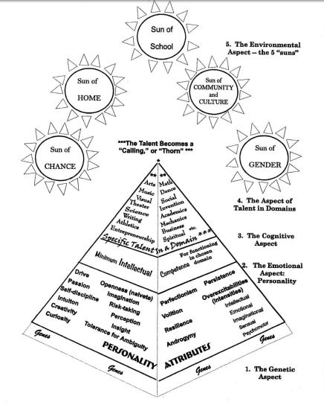
The Piirto Pyramid
(handout)

Slide 4
From Piirto’s Creativity for 21st Century Skills
“I noticed that no matter what a creator creates, the creative process is remarkably similar. There are commonalities across domains.”
“As I studied the creative processes of creators, I found no mention of the words creative problem-solving, fluency, flexibility, brainstorming, or elaboration . . . “
“. . . none of them has described the creative process in the way that it has been taught in schools for the past fifty year.”
“. . . The creative process has also been tied with desire for spiritual unity . . . “

Slide 5
From Piirto’s Creativity for 21st Century Skills
“Those who are creative seem to follow certain common practices.”
“Many of the creative and productive adults . . . seemed to have creative processes that could be divided into themes . . .
  Certain Core Attitudes toward creativity
  Experienced Seven I’s
  Engaged in certain general practices”
“Not all creators use all of these techniques, but many creators use t least some of the techniques.”

Slide 6
The Piirto Model of
Creativity Training
(handout)
 | Piirto Model of Creativity Training
 | Theme | Activities
 | Core Attitudes | Risk-taking (Princess and the Pea) Naiveté (Raisin Meditation) Group trust (Red Wounds) Tolerance for ambiguity (More than one right answer) Self-discipline (Thoughtlogs--Individuation)
 | Seven I’s | 1. Imagery (archetypes) 2. Imagination (finger painting, clay, poetry, fiction) 3. Intuition (intuition probe, psychic intuition, dreams) 4. Insight (grasping the gestalt, Aha! Zen Sketching) 5. Inspiration (Love, dreams, travel, others, ‘I’ll show you’, frustration) 6. Incubation (See Meditation) 7. Improvisation (jazz, theater, word rivers, writing practice, creative movement, rhythm and drumming, scat singing, doodling)
 | General Practices | 1. The need for solitude; 2. Creativity rituals; 3. Meditation; 4. Exercise, especially walking; 5. The quest for silence; 6. Synchronicity; 7. Divergent production practice; 8. Creativity salon; 9. Individual or group creativity projects; 10. Creativity as the process of a life; 11. Supporting—Visiting bookstores, museums, concerts, plays, movies, readings or lectures.

Slide 7
A word about
Risk-taking and
Feeding Back
 | Piirto Model of Creativity Training
 | Theme | Activities
 | Core Attitudes | Risk-taking (Princess and the Pea) Naiveté (Raisin Meditation) Group trust (Red Wounds) Tolerance for ambiguity (More than one right answer) Self-discipline (Thoughtlogs--Individuation)
 | Seven I’s | 1. Imagery (archetypes) 2. Imagination (finger painting, clay, poetry, fiction) 3. Intuition (intuition probe, psychic intuition, dreams) 4. Insight (grasping the gestalt, Aha! Zen Sketching) 5. Inspiration (Love, dreams, travel, others, ‘I’ll show you’, frustration) 6. Incubation (See Meditation) 7. Improvisation (jazz, theater, word rivers, writing practice, creative movement, rhythm and drumming, scat singing, doodling)
 | General Practices | 1. The need for solitude; 2. Creativity rituals; 3. Meditation; 4. Exercise, especially walking; 5. The quest for silence; 6. Synchronicity; 7. Divergent production practice; 8. Creativity salon; 9. Individual or group creativity projects; 10. Creativity as the process of a life; 11. Supporting—Visiting bookstores, museums, concerts, plays, movies, readings or lectures.

Slide 8
The “I” of Improvisation
Play a jazz composition based on a familiar melody and improvise on the melody. Talk about being beyond the written notes.
Play theater games – Questions Only, Props, Story Around the Circle.
Drum Circle/Found Sounds
Story telling, joke telling
Doodling and Sketchnoting
Creative Movement – Where the Heck is Matt?

Slide 9
Where the Heck is Matt?
2006

Slide 10
The “I” of Imagination
Play pretend.
Create an “imagination corner” in your classroom with materials and prompts for using imagination.
Tell a true story. Then retell it with exaggerated aspects, delighting in the imaginative and fun new story.
Emphasize using play as an initial activity for any topic, warm-up, getting acquainted.
Teach students to imagine how others think and feel – “walk in someone else’s shoes.”

Slide 11
The “I” of Intuition
Employing quick memory/recall games and exercises.
Discussing the meaning of archetypal ideas, symbols, metaphor, in stories, myths, films, etc.
Recognize that teaching itself is an intuitive process!
Pay attention to hunches, guesses, when students “just know.”
Have a discussion about intuition and students’ experience with it.
Have students make predictions – about the rest of their day, their week, what might happen when they go home.
Discuss safety issues and “gut feelings” or reactions.
Look for examples of characters (book, films) using intuition.
Respect when students skip steps to reach a correct conclusion.
Zen Sketching

Slide 12
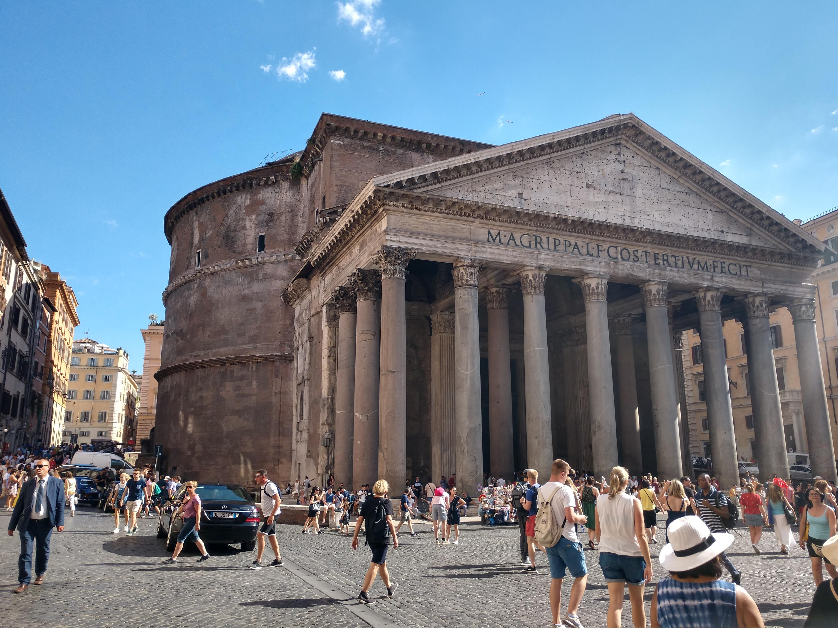

Slide 13
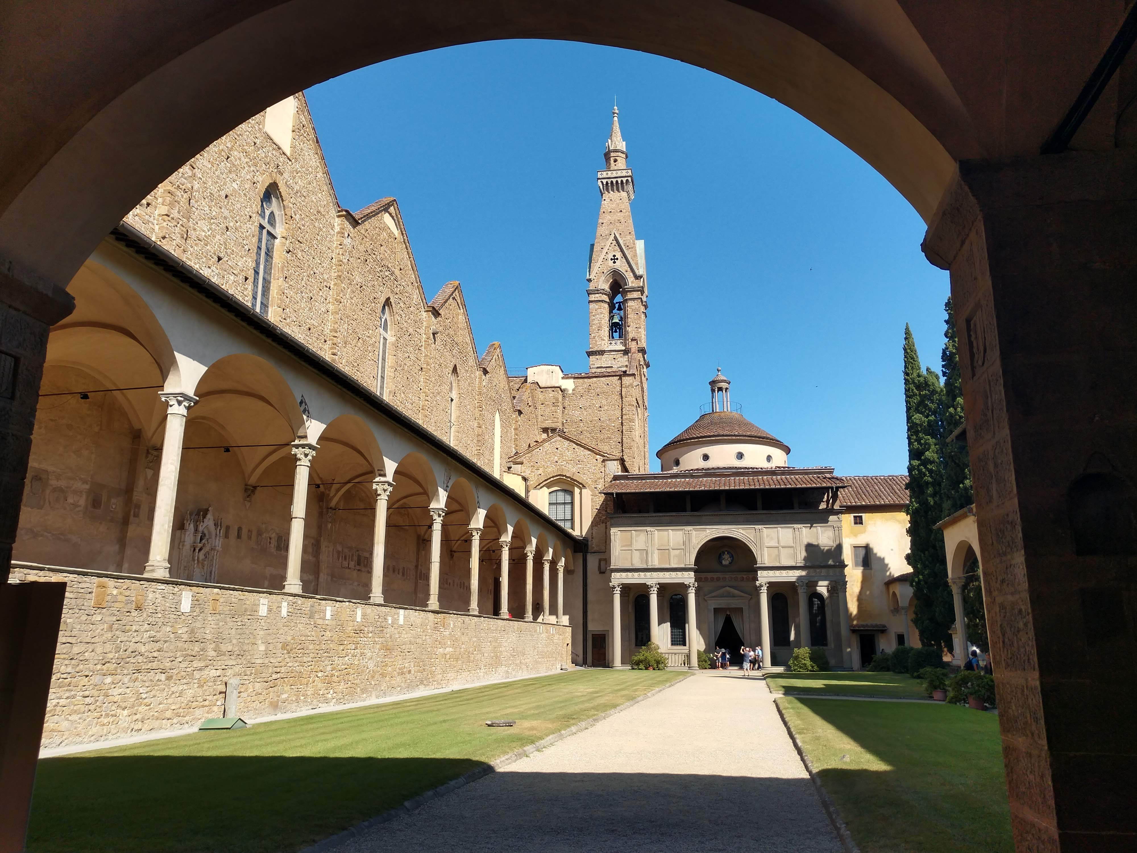

Slide 14
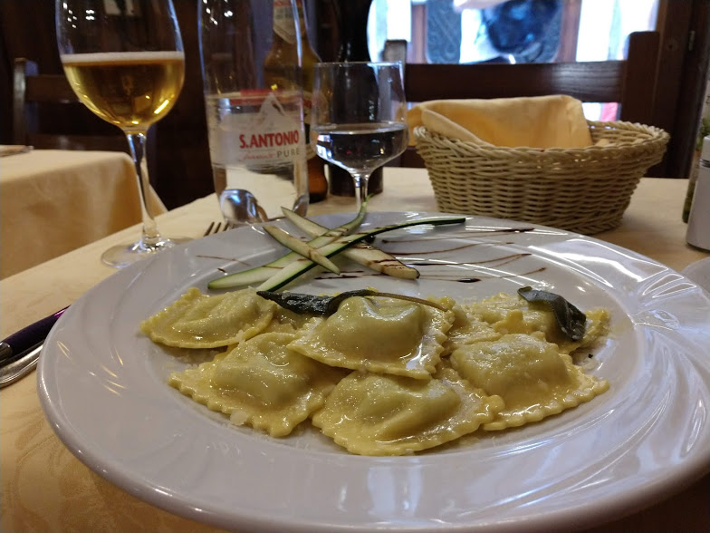

Slide 15
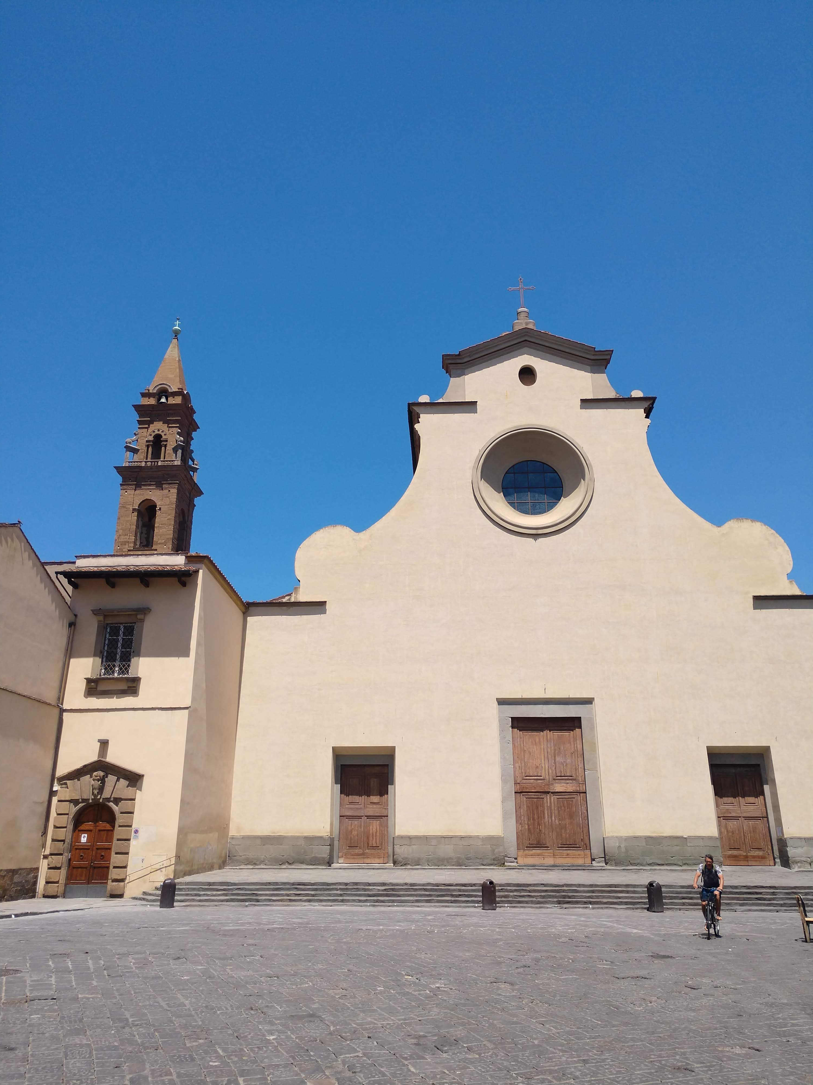

Slide 16
Thoughts about Zen Sketching?

Slide 17
The “I” of Insight
Intentionally define insight and talk about it, discuss it with students.
Keep a list of students’ insights and post it.
Talk about insights and solving problems – give students a problem without a single solution.
Discuss how dreams (day and nighttime dreams!) can provide insight. Also walking, driving, gardening, bathing, repetitive or (seemingly) menial work can open the mind to insights. This is where insight and incubation work together.
Up Close and Personal Sketches

Slide 18
The “I” of Inspiration. Inspiration of . . .
…Love – notice how Love is the subject of music, literature, film.
…Nature – conduct class outside/outdoor education experience, plant a garden, display nature photos, nature meditations.
…Transcendent Experience – teach tolerance, see how education transforms individuals, culture, emphasize Purpose, the Whole Child, spiritual education, study the foundations of various faiths, works of art, respect stories of transcendent experiences.
…Through substances – study creative individuals who often suffer with substance abuse. Substances mimic the “high” experienced in creative work, or are part of the risk-taking experience, or are used to cope with inner/outer expectations or vulnerability.

Slide 19
The “I” of Inspiration. Inspiration of . . .
…Other’s creativity – talk about your own creative work, keep creative work in your classrooms in the form of posters, literature, images, sayings, inventions. Instead of Current Events, have students share creative work (their music included!) that inspires.
…Dreams – talk about dreams, tell the dream’s story and include images, metaphors, symbols, archetypes.
…Travel and Novel Surroundings – take a new route, take a trip (virtual trips through travel photos, videos, websites work in the classroom, too!), have students talk about trips, have them keep a thoughtlog if they travel during school time.

Slide 20
The “I” of Inspiration. Inspiration of . . .
…The Dark Side – read Poe, play protest songs, read slave narratives, discuss the holocaust and the force of human resilience, during dark times creative work can truly soothe and help students process.
…of Injustice – have students conduct research about a social justice issue or community service project, encourage students’ questions, sensitivities, and solutions about issues.
…of “I’ll Show You!” – talk about famous individuals who have overcome initial rejection.

Slide 21
The Inspiration of Rejection
Stephen King – Carrie rejected 30 times.
Dr. Seuss – tried 27 times before getting published.
Milton Hershey – failed in business 3 times before his success.
Albert Einstein – did not speak until age 4, called Lazy by his teacher.
Benjamin Franklin – an elementary school dropout.
Thomas Edison – failed over 1,000 times before creating the right balance for the light bulb.
Walt Disney – fired by a newspaper for “not being creative enough.”
https://www.entrepreneur.com/article/249961

Slide 22
The “I” of Incubation
Give time for transitions – use music or sound, dimmed lights, meditation time or simple chair yoga moves to calm students.
Provide time and materials for processing ideas before writing or sharing.
Use Wait Time.
Thoughtlogs, sketchbooks, writing journals are all good ways to “think things through.”

Slide 23
The “I” of Imagery
Have students create an image or visual for things they need to remember.
Visualize what it would feel like to reach a goal or overcome an obstacle.
Practice creating images from thoughts.
Mentally imagine a lemon and mentally “eat” it. Feel your taste buds react to the sourness – this is gustatory imagery. Write about it.
Mentally imagine yourself accomplishing something amazing. Take yourself through the whole process, all of the steps. Make a flow chart or graphic.
Mentally imagine the voice of your mother, father, or favorite individual saying something supportive to you. Imitate him/her.
Mentally imagine a pet’s soft fur, picking up a small baby, climbing into a warm bed.
Creativity Monster – creating and Feeding Back

Slide 24
Essential Tool: Feeding Back
What did you mean?
What is this?
That’s really cool!
I don’t like that.
I don’t get it.
*Empty Silence*
This reminds me of . . .
Give a descriptive adjective or phrase.
The work resembles . . .
I see . . .
To me this means . . .
Awe - *silence*
Answering with Art (poetry, sketch, song)
Feeding Back is. . . Feeding Back is not . . .

Slide 25
Review
What are your ideas?
 | Piirto Model of Creativity Training
 | Theme | Activities
 | Core Attitudes | Risk-taking (Princess and the Pea) Naiveté (Raisin Meditation) Group trust (Red Wounds) Tolerance for ambiguity (More than one right answer) Self-discipline (Thoughtlogs--Individuation)
 | Seven I’s | 1. Imagery (archetypes) 2. Imagination (finger painting, clay, poetry, fiction) 3. Intuition (intuition probe, psychic intuition, dreams) 4. Insight (grasping the gestalt, Aha! Zen Sketching) 5. Inspiration (Love, dreams, travel, others, ‘I’ll show you’, frustration) 6. Incubation (See Meditation) 7. Improvisation (jazz, theater, word rivers, writing practice, creative movement, rhythm and drumming, scat singing, doodling)
 | General Practices | 1. The need for solitude; 2. Creativity rituals; 3. Meditation; 4. Exercise, especially walking; 5. The quest for silence; 6. Synchronicity; 7. Divergent production practice; 8. Creativity salon; 9. Individual or group creativity projects; 10. Creativity as the process of a life; 11. Supporting—Visiting bookstores, museums, concerts, plays, movies, readings or lectures.

Slide 26
Other ideas
Have students read scholarly biographies of creative individuals, looking for these themes. Discuss challenges of creativity and giftedness, negative responses and positive coping skills.
“Feeding Back” can be used in many ways in the classroom to help students support one another’s creativity and look more deeply into the work of others.
Incubation, meditation, naivete are all good stress relievers. Bonus!

Slide 27
Other ideas
Share your own creative endeavors and positive risk-taking experiences.
Encourage creative self-discipline when you see talent or interest in a creative domain.
Remember - creativity is not limited to the visual and performing arts! Creativity domains include mathematics, science, writing, athletics, architecture and technical drawing, computer science, design, problem solving and invention, entrepreneurship, and leadership.

Slide 28
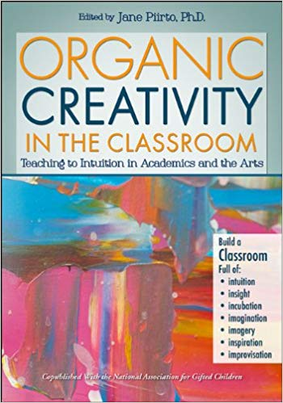
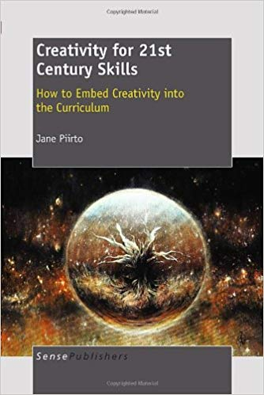

References
Piirto, J. (2013). Organic creativity in the classroom: Teaching to
intuition in academics and the arts. Waco, TX: Prufrock Press.
Piirto, J. (2011). Creativity for 21st century learning: How to embed
creativity into the curriculum. Rotterdam: Sense Publishing.
Piirto, J. (2004). Understanding creativity. Scottsdale, AZ: Great
Potential Press.
If you would like a copy of my two PowerPoint presentations, put your name and email address on the card in your bag and put it in my singing bowl before you leave.

Slide 29
My articles
Groman, J. (2014). The mirror: Creativity as seeing and being seen: Authoethnography of a
teacher. In J. Piirto (Ed.), Organic creativity in the classroom: Teaching to intuition in academics and the arts (pp. 267-283). Waco, TX: Prufrock Press.
Groman, J. L. (2015). What matters: Using art-based methods to sculpt preservice
teachers’ philosophical beliefs. International Journal of Education and the Arts (16)2. 1-17.
Groman, J.L. (in press). The bully’s face: Using art to understand bullying in gifted children. Gifted Child Today (Fall, 2018 or Spring, 2019).

