Slide 1

Understanding Creativity I:
The Pyramid and The Suns
Dr. Jennifer Groman
Ashland University
jgroman@ashland.edu
If you would like a copy of my two PowerPoint presentations, put your name and email address on the card in your bag and put it in my singing bowl before you leave.

Slide 2
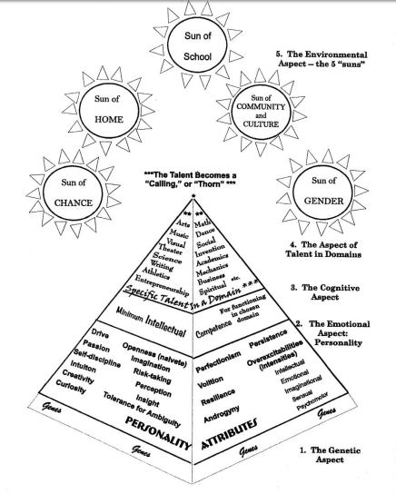
The Piirto Pyramid
(handout)

Slide 3
From Piirto’s Creativity for 21st Century Skills
“I noticed that no matter what a creator creates, the creative process is remarkably similar. There are commonalities across domains.”
“As I studied the creative processes of creators, I found no mention of the words creative problem-solving, fluency, flexibility, brainstorming, or elaboration . . . “
“. . . none of them has described the creative process in the way that it has been taught in schools for the past fifty year.”
“. . . The creative process has also been tied with desire for spiritual unity . . . “

Slide 4
From Piirto’s Creativity for 21st Century Skills
“Those who are creative seem to follow certain common practices.”
“Many of the creative and productive adults . . . seemed to have creative processes that could be divided into themes . . .
  Certain Core Attitudes toward creativity
  Experienced Seven I’s
  Engaged in certain general practices”
“Not all creators use all of these techniques, but many creators use at least some of the techniques.”

Slide 5
The Piirto Model of
Creativity Training
(handout)
 | Piirto Model of Creativity Training
 | Theme | Activities
 | Core Attitudes | Risk-taking (Princess and the Pea) Naiveté (Raisin Meditation) Group trust (Red Wounds) Tolerance for ambiguity (More than one right answer) Self-discipline (Thoughtlogs--Individuation)
 | Seven I’s | 1. Imagery (archetypes) 2. Imagination (finger painting, clay, poetry, fiction) 3. Intuition (intuition probe, psychic intuition, dreams) 4. Insight (grasping the gestalt, Aha! Zen Sketching) 5. Inspiration (Love, dreams, travel, others, ‘I’ll show you’, frustration) 6. Incubation (See Meditation) 7. Improvisation (jazz, theater, word rivers, writing practice, creative movement, rhythm and drumming, scat singing, doodling)
 | General Practices | 1. The need for solitude; 2. Creativity rituals; 3. Meditation; 4. Exercise, especially walking; 5. The quest for silence; 6. Synchronicity; 7. Divergent production practice; 8. Creativity salon; 9. Individual or group creativity projects; 10. Creativity as the process of a life; 11. Supporting—Visiting bookstores, museums, concerts, plays, movies, readings or lectures.

Slide 6
Core Attitude of Risk Taking
Demonstrate your own risk-taking.
Create a classroom atmosphere that encourages intellectual and creative risks. Discuss what that means.
Make a spot in your classroom a creative “safe zone.”
Do trust activities.
Make sure students know how they will be assessed on assignments.
“Princess and the Pea.”
“Music from My Life.”
The Drumming Circle / Found Sounds.
Partner drawing.
Sculpture – “What Matters?”

Slide 7
Core Attitude of Self-Discipline
Discuss self-discipline with students and as for their own ideas.
Discuss long-term and short-term goal setting.
Do a visualization where students look into their own future – a month, a year, five years.
Break long-term assignments into smaller steps.
Discuss frequent excuses for not achieving goals
Value hard work – the process, not the product.
What does self-discipline look like in different domains?
    Music, athletics, foreign language, art, creative writing, scholarly writing, invention, theater, mathematics)

Slide 8
Core Attitude of Naivete (Openness to Experience)
Create a climate of mindfulness – allow time for settling in.
Look at something from different points of view.
Notice small things when you share, ask for specifics when students share.
See connections between unlike things.
Notice small details of student work.
Talk about how traveling opens you to new experiences.
Invent a new use for an object or improve on a tool or object.
Up Close and Personal Sketches
The Raisin Meditation (also Incubation, Meditation)

Slide 9


Slide 10
Core Attitude of Tolerance for Ambiguity
Create a climate that allows for opposing viewpoints.
Ask open-ended questions with no right answer – “What is good art?”
Start a debate society.
Have students list questions that have no Right Answer.
Read and discuss a novel, poem, or film.
Practice the Myers-Briggs Type Indicator “P” Perceiving preference – not making lists, waiting until the last minute, doing things spur of the moment, going in without a plan.
Do the Creative Problem Solving process of Divergent Production

Slide 11
Core Attitude of Group Trust
This is very closely related to the Core Attitude of Risk-Taking (Vulnerability)
Model supportive behavior when anyone tries something new, something challenging, or takes a risk.
Practice giving non-judgmental feedback.
When a pattern of negative behavior begins, change the behavior by taking the person aside to discuss it privately.
Use sincere compliments, expect the same from students.
Push students to challenge themselves, then celebrate their successful and non-successful attempts.
Sharing personal and creative work using the Feeding Back Prompts.

Slide 12
Essential Tool: Feeding Back
What did you mean?
What is this?
That’s really cool!
I don’t like that.
I don’t get it.
*Empty Silence*
This reminds me of . . .
Give a descriptive adjective or phrase.
The work resembles . . .
I see . . .
To me this means . . .
Awe - *silence*
Answering with Art (poetry, sketch, song)
Feeding Back is. . . Feeding Back is not . . .

Slide 13
Other General Practices
The need for solitude | Silent alone reading or writing time
Rituals | Starting the day, ending the day with the same words or actions
Meditation | Walking or finger labyrinths, breathing exercises
Exercise | Walking in nature, playground time, active games
The Quest for Silence | Meditation, encouraging and supporting silent working time
Synchronicity | Looking for small connections
Creativity “salon” | Joining together to share creative works, “Poetic License”
Supporting creative places | Art museums, book stores, galleries, studios,

Slide 14
Review
What are your ideas?
 | Piirto Model of Creativity Training
 | Theme | Activities
 | Core Attitudes | Risk-taking (Princess and the Pea) Naiveté (Raisin Meditation) Group trust (Red Wounds) Tolerance for ambiguity (More than one right answer) Self-discipline (Thoughtlogs--Individuation)
 | Seven I’s | 1. Imagery (archetypes) 2. Imagination (finger painting, clay, poetry, fiction) 3. Intuition (intuition probe, psychic intuition, dreams) 4. Insight (grasping the gestalt, Aha! Zen Sketching) 5. Inspiration (Love, dreams, travel, others, ‘I’ll show you’, frustration) 6. Incubation (See Meditation) 7. Improvisation (jazz, theater, word rivers, writing practice, creative movement, rhythm and drumming, scat singing, doodling)
 | General Practices | 1. The need for solitude; 2. Creativity rituals; 3. Meditation; 4. Exercise, especially walking; 5. The quest for silence; 6. Synchronicity; 7. Divergent production practice; 8. Creativity salon; 9. Individual or group creativity projects; 10. Creativity as the process of a life; 11. Supporting—Visiting bookstores, museums, concerts, plays, movies, readings or lectures.

Slide 15
Other ideas
Have students read scholarly biographies of creative individuals, looking for these themes. Discuss challenges of creativity and giftedness, negative responses and positive coping skills.
“Feeding Back” can be used in many ways in the classroom to help students support one another’s creativity and look more deeply into the work of others.
Incubation, meditation, naivete are all good stress relievers. Bonus!

Slide 16
Other ideas
Share your own creative endeavors and positive risk-taking experiences.
Encourage creative self-discipline when you see talent or interest in a creative domain.
Remember - creativity is not limited to the visual and performing arts! Creativity domains include mathematics, science, writing, athletics, architecture and technical drawing, computer science, design, problem solving and invention, entrepreneurship, and leadership.

Slide 17
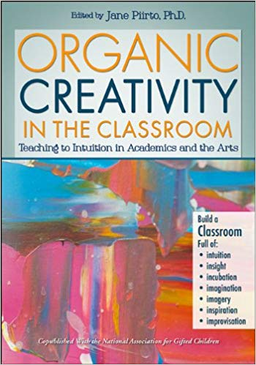
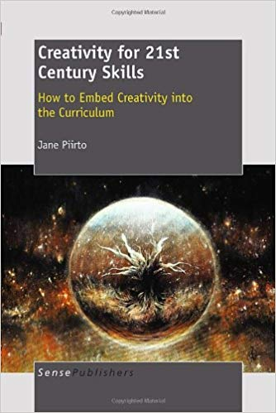

References
Piirto, J. (2013). Organic creativity in the classroom: Teaching to
intuition in academics and the arts. Waco, TX: Prufrock Press.
Piirto, J. (2011). Creativity for 21st century learning: How to embed
creativity into the curriculum. Rotterdam: Sense Publishing.
Piirto, J. (2004). Understanding creativity. Scottsdale, AZ: Great
Potential Press.
If you would like a copy of my two PowerPoint presentations, put your name and email address on the card in your bag and put it in my singing bowl before you leave.

Slide 18
My articles
Groman, J. (2014). The mirror: Creativity as seeing and being seen: Authoethnography of a
teacher. In J. Piirto (Ed.), Organic creativity in the classroom: Teaching to intuition in academics and the arts (pp. 267-283). Waco, TX: Prufrock Press.
Groman, J. L. (2015). What matters: Using art-based methods to sculpt preservice
teachers’ philosophical beliefs. International Journal of Education and the Arts (16)2. 1-17.
Groman, J.L. (in press). The bully’s face: Using art to understand bullying in gifted children. Gifted Child Today (Fall, 2018 or Spring, 2019).

