Slide 1
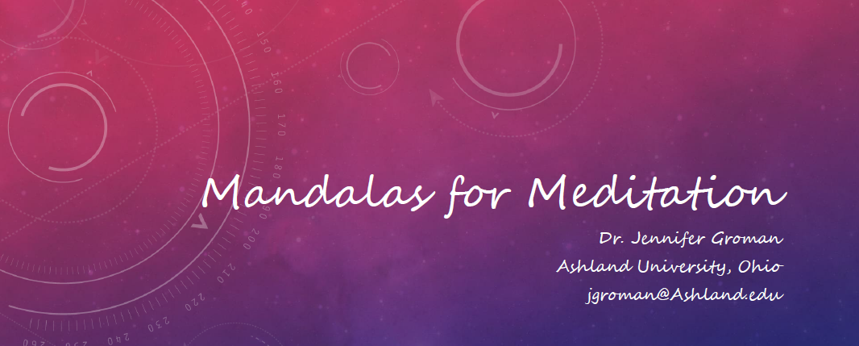

Slide 2
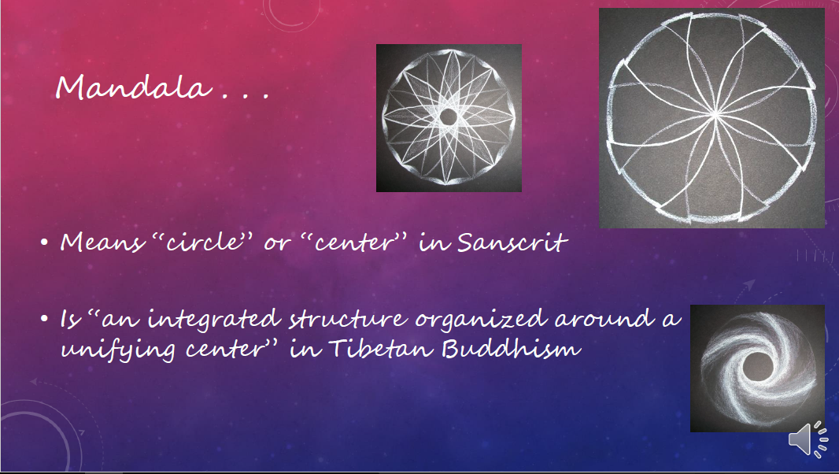

Slide 3
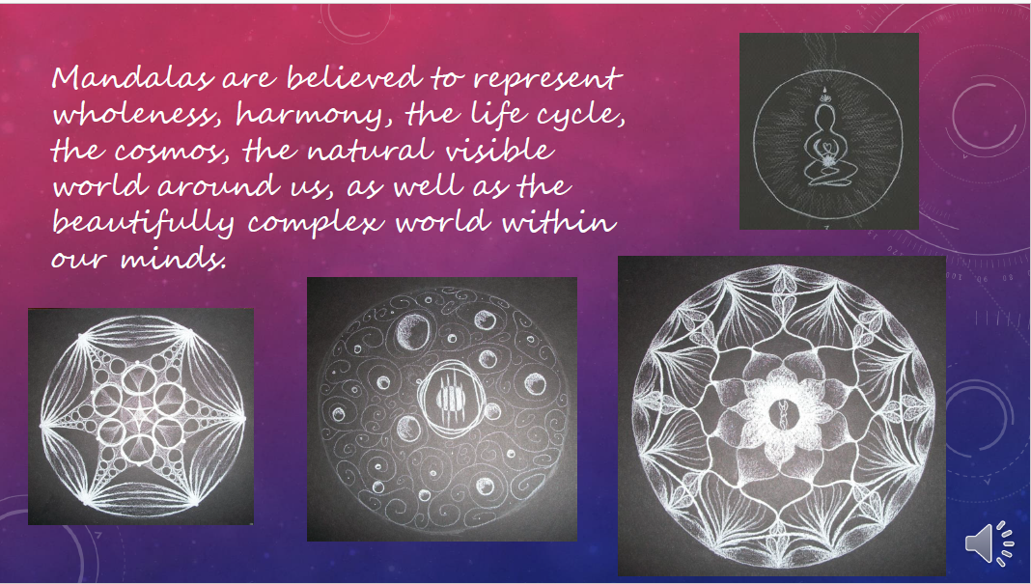

Slide 4
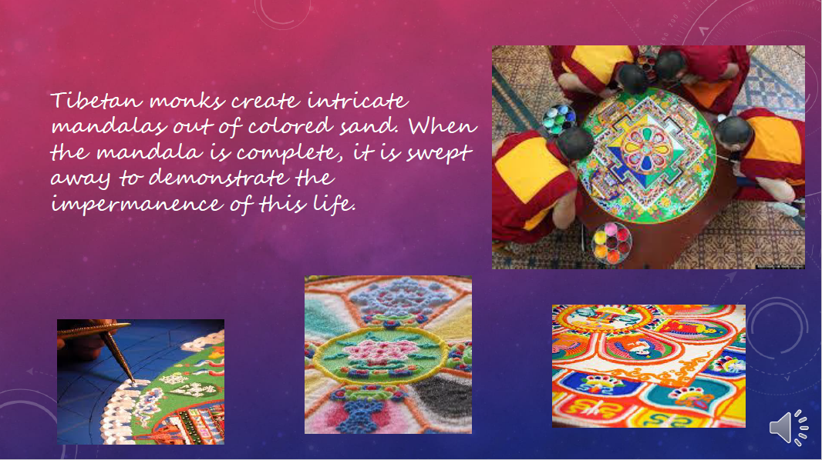

Slide 5
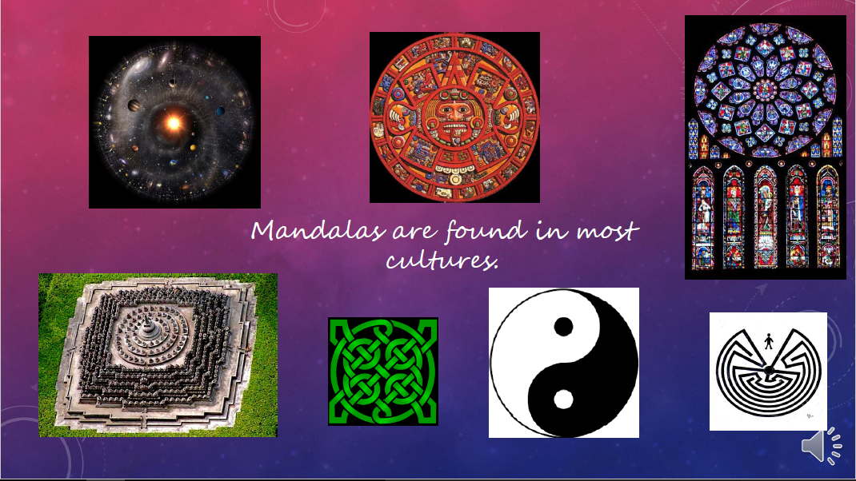

Slide 6
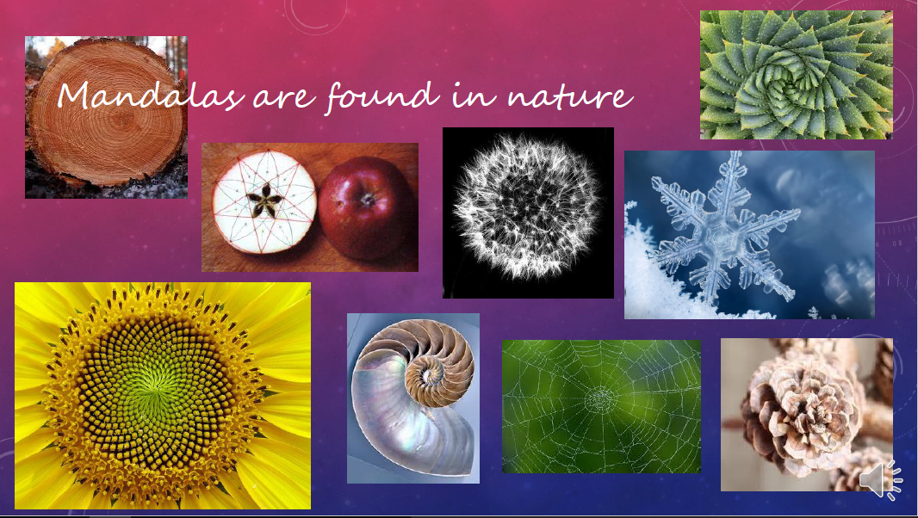

Slide 7


Slide 8
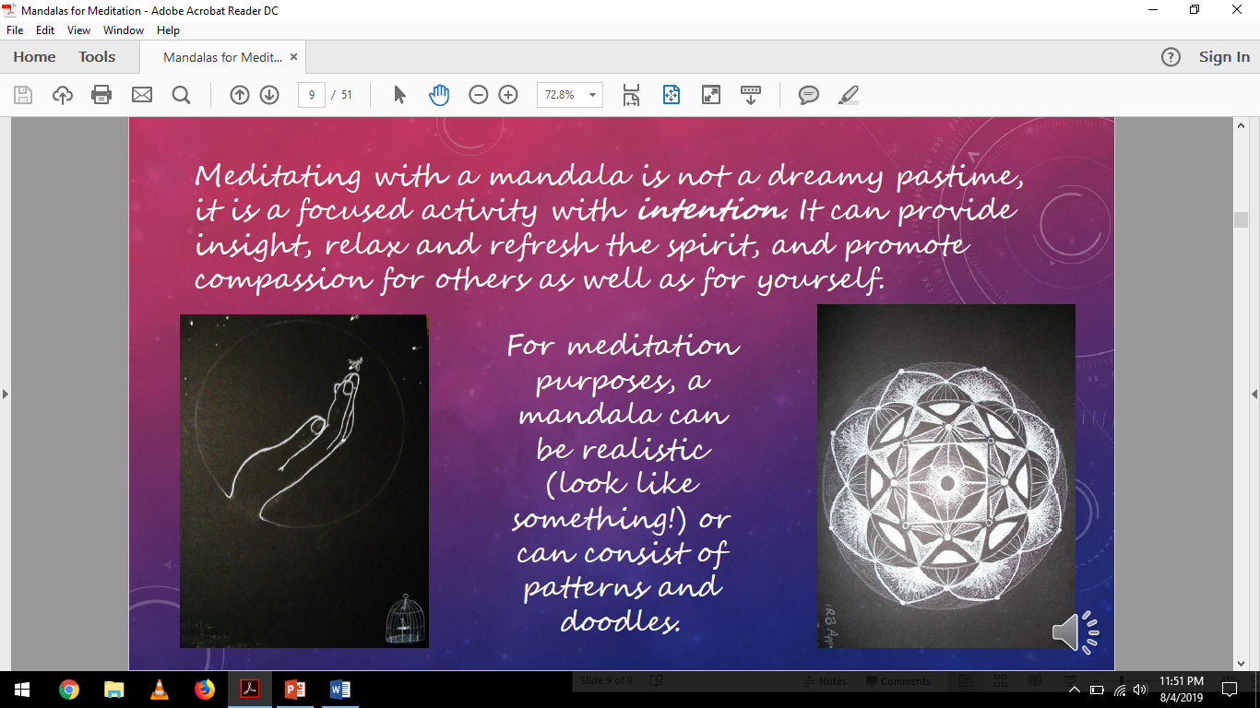

Slide 9
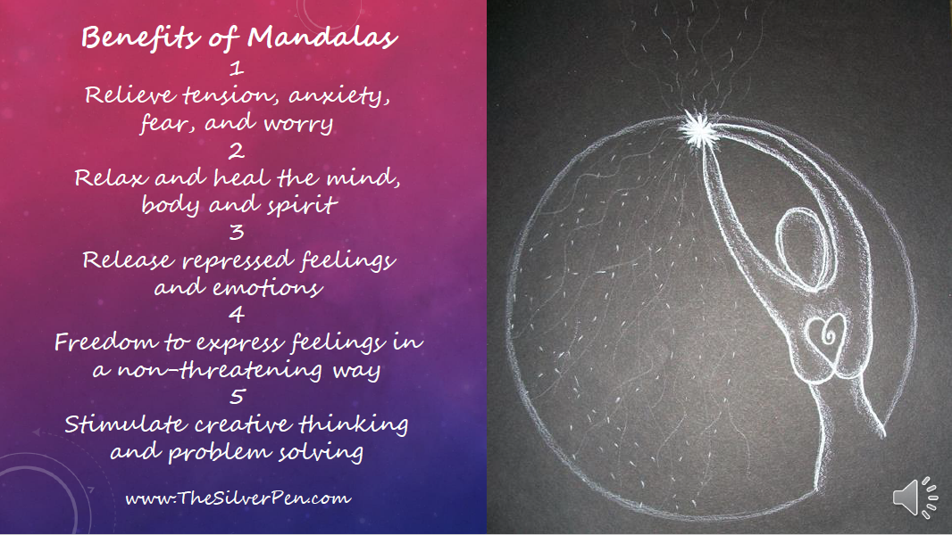

Slide 10


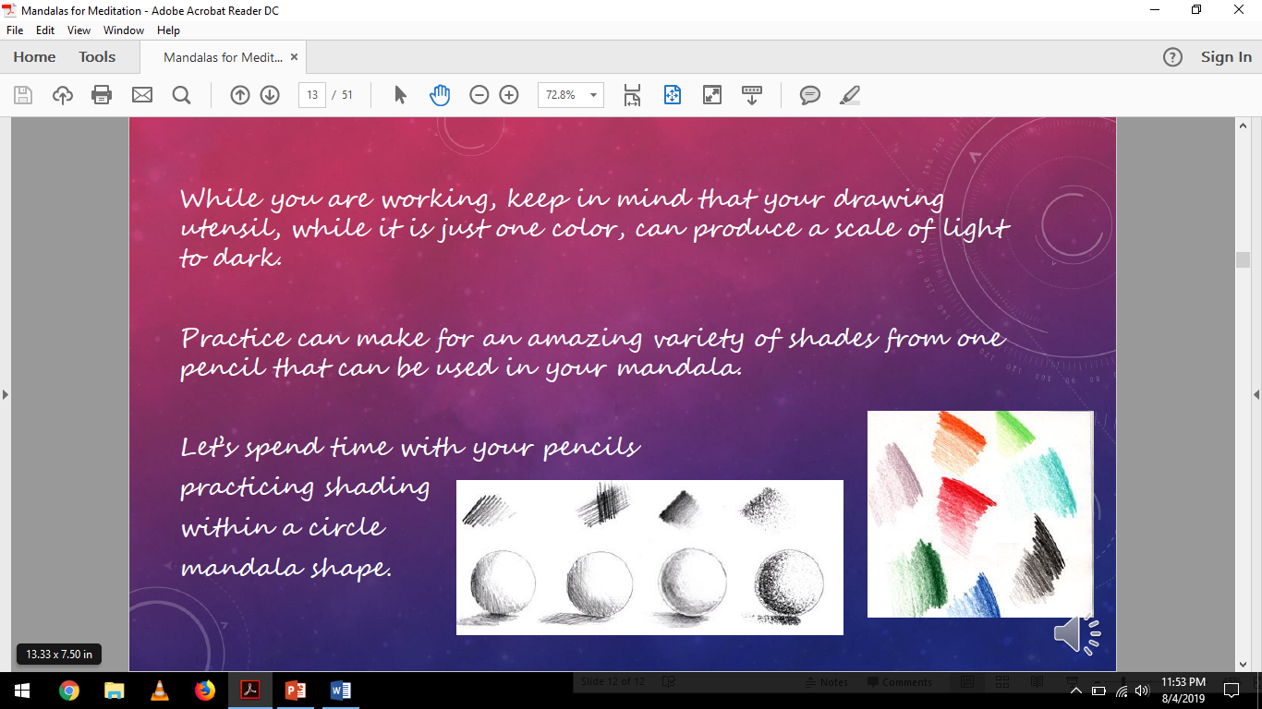

Slide 11
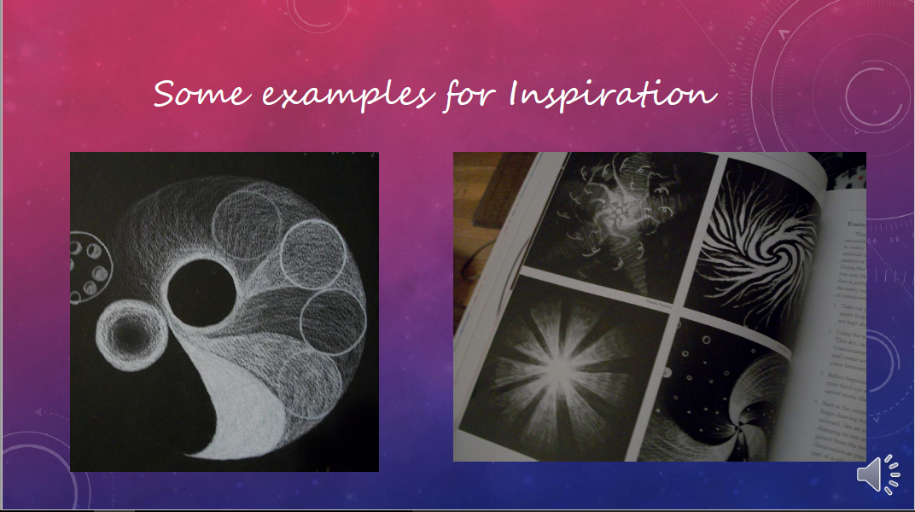

Slide 12
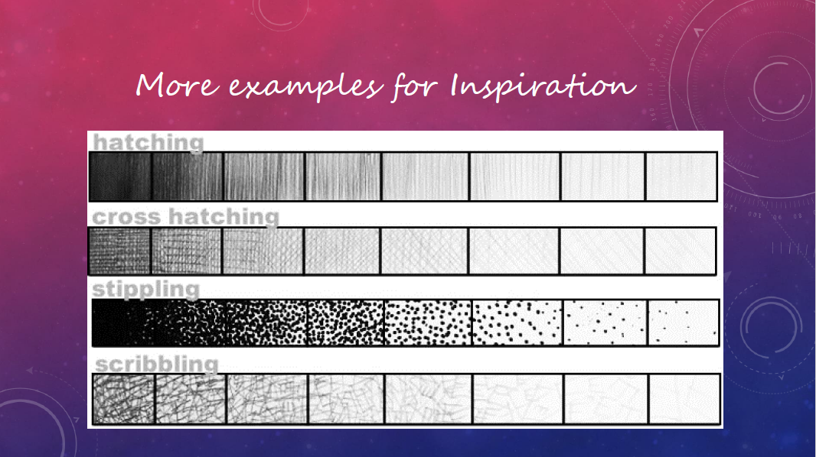

Slide 13
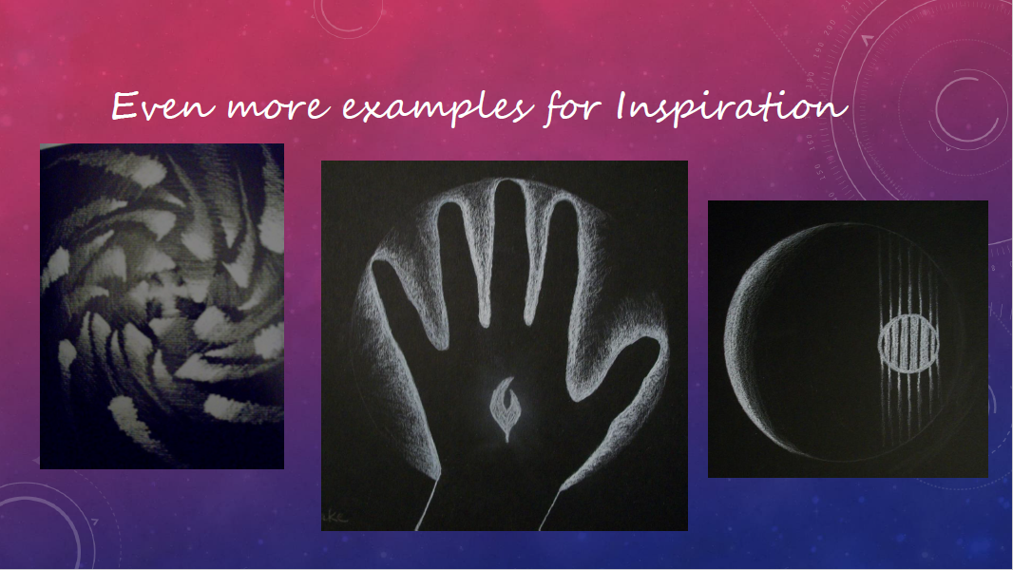

Slide 14
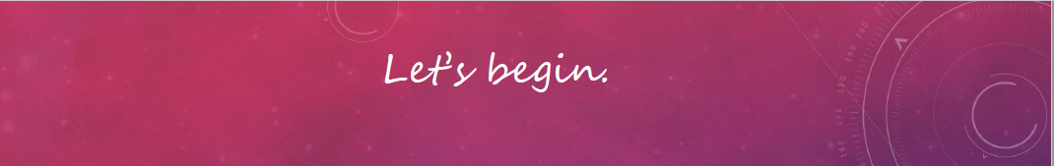

Slide 15
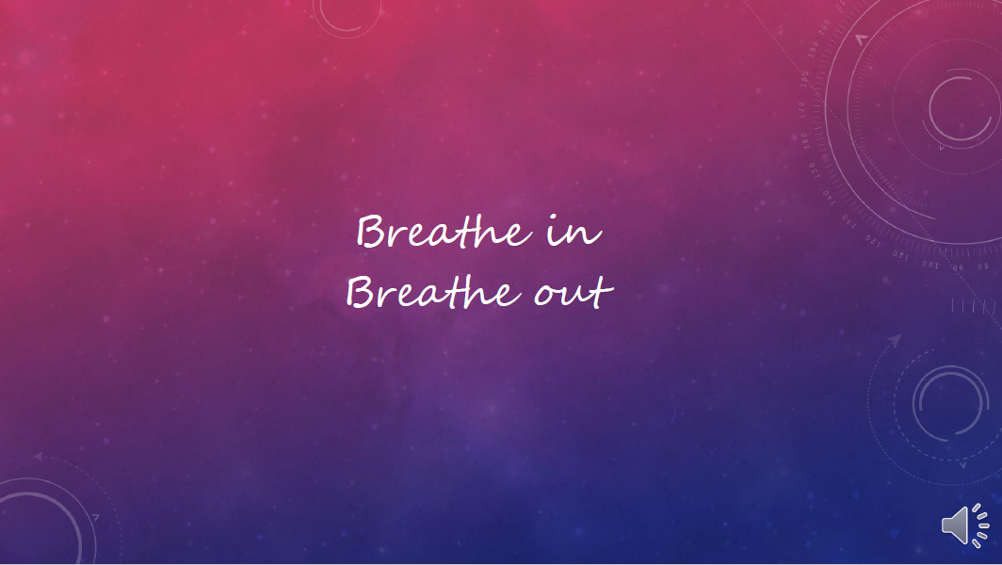

Slide 16
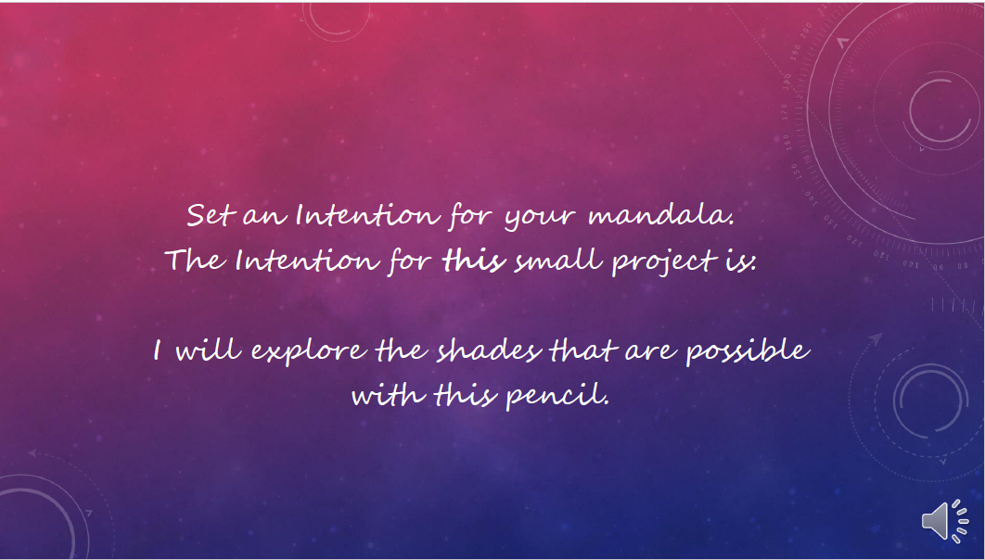

Slide 17


Slide 18
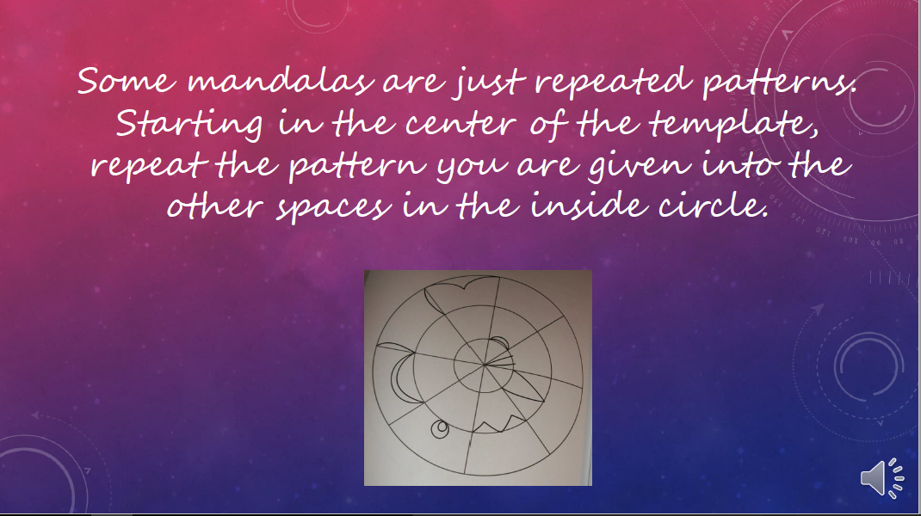

Slide 19
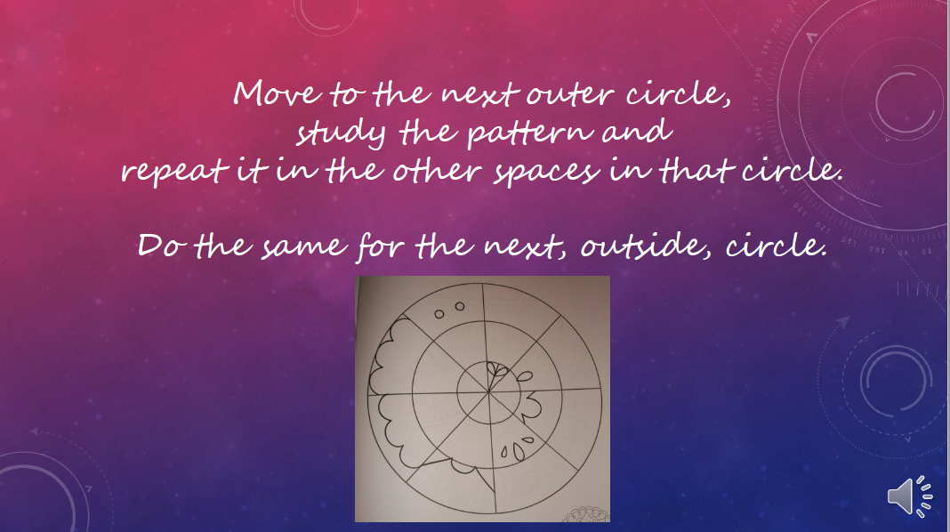

Slide 20
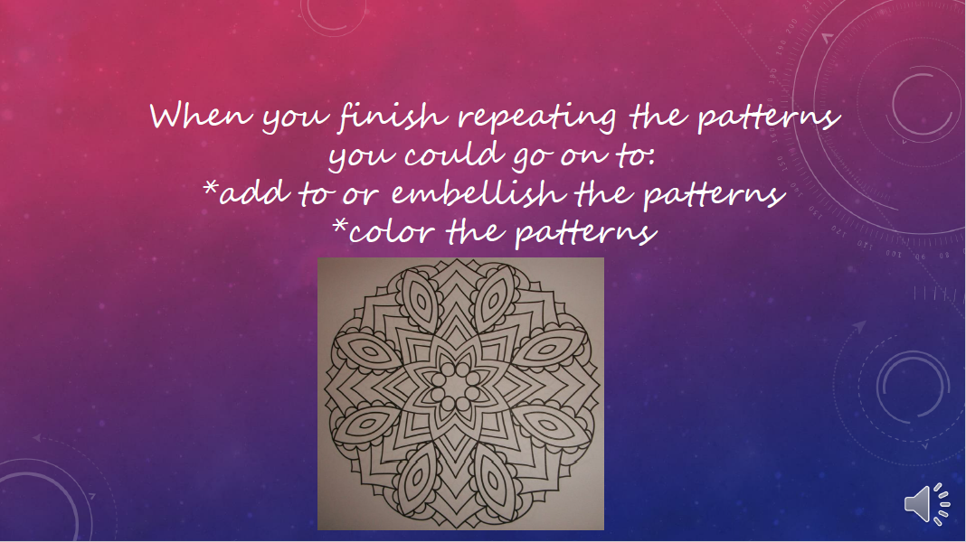

Slide 21
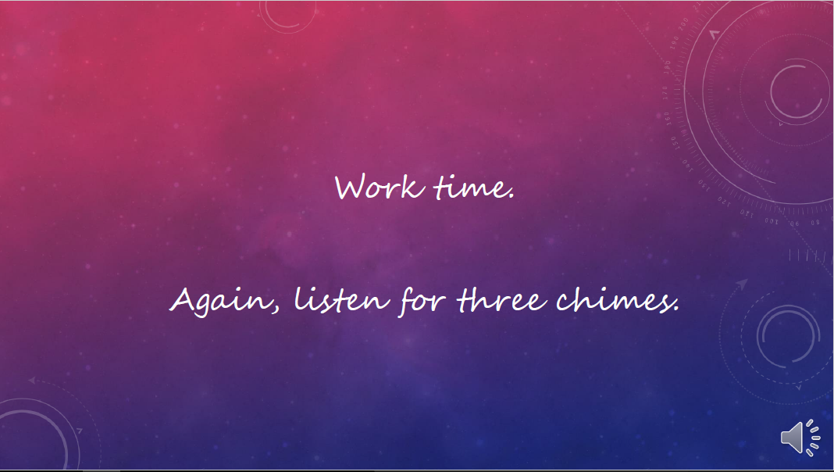

Slide 22


Slide 23
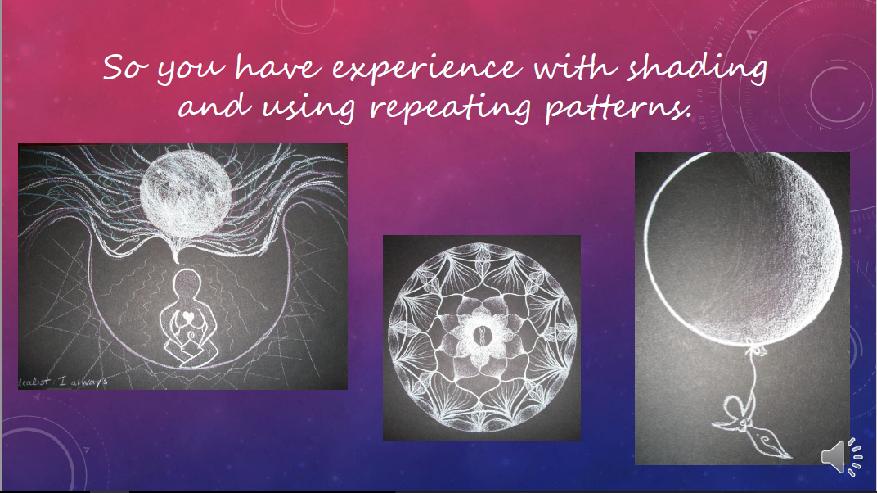

Slide 24
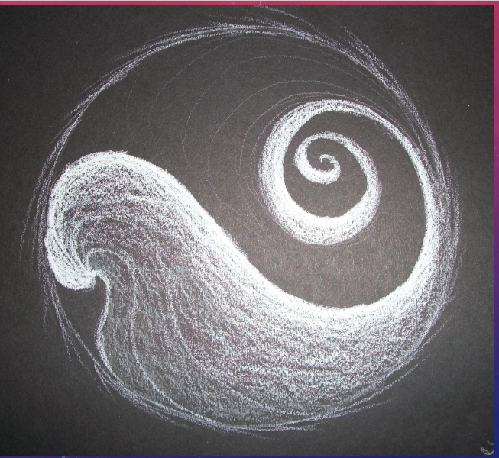

Slide 25
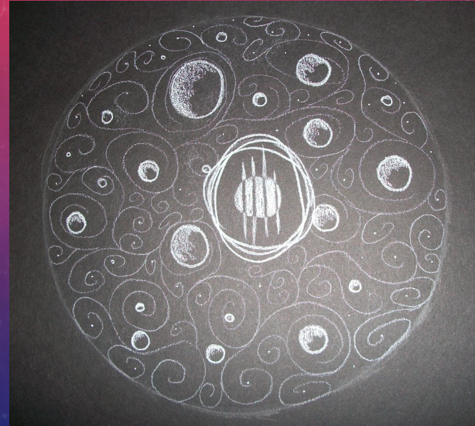

Slide 26
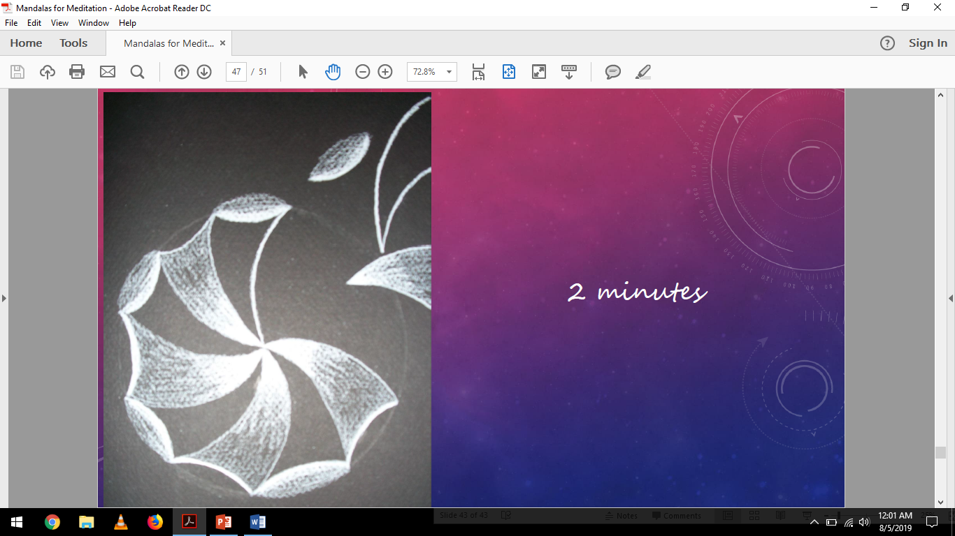

Slide 27
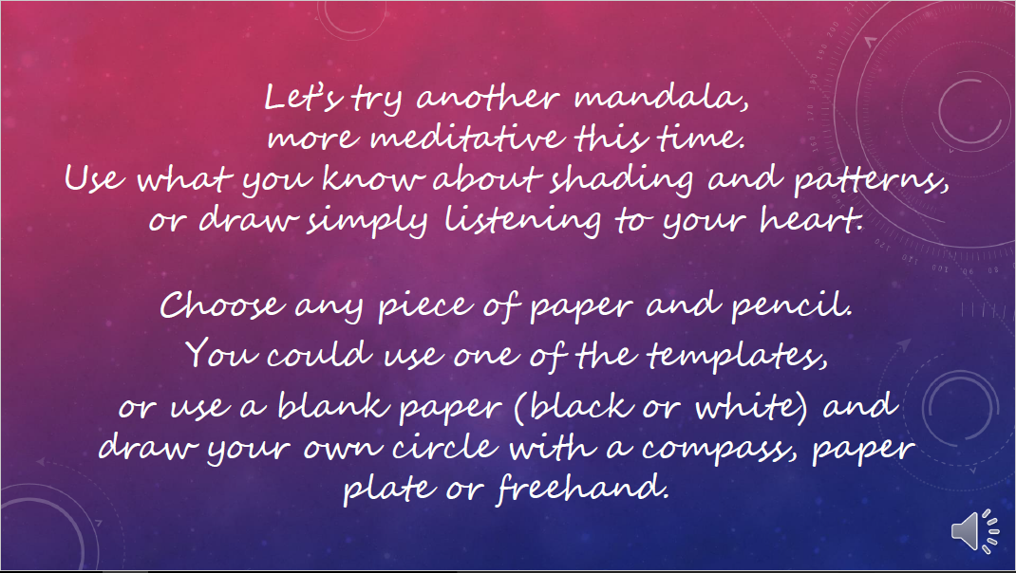
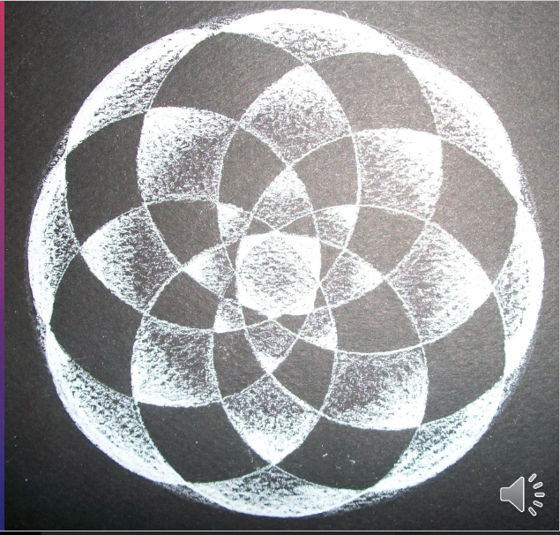

Slide 28
Some ideas for meditative mandalas
(just a couple!)
Acceptance
Authenticity
Awakening
Balance
Beauty
Beginnigs
Naivete
Play
Clarity
Compassion
Devotion
Faith
Fearlessness
Freedom
Grace
Gratitude
Harmony
Illumination
Integrity
Joy
Kindness
Celebration
Listening
Mindfulness
Miracles
Openness
Love
Patience
Peace
Perseverance
Truth
Soul
Surrender
Transformation
Intuition
Unity
Wisdom
Wonder
Forgiveness
Risk-taking
Intuition
Insight
Inspiration
Creativity
Intention

Slide 29


Slide 30
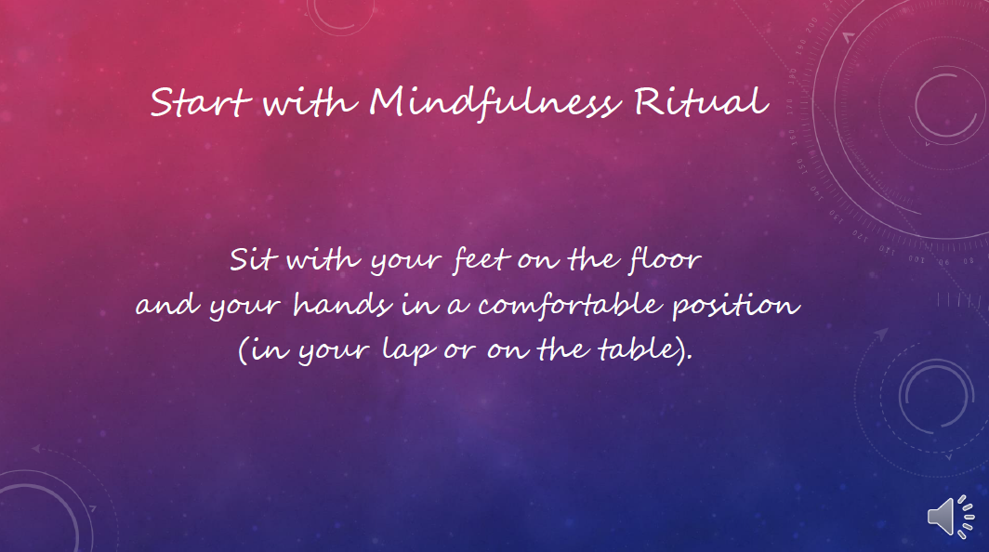

Slide 31


Slide 32
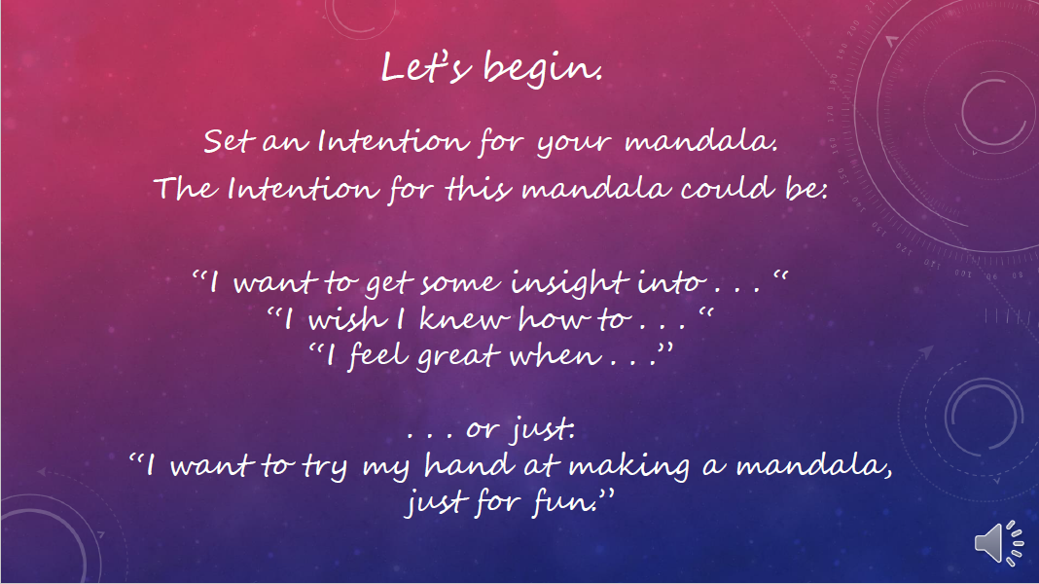

Slide 33


Slide 34
Some ideas for meditative mandalas
(just a couple!)
Acceptance
Authenticity
Awakening
Balance
Beauty
Beginnigs
Naivete
Play
Clarity
Compassion
Devotion
Faith
Fearlessness
Freedom
Grace
Gratitude
Harmony
Illumination
Integrity
Joy
Kindness
Celebration
Listening
Mindfulness
Miracles
Openness
Love
Patience
Peace
Perseverance
Truth
Soul
Surrender
Transformation
Intuition
Unity
Wisdom
Wonder
Forgiveness
Risk-taking
Intuition
Insight
Inspiration
Creativity
Intention

Slide 36
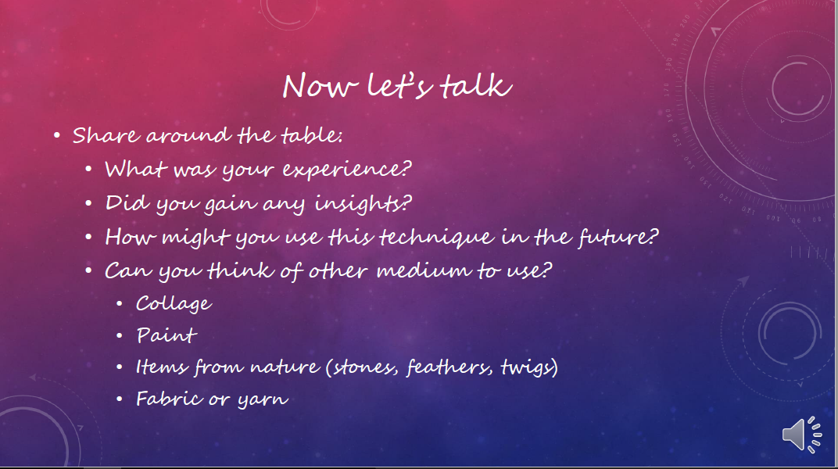

Slide 37
Questions?
Jennifer Groman
jgroman@ashland.edu

Slide 38


