Slide 1
Extraordinaires Design Kits
“The Creativity Hub publishes games and playthings that foster imagination, empathy and self-esteem.
The co-founders envision a world where these attributes are valued and fostered in every individual.
Their website. https://www.extraordinaires.com/story
You are going to play a version of this game!

Slide 2
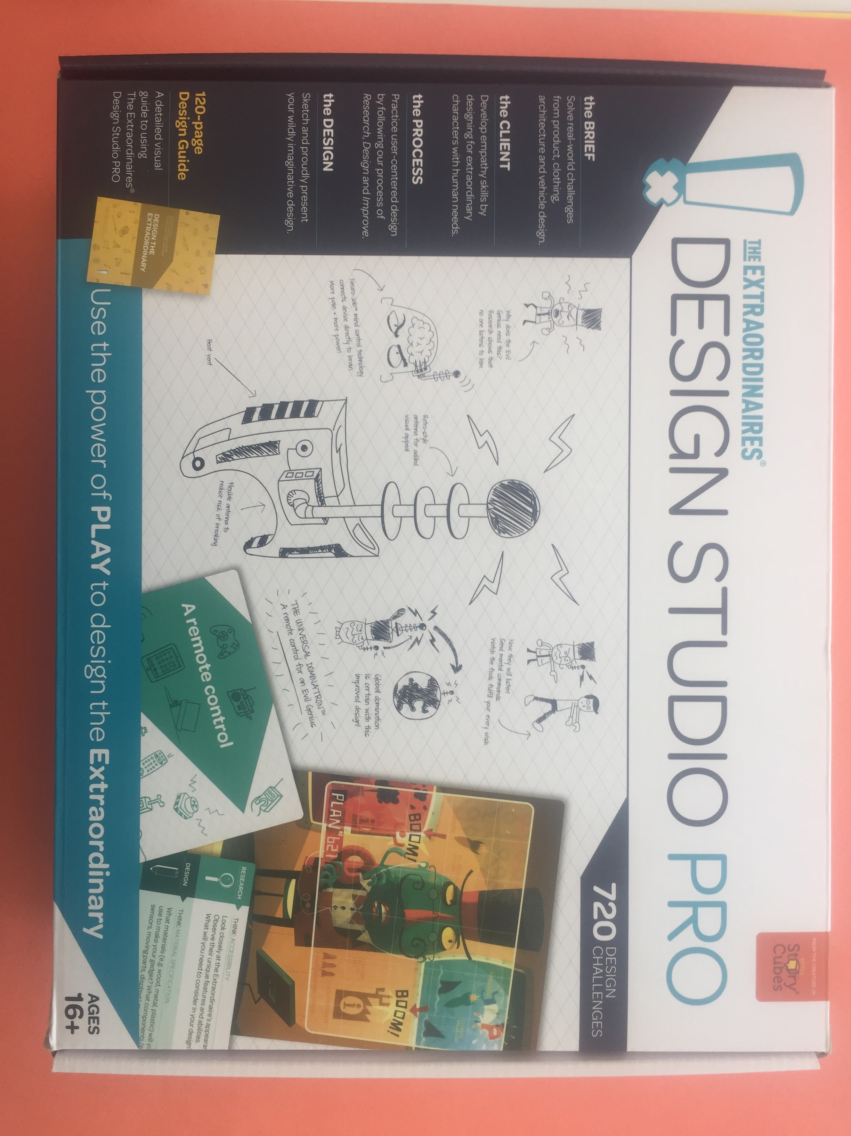
You are going to use cards from this kit

Slide 3
Extraordinaires Design Studio Pro
There are kits for ages 8 on up
We are going to use a kit is that is for 15 year olds and older
Players Mix and Match Cards to create Challenges.
They pick one of each:
Character Cards
Design Project Cards (5 categories)
Inventions, Vehicles, Clothing, Gadgets, Buildings
Think Cards-3 categories of questions

Slide 4
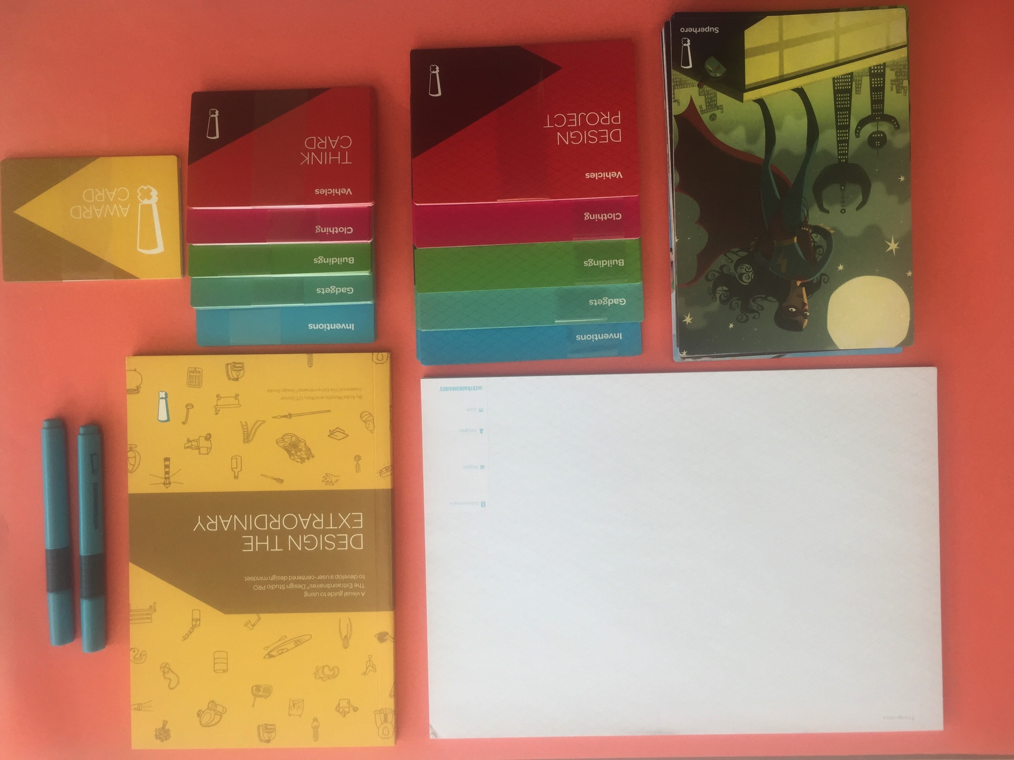
Contents of the kit: instruction manual, notepad, character cards, Design project cards (the large ones), think cards and yellow award cards

Slide 5
Teaching something about the design process is one purpose of this kit. The other is learning about Visual Literacy
How do we read visual images?
Analyzing visual images
Observing is a skill that can be taught.
Slow down, look, and concentrate
Observations are visual facts of what is seen. We must do this first before interpreting meaning.

Slide 6
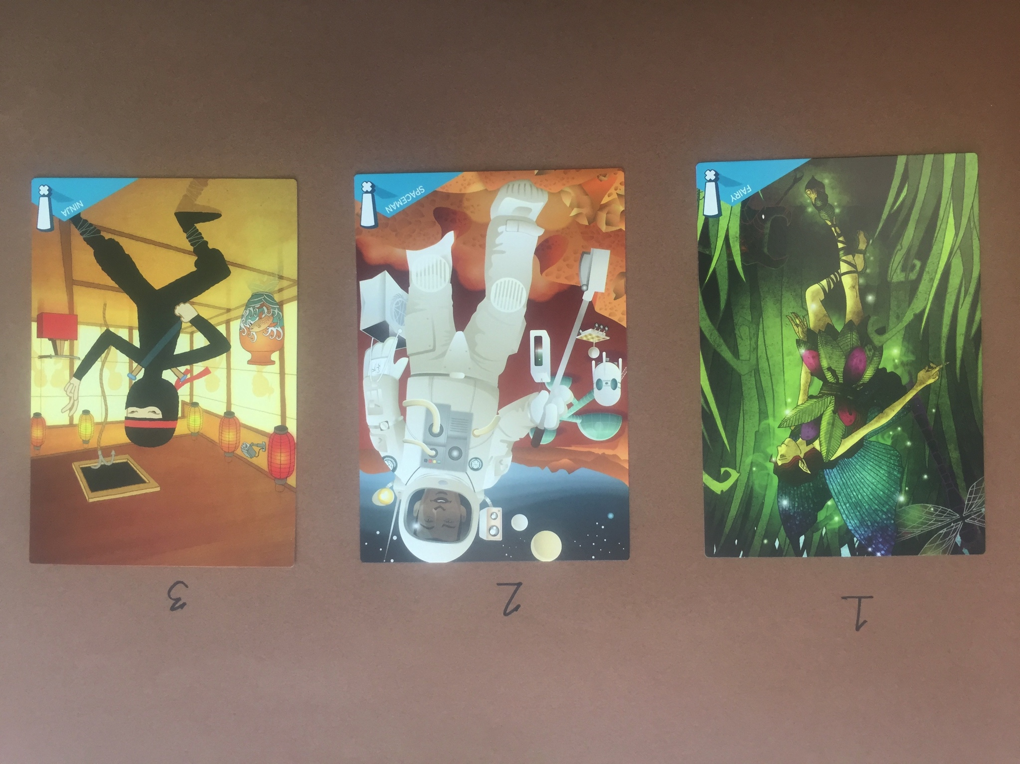
Here are three Characters

Slide 7
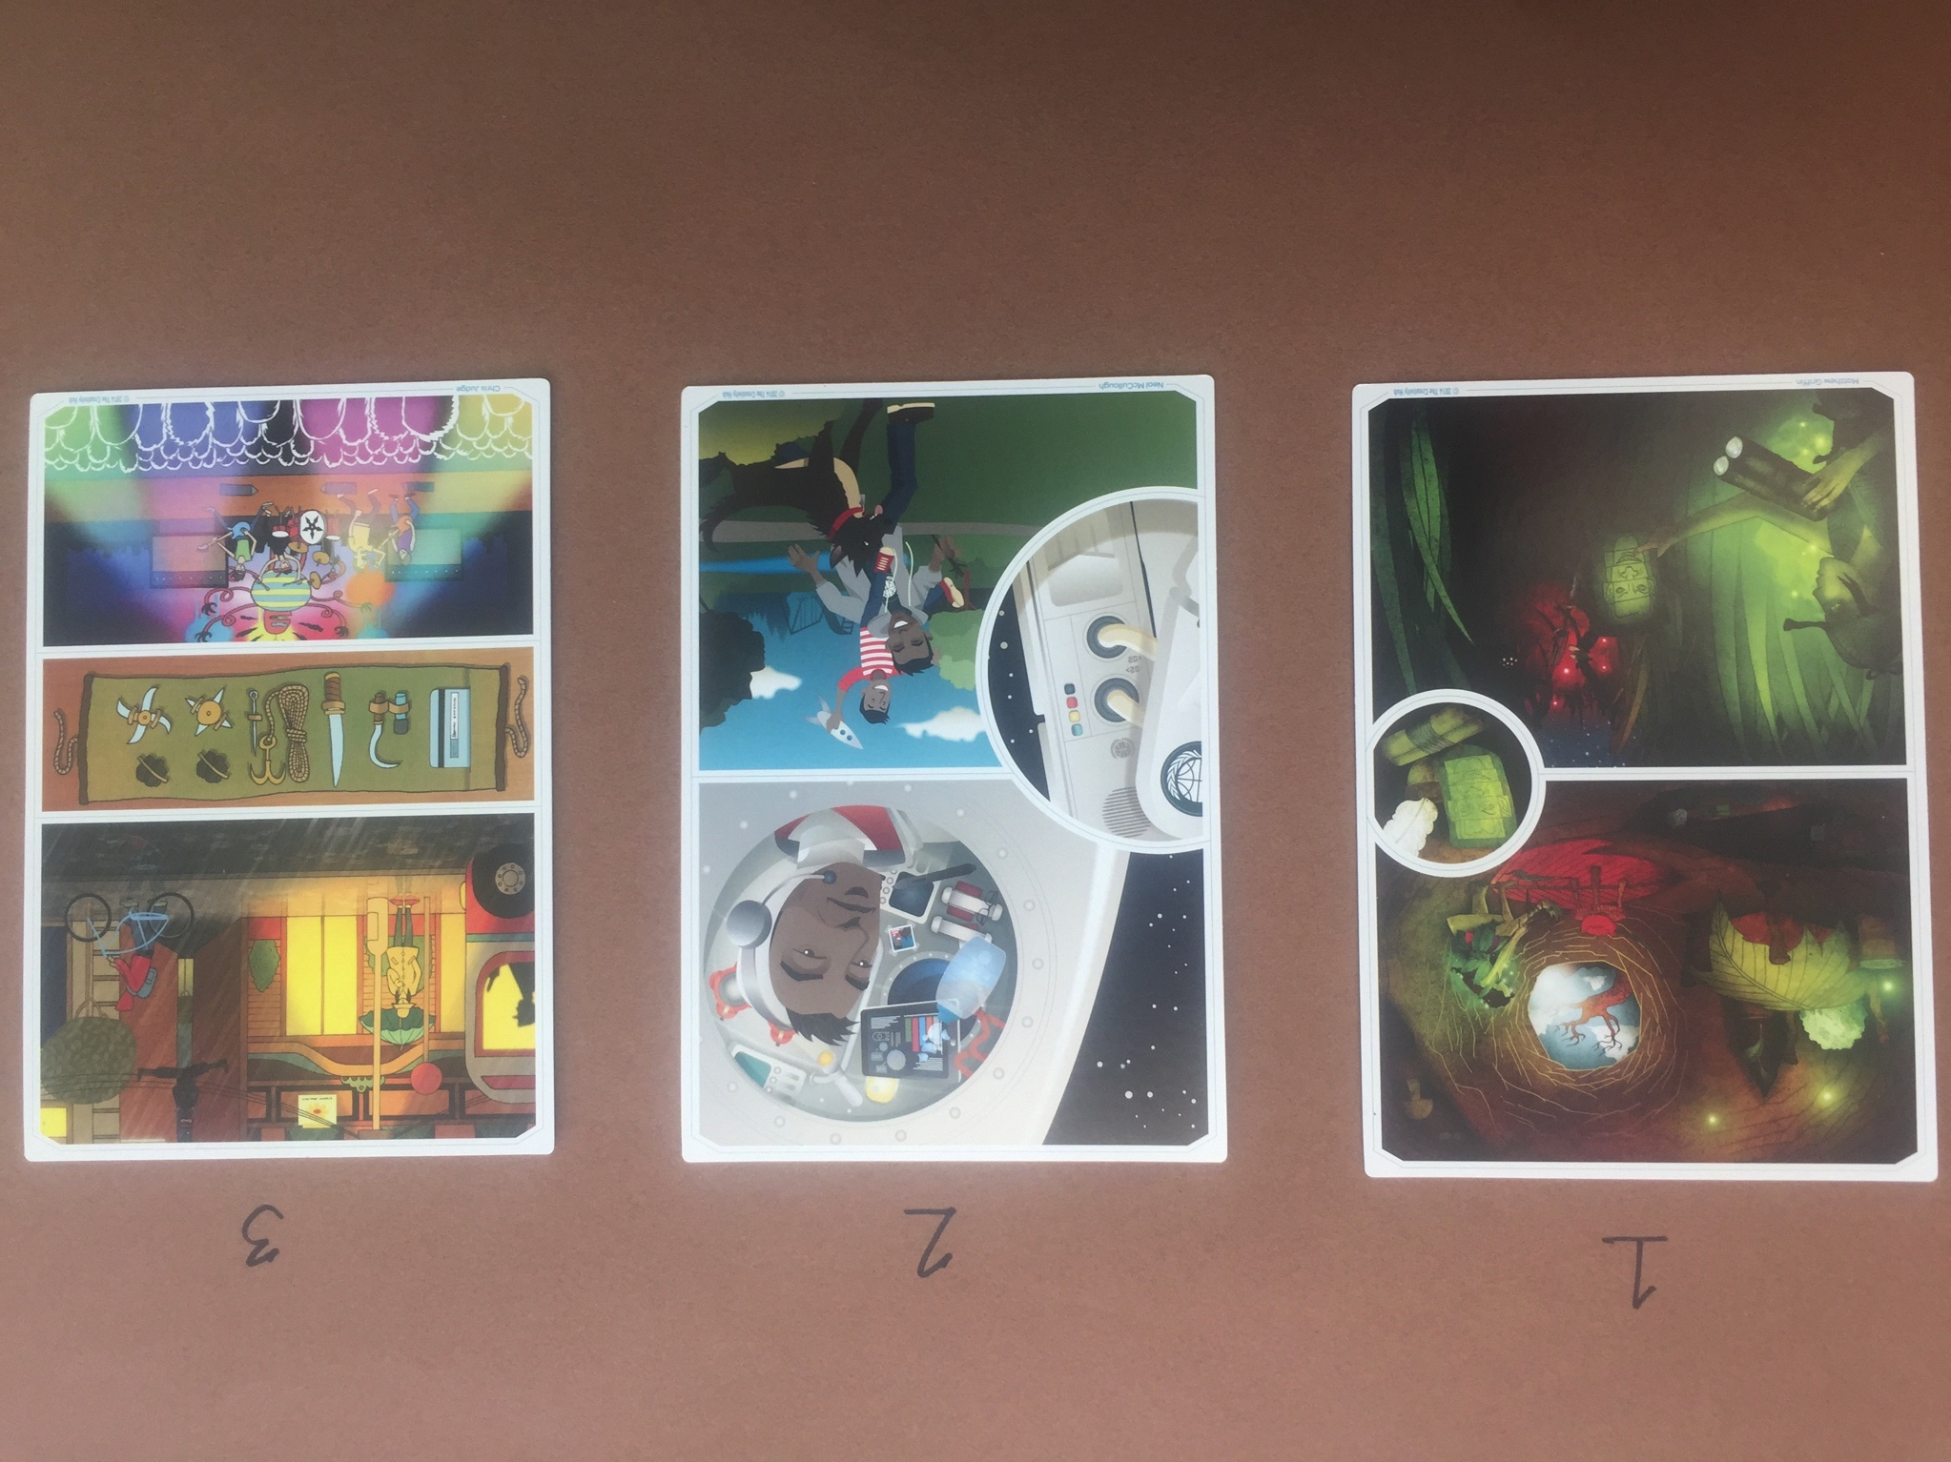
On the flipside of the character cards, it shows these backgrounds

Slide 8
Observations of your client
Look at your character card and answer these questions:
What do you notice about the front of the card? What do you see?
  Character(s)?
  Colors?
  Objects?
  Action?
Looking at the back of the card. Look for clues to write the answer:
What is going on in the pictures?
What do you think is happening and/or predict will happen?
What do you wonder?

Slide 9
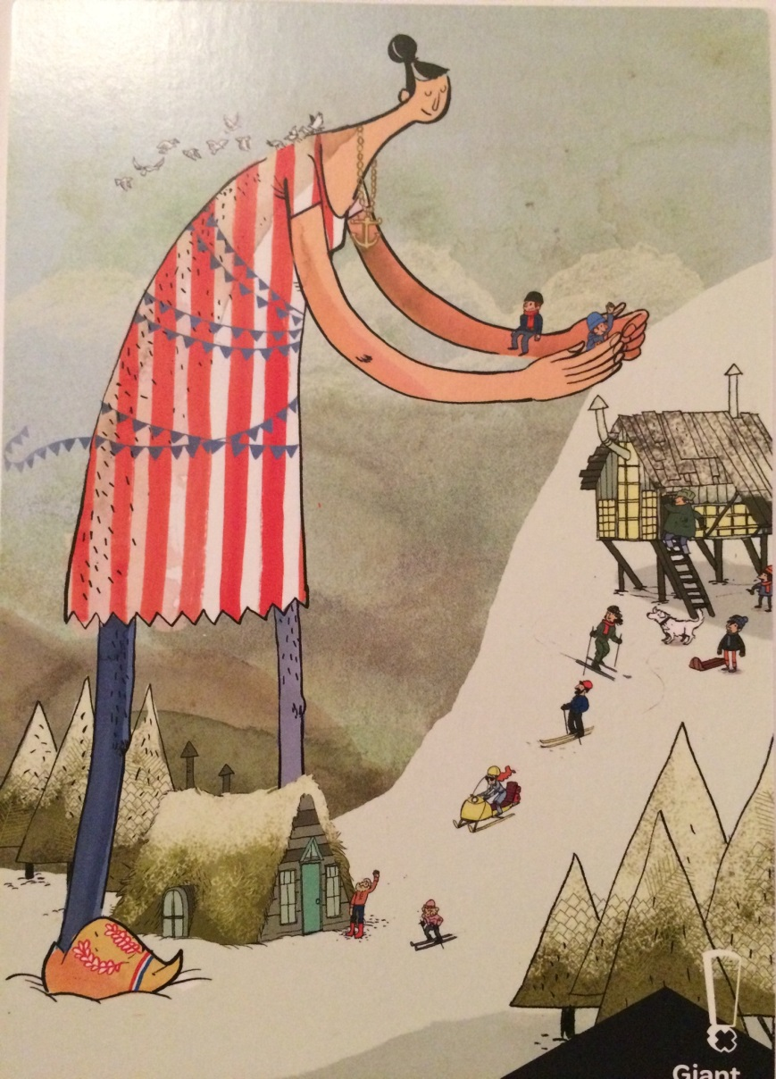
Visual Literacy
What do you notice about this card?
  Character(s)?
  Colors?
  Objects?
  Action?

Slide 10
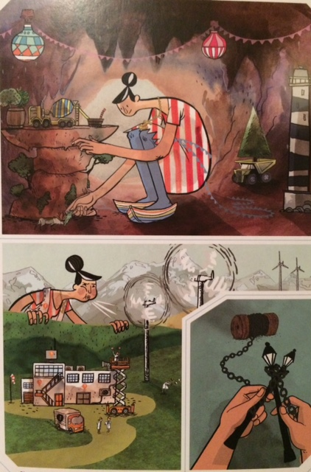
Flip Your Card to the back
What is going on in the pictures?
What do you think is happening and/or predict will happen?
What do you wonder?

Slide 11
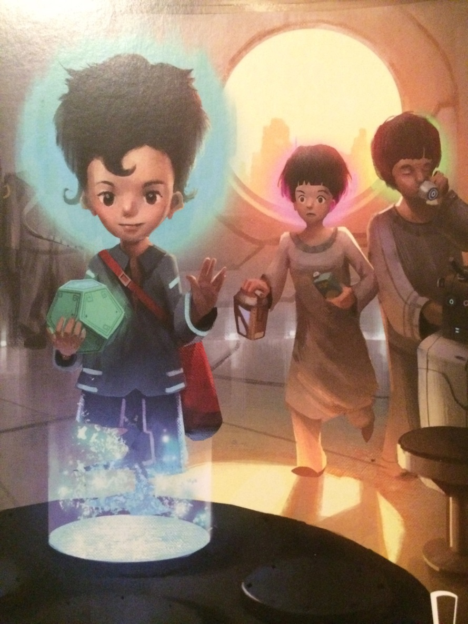
Now it’s your turn.
Make Observations
Write everything you see.

Slide 12
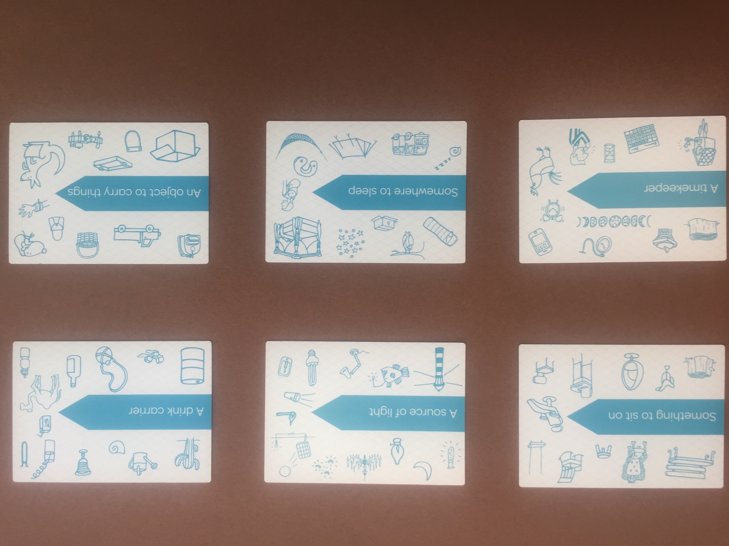
Design Project cards
(There are different categories. These are from “invention”)

Slide 13
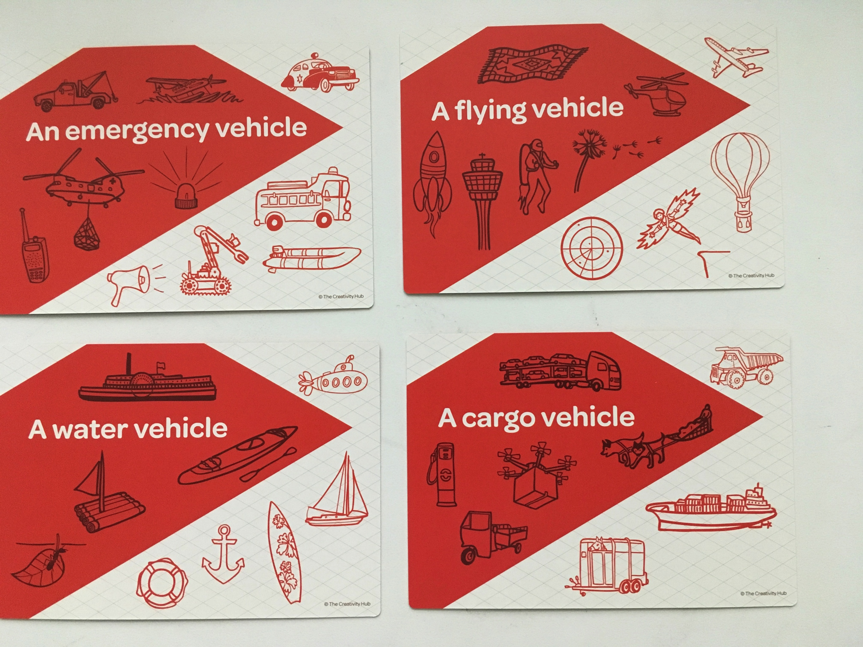
Look at your design project card

Slide 14

Practice writing a Challenge based on your character and project card.
Start with your Character Card (who)and the Design Project Card (what).
Use the Design Challenge Questions
Who, What, Where, When, Why, How

Slide 15
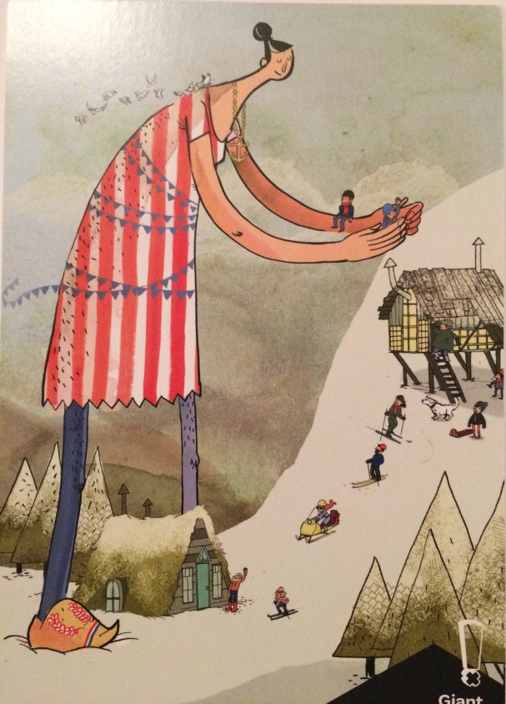
How might we create a single person vehicle (what) for a giant (who) that can carry over 1,000 lbs. (why) over snowy mountain roads (where)?

Slide 16
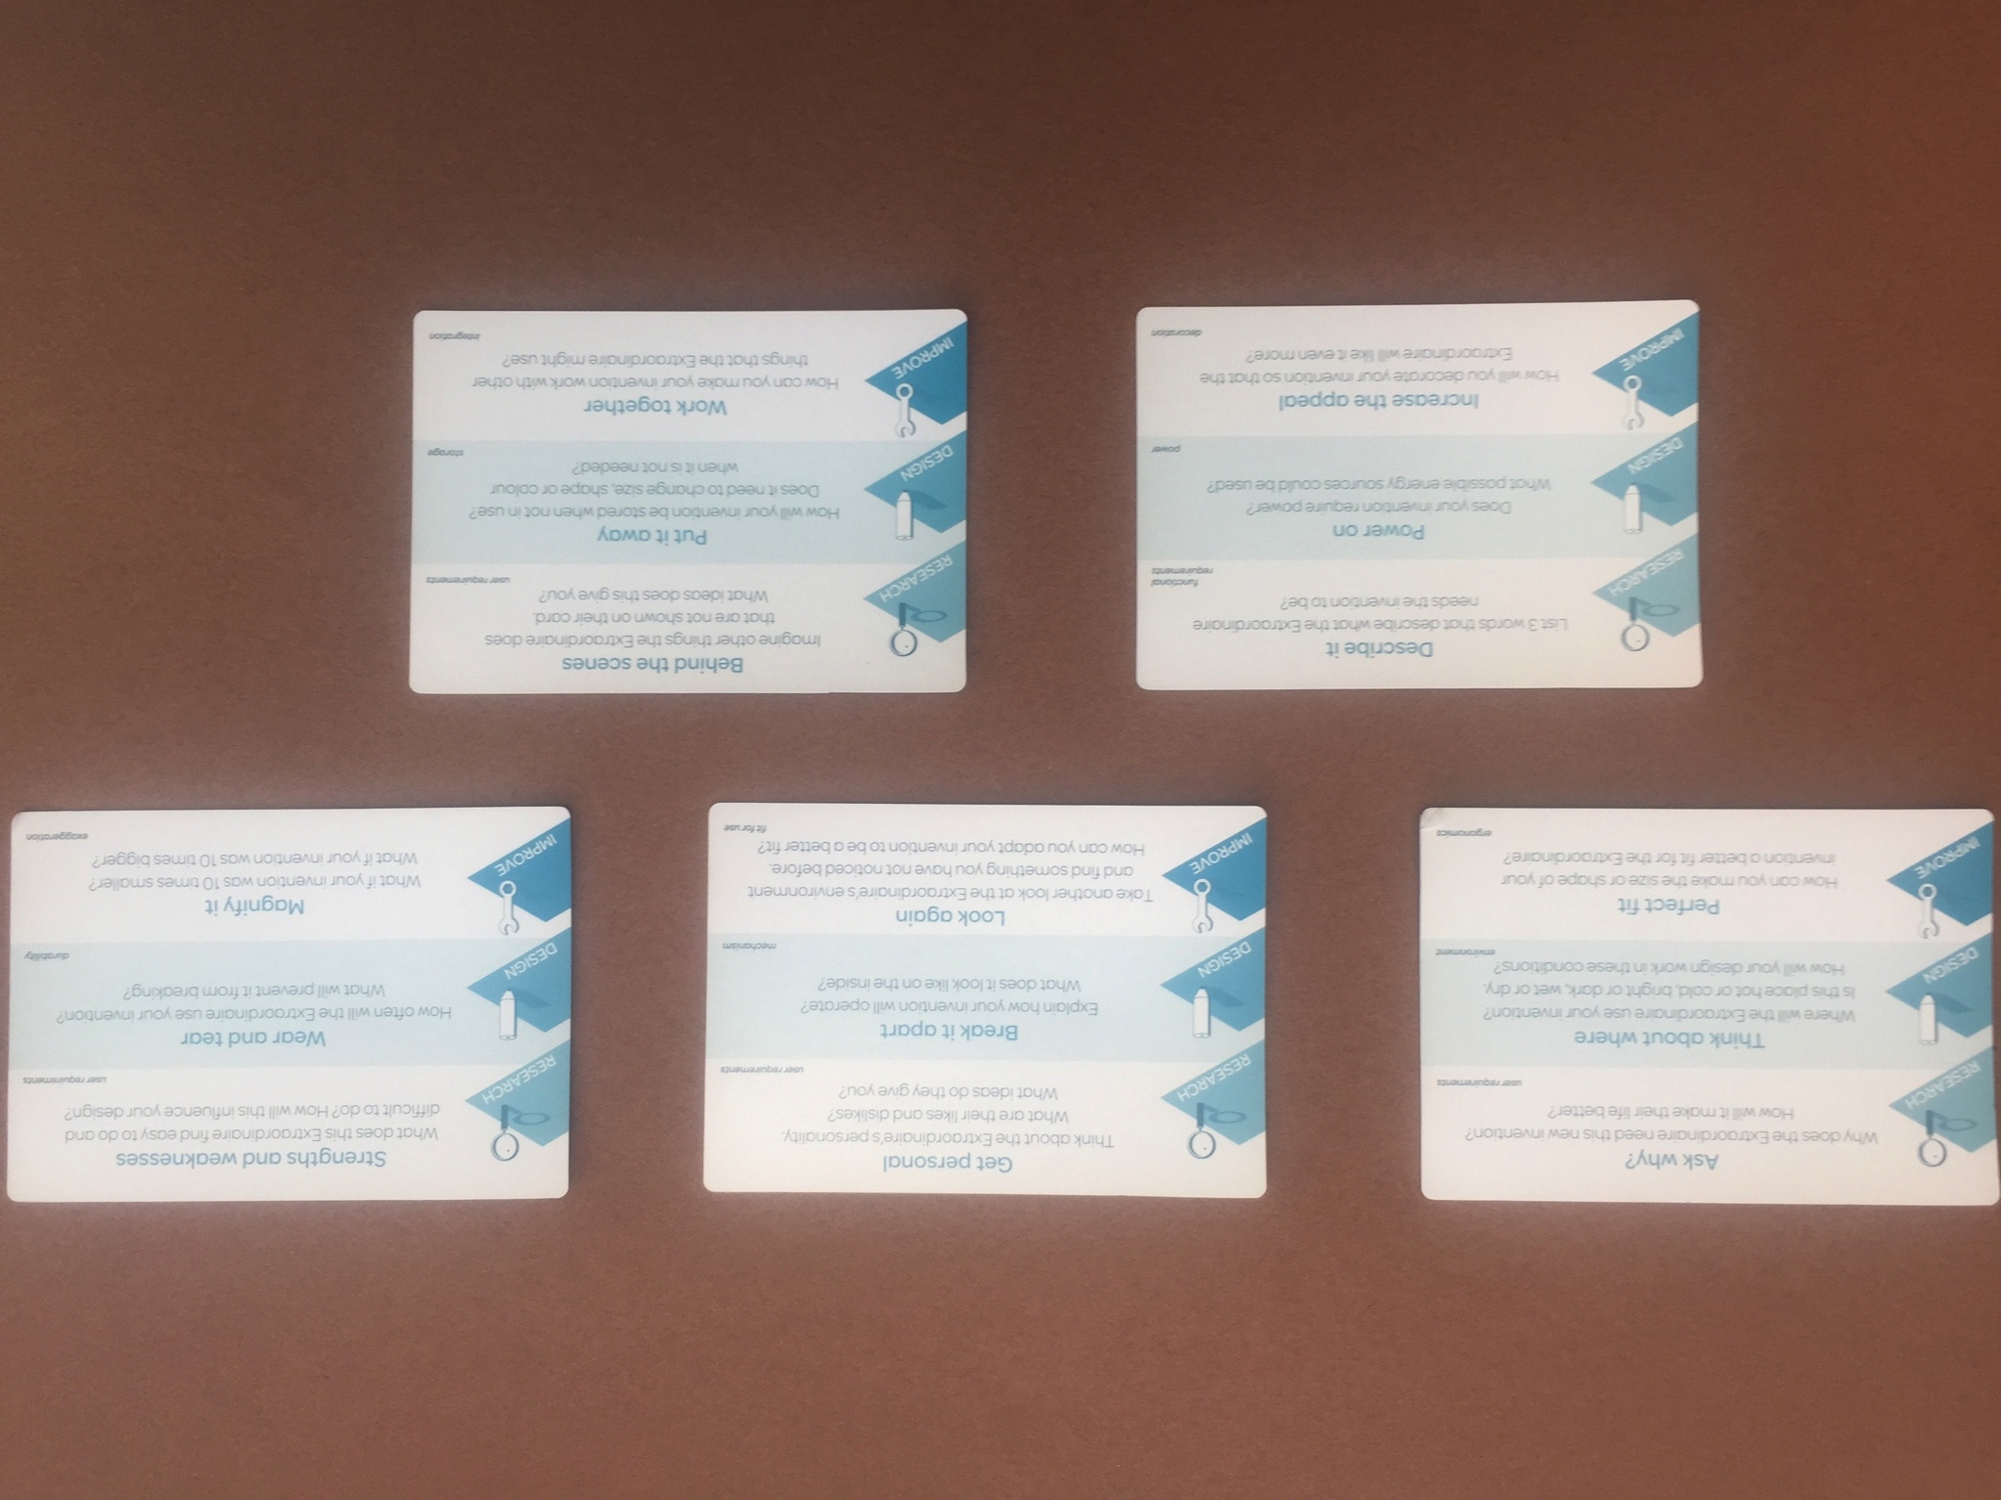
Think Cards
(There are different categories. These are from “invention”)

Slide 17
How might we create a single person vehicle for a giant?
The next step would be to pick a Think Card and answer the design challenge questions on the card to expand on this.

Slide 18
Design Thinking Steps
Research.
Research anything pertinent to the design challenge. What already exists? What are safety features? Etc
Brainstorm ideas
    Do a mindmap or some other way that you brainstorm numerous possible ideas.
Prototype (a quick 2-D drawing or 3-D Model)
    Select one or a combination of concepts from your brainstorming tool to make into a prototype

Slide 19

Research
Look up anything that will help you think about ideas that are not the easiest to come up with.
Look on the Internet, look in books or magazines, talk to people, observe, play, etc

Slide 20
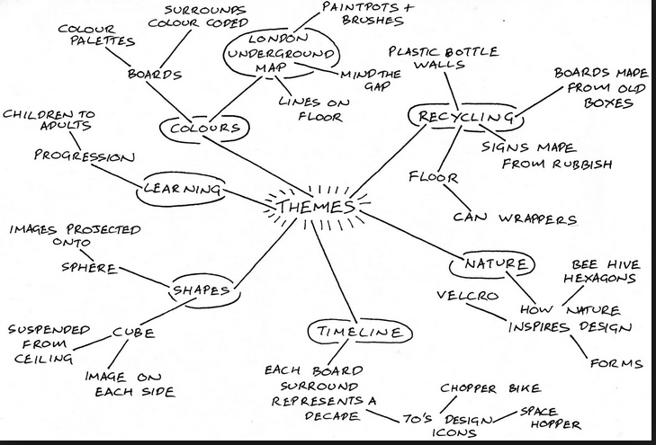
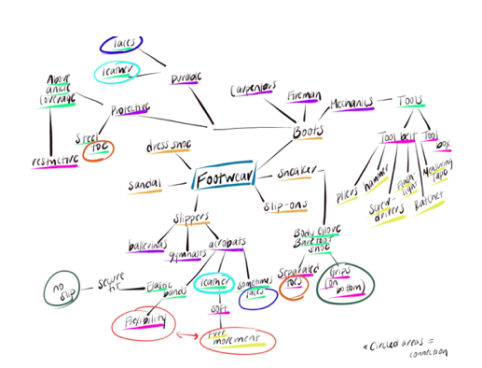
Brainstorming
Do a mindmap to brainstorm numerous possible ideas. Put down anything that comes to your mind. Do this very quickly

Slide 21
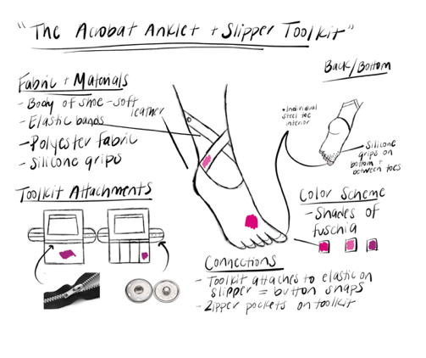
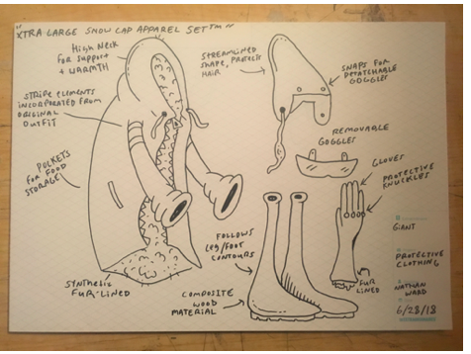
Prototyping
  This is a 2D or 3D model
  Select one or a combination of concepts from your brainstorming tool to make a prototype.

Slide 22
Presentation
You will be creating a presentation of the design that you developed. Here are the requirements for your presentation:
Include this Information in your presentation.
The character you used.
The design challenge – The problem you needed to solve.
The research you did and how it informed your design.
Answers to the questions on the Think card
A picture of the brainstorming sheet.
The prototype with an explanation
Explain why this was the best solution for the design challenge. What is innovative?

Slide 23
Audience Feedback
Give feedback on what was good about the design
Give feedback on what the designer could think about for improvement.

Slide 24
Reflection and Revision
Think about the reviewers’ remarks on your design.
DeDecide on one think you think was the best about your design….. and one thing you would improve

